Slide 1
Rebuilding Greenwich’s
Community Directory
Show & Tell #13
06/12/2022
Please note this Show & Tell will be recorded
Notes:
Alex [press record]
Hi everyone, and welcome to today’s show and tell for the Greenwich Community Directory project on the 6 December
Please note that this show and tell is being recorded, so if you don’t want to appear on the recording, feel free to turn your camera off.

Slide 2
What is a Show & Tell?
A regular event where we...
Get feedback from everyone, to shape what we do next
(not just those involved in the day to day work)
Make connections with other work and knowledge
Show progress early and often
Notes:
Steve
I think most people here have been to one of our show and tells before, but if you haven’t, a show and tell is an event where:
We show our progress early and often. We don’t want to hide our work away, we want to make sure everyone is really clear on what we’re doing and where we’re heading.
It’s a chance for us to get feedback from everyone, to shape what we do next. We want to hear what’s important to you, and be steered by your ideas.
And it’s a place for us to make connections with other work that’s going on, both within the council and with other councils and organisations.

Slide 3
Today’s Show & Tell
We will cover:
Some recent project decisions we’ve made
What the next phase of our work will look like
Workshops we’ve run with HAS and Children’s to review what content we need on the GCD
So that you:
Will have an overview of our approach for the next phase.
Understand the next steps regarding the technology we'll use.
Find out more about the work underway building and refining the content for the GCD.
Notes:
Steve
In today’s show and tell, we’re going to cover:
Some of the recent project decisions we've made
What the next phase of our work will look like
And also an update on workshops we've run with HAS and Children's to review what content we need on the GCD
There will be an opportunity to feedback and also please do use the chat function

Slide 4
Our team + mission
Notes:
Steve
Before we get into the detail, I just want to refresh on who we are and what we’re trying to achieve.

Slide 5
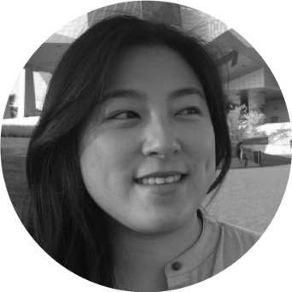
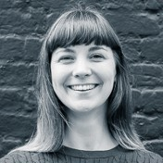
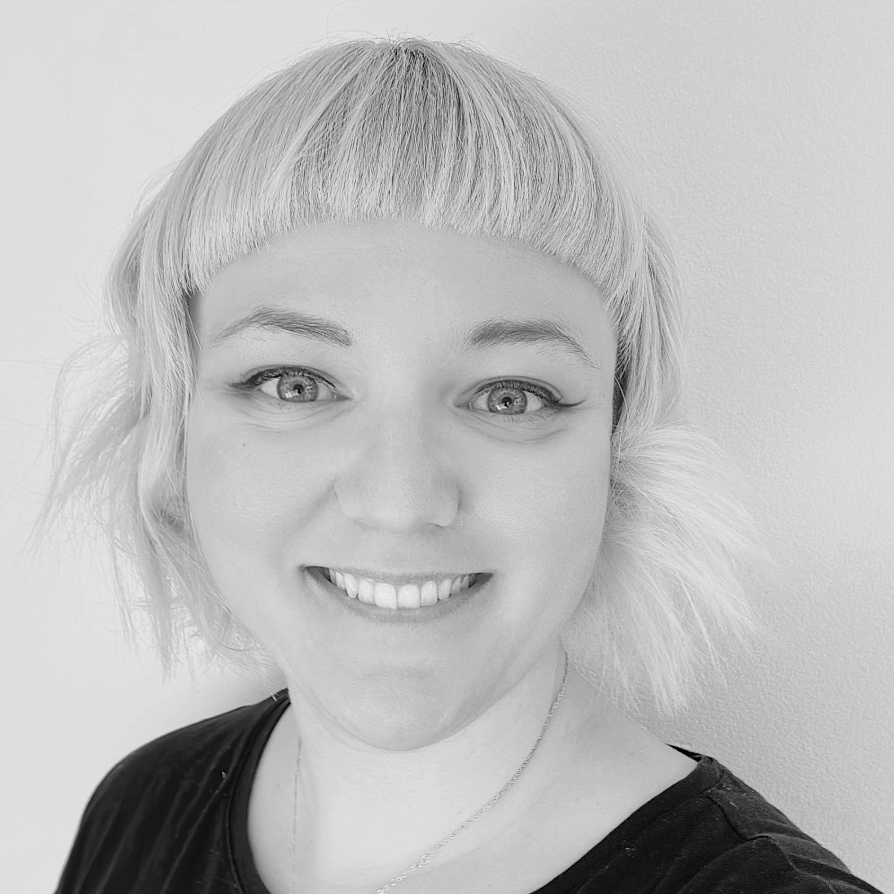
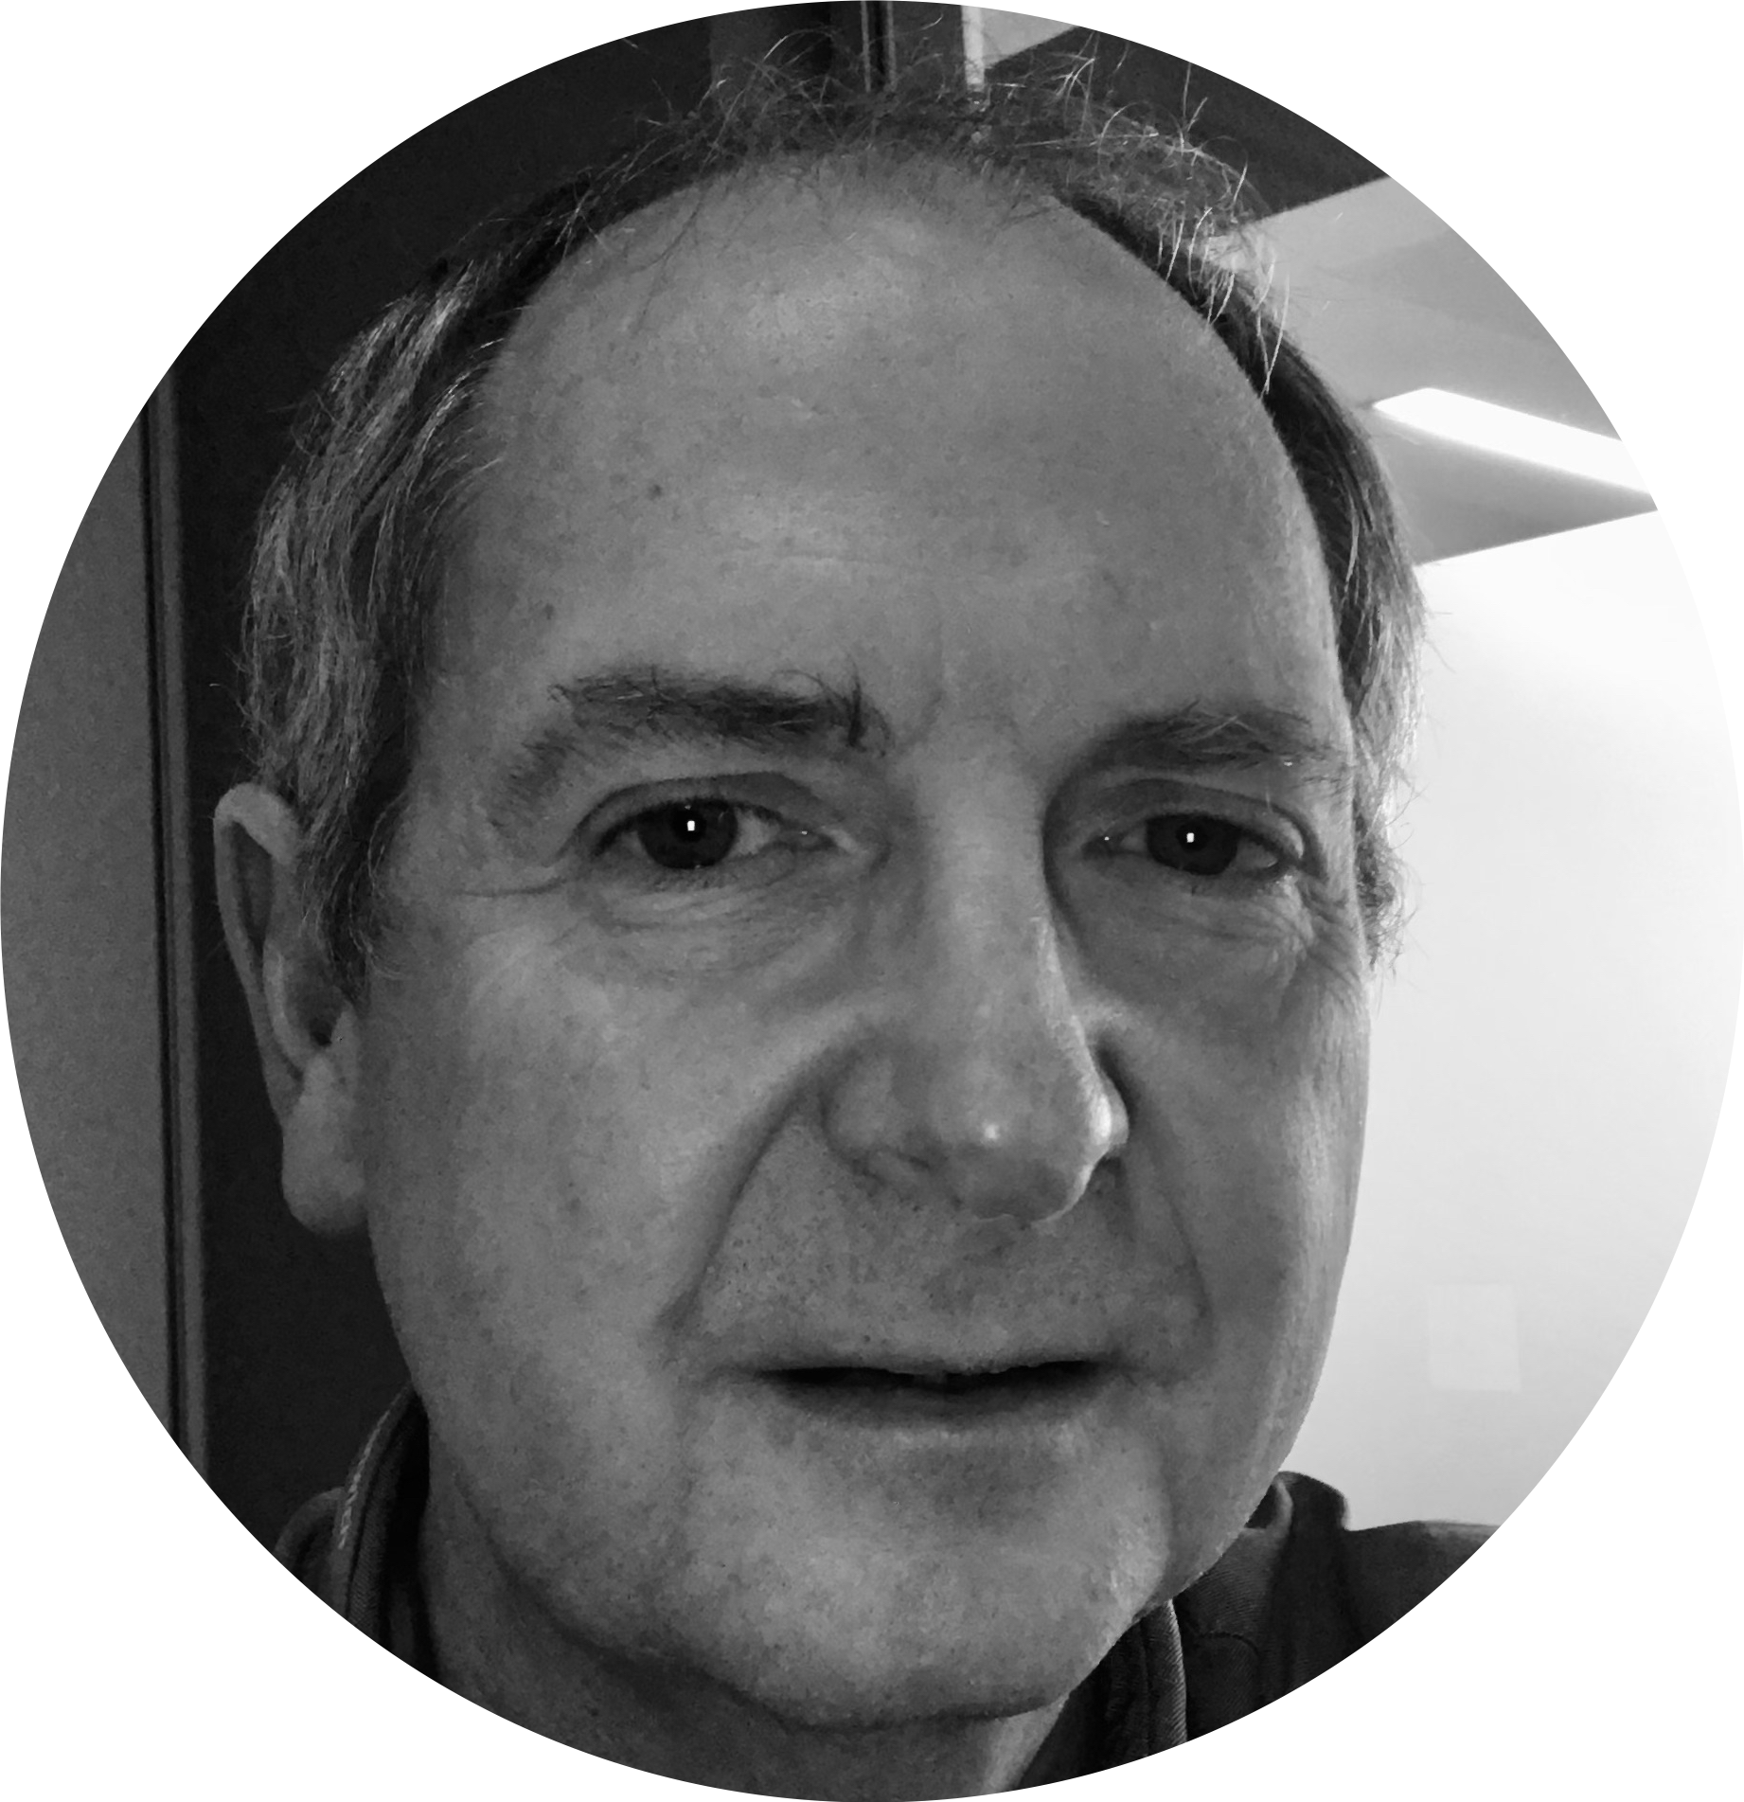
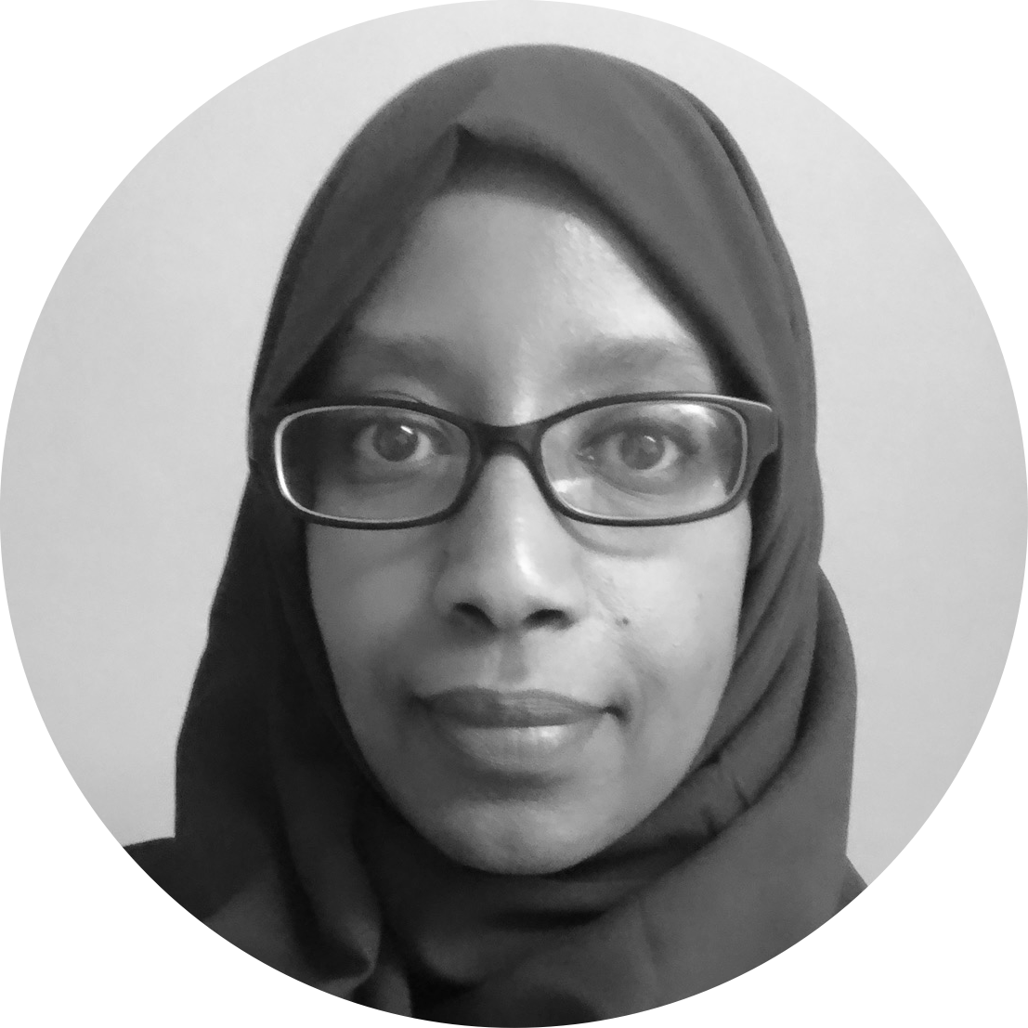
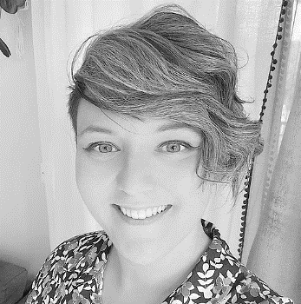
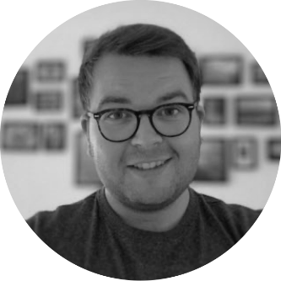
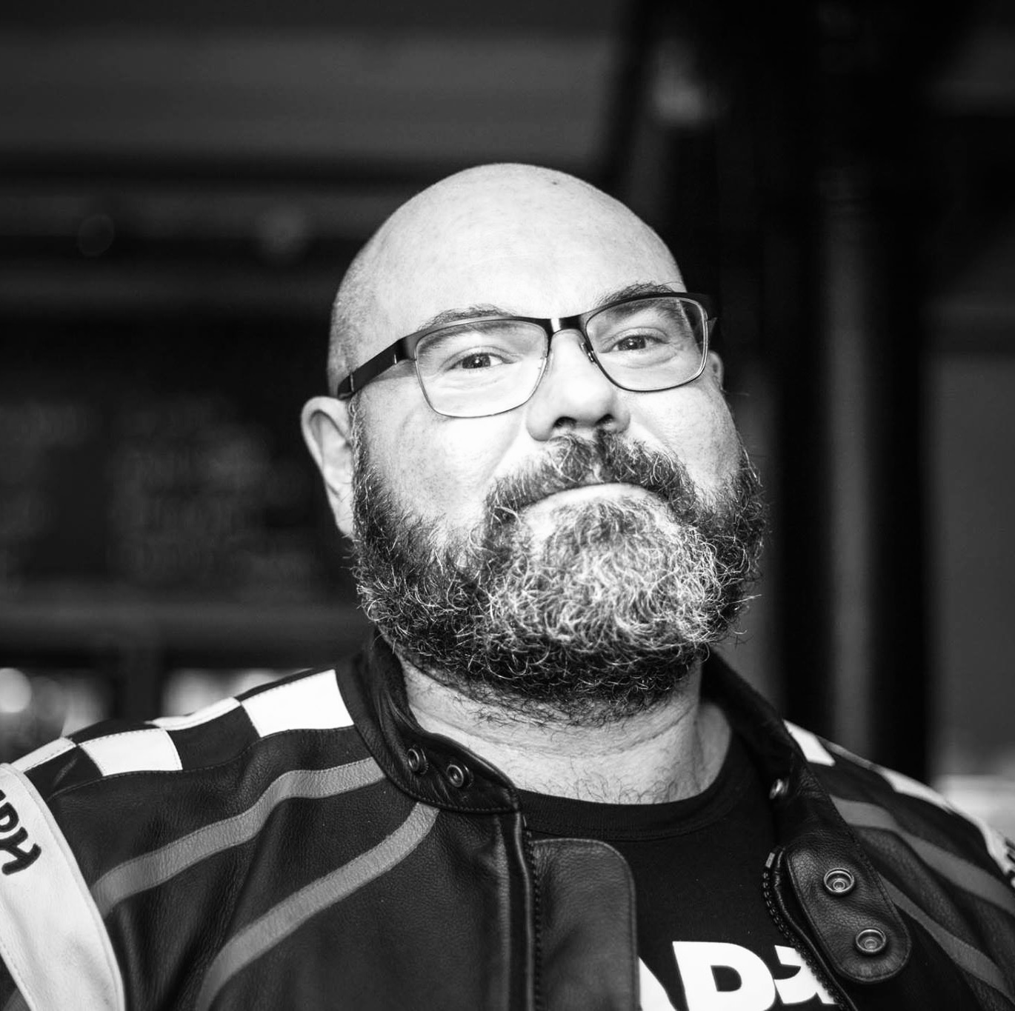
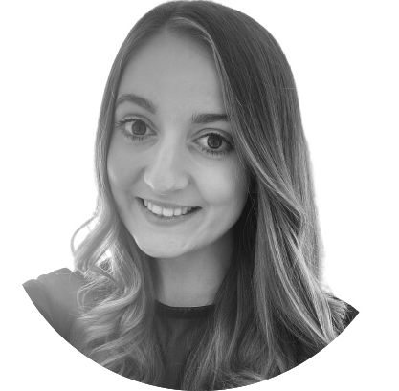
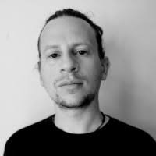
A blended team from across the council
Steve Ollier
Principal Performance Officer Health & Adult Services
Hibak Yusuf
FIS Team Leader
Children’s Services
Jenny Thai
Senior Product Designer
Digital and Customer Services
Lizzie Cullen Davison
Software Developer
TPX Impact
Hannah Nicholas
Software Developer
TPX Impact
RD
Alysia-Marie Annett
Senior Content Designer
Digital and Customer Services
Rachel Dunn
Senior Families Information Officer
Children’s Services
Paul Murray
Principal Product Manager
TPX Impact
Alex Sturtivant
Product Manager
Digital and Customer Services
Darren McCormac
Senior Delivery Manager
Digital and Customer Services
Notes:
Steve
We’re a blended team from across the council, made up of colleagues from Adults, Childrens, Digital and from our product partner TPX Impact.
We also meet weekly with our collaborators – a mix of colleagues from Public Health, Childrens and Digital. We work with them to get regular critique and feedback on our work.

Slide 6
Our mission
To design a community directory product that:
makes it easy for residents to understand and connect to the support available in their local community
creates a more sustainable and devolved way to publish and update content for all organisations and service providers involved
is reusable and easy to adopt for other local authorities
Notes:
Steve
And we have a mission statement, that summarises what we want to achieve.
We want to design a reusable community directory product that:
1) makes it easy for residents to understand and connect to the support available in their local community
2) creates a more sustainable and devolved way to publish and update content for all organisations and service providers involved
3) is reusable and easy to adopt for other local authorities
This project is also part-funded by the Local Digital Fund, so that the product we create at Greenwich can be reused by other local authorities too.

Slide 7
Making decisions
Notes:
Alex

Slide 8
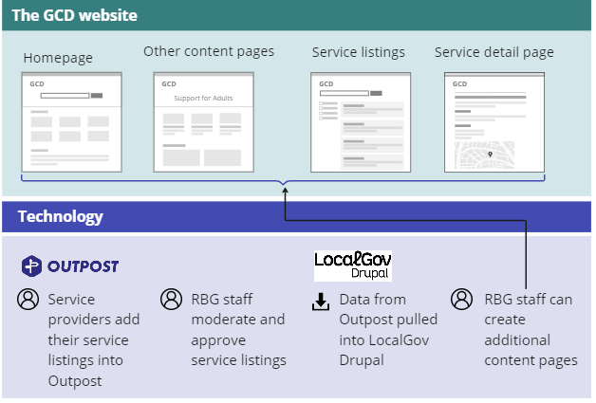
Locking in the technology we’ll use
Following our recent proof of concept, we met with some of our Digital Heads of Service to agree the technology we’ll use for the new directory.
Outpost
Used to manage the hundreds of service listings that will be shown on the directory
Used by service providers in the community and RBG staff who moderate listings
We’re developing Outpost into a product that can be easily reused by other local authorities
LocalGov Drupal
Pulls in the services in Outpost and allows us to present it as a directory
Also used for creating the homepage or information pages
Used by a small number of RBG staff
Notes:
Outpost is the main product that we’ll be using for our new directory
It’s the product we’ll use to manage the 100s of service listings that get listed on the directory
That will be used by anyone in the community who lists a service on the directory
And any staff at RBG who moderate service listings
It’s also the product we’re making reusable, so any local authority can use it for their directory
Then we have LocalGov Drupal, another product we’re using alongside Outpost
LocalGov Drupal allows us to take the services in Outpost, and present it as an actual directory
Whereas Outpost will be used for managing individual services, we’ll be using LocalGov Drupal to create things like the homepage, or pages with information on
This will be used by a much smaller group of people – probably just 5 or 6 members of staff at RBG

Slide 9
Beta Springboard
Discovery
Alpha
Beta
We presented our proposal for the scope of the next phase and what we wanted to learn from it
There was useful challenge and conversation on the approach but agreed it was right
We discussed the risks we thought might hold us back (e.g. timescales, unknowns on branding) and how to mitigate them
… so what is it we want to do next?

Slide 10
Our plan for Beta
Notes:
Alex

Slide 11
What is Beta?
Beta is where we take our best ideas from Alpha and start building them for real
We will have a live directory on the internet in this phase
We still test with residents, staff and other users during this phase to make sure that our designs work in the real world
We will start with a "private Beta" to get feedback from real users, then scale up

Slide 12
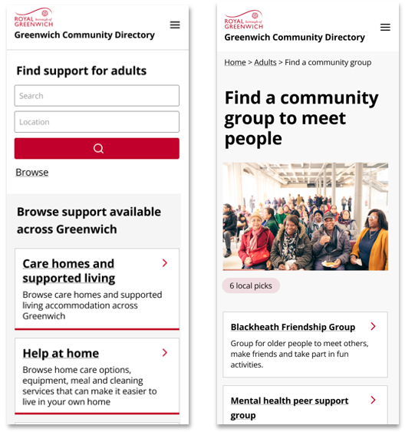
The scope of what we’ll start with
We’ll start by building the directory within the scope of ‘Support for Adults’
Initially we’ll populate it with a small number of services and focus on delivering core functionality only
Once we’ve tested it and feel confident with the product and approach, we’ll move all the services in this section across to the new directory

Slide 13
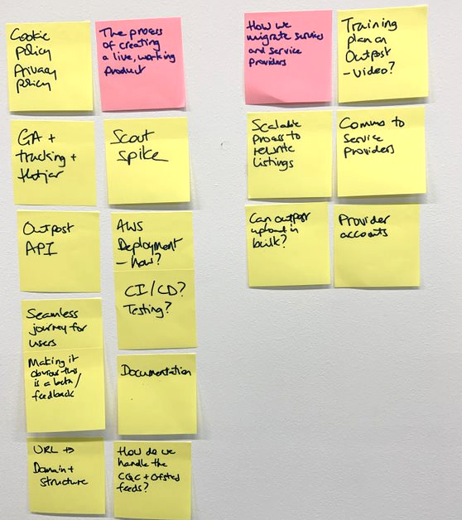
Learning goals for Beta
We want to understand:
The process of creating a live, working product
How we'll migrate services and service providers to the new GCD
The best way to upskill staff on using the new technology
How well we're meeting our users' needs

Slide 14
How we’ll measure our success
We’ll measure our progress based on answering our learning goals and seeing progress towards the outcomes we’ve set ourselves.
Is it easier for residents to find what they’re looking for?
Is it easier for service providers to add their listings to the GCD?
Is it more efficient for RBG staff to maintain content on the GCD?
These outcomes tie back to the problems we learned about in Discovery. If we can see progress towards these outcomes, we can be confident we’re on track to solving those problems.

Slide 15
Over to you
Is there anything else you’d like to see us cover in our Beta?
Who do we need to keep talking to as we continue to test the new directory?

Slide 16
Reviewing what content we need the GCD
Notes:
Alysia

Slide 17
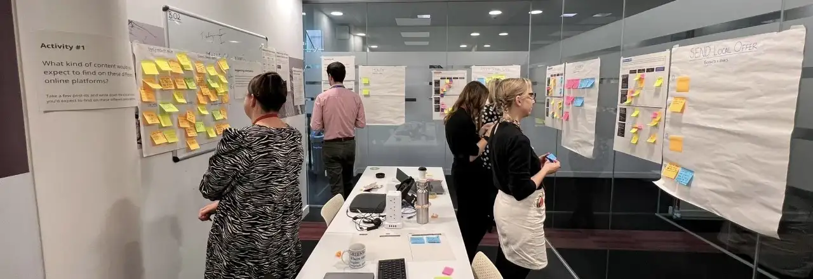
Who was invited: Colleagues from Children's, Adults and Public Health.
Purpose: To hear other people's perspectives about what should and shouldn't be on the new GCD and the most relevant place for that content such as the new GCD, the new RBG council website, NHS.
Content proposition workshops

Slide 18
Why we ran the workshops
Right now, content is duplicated across different online platforms. We’ve heard that this can make it difficult for some residents to know where to look and what to trust. It also increases the workload for some staff who need to maintain the content and makes it less clear where they should signpost residents to.
By removing duplication and ensuring content is where residents would expect to find it, then:
Residents won’t feel overwhelmed
Residents will find navigation easier
There will be less work for RBG staff
The purpose of our websites is clearer
We can create more joined up journeys
Notes:
residents won't feel overwhelmed with the amount of information, and it will be easier for them to find what they need
residents will find it easier to know where to look for different types of information, and know where the source of truth is
RBG staff will have less work to do in maintaining content, reducing the likelihood content goes out of date
We will be able to more easily communicate the purpose of the GCD and other platforms like Live Well and the corporate website
We can signpost people and create a more joined up journey of finding support if each product has one clear content goal

Slide 19
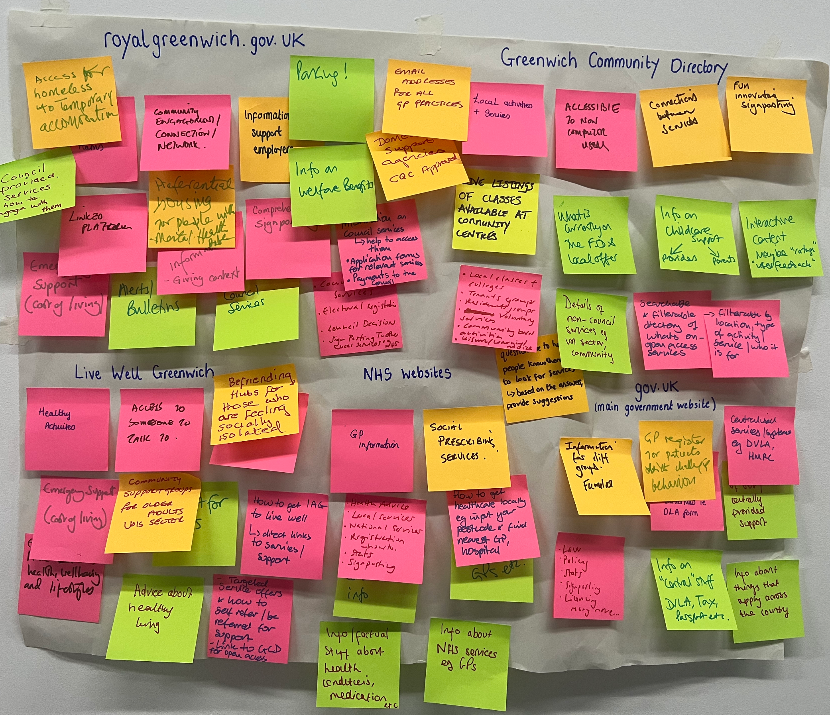
Overall workshop findings
The workshop showed that people expected to go to:
GCD for local support and activities
RBG site for support the council provides
external sites like GOV.UK for government support
Information and advice was less clear:
For Adults it was a mix of the RBG council website and external sites
For Health it was external sites or Live Well
For Children’s and Local Offer it was the GCD or a mixture
Notes:
Darren
And we have a mission statement, that summarises what we want to achieve.
We want to design a reusable community directory product that:
makes local information, advice and services more accessible, intuitive and easy to navigate for residents
creates a more sustainable and devolved way to publish and update content for all organisations and service providers involved
This project is also part-funded by the Local Digital Fund, so that the product we create at Greenwich can be reused by other local authorities too.

Slide 20
Workshop findings – Adult Social Care
Type of content
Most voted location
Find local support or activities e.g. Carer's support groups
Greenwich Community Directory
What did people feel uncertain about?
How do we best present information and advice on a particular topic or theme e.g. Dementia?
Do we still need the personal assistant finder or the self-assessment tool if the GCD is easier for residents to use?
How do we better signpost between different online platforms to create joined-up journeys? (e.g. support for Carers)
Council services e.g. Apply for a carer’s assessment
Royalgreenwich.gov.uk
National government services e.g. Carer’s allowance
GOV.UK
Advice and guidance e.g. How to access independent financial advice
Royalgreenwich.gov.uk or
external websites (e.g. Age UK)
Notes:
Darren
And we have a mission statement, that summarises what we want to achieve.
We want to design a reusable community directory product that:
makes local information, advice and services more accessible, intuitive and easy to navigate for residents
creates a more sustainable and devolved way to publish and update content for all organisations and service providers involved
This project is also part-funded by the Local Digital Fund, so that the product we create at Greenwich can be reused by other local authorities too.

Slide 21
Workshop findings – Health
Type of content
Most voted location
Find local support or activities e.g. Drug and alcohol services
Greenwich Community Directory
What did people feel uncertain about?
Would people choose to go to the GCD for health advice if it’s already available on the NHS and other charity websites?
What content differentiates the GCD from Live Well?
Council services e.g. Adult mental health services
Royalgreenwich.gov.uk
National government services
GOV.UK
For the Adults and Health workshop findings, is there anything here that surprises you or you’d like to talk more about?
Advice and guidance e.g. How to look after your heart
Live Well or
external websites (e.g. NHS)
Notes:
Darren
And we have a mission statement, that summarises what we want to achieve.
We want to design a reusable community directory product that:
makes local information, advice and services more accessible, intuitive and easy to navigate for residents
creates a more sustainable and devolved way to publish and update content for all organisations and service providers involved
This project is also part-funded by the Local Digital Fund, so that the product we create at Greenwich can be reused by other local authorities too.

Slide 22
Workshop findings – Local Offer
Type of content
Most voted location
Find local support or activities e.g. ASD support services
Greenwich Community Directory
What did people feel uncertain about?
How can we better signpost people to information, services and support on both online and offline channels?
How do we make better use of channels people trust? Like Facebook groups, practitioners like health visitors, and schools
Do people who haven’t been referred to the GCD by the FIS or SEND teams look on the GCD for this info?
Council services e.g. Education, Health and Care Plans
Royalgreenwich.gov.uk
National government services e.g. Disability Living Allowance for children
GOV.UK
Advice and guidance e.g. A parent's guide to autism
Greenwich Community Directory or
external websites (e.g. Age UK)
Notes:
Darren
And we have a mission statement, that summarises what we want to achieve.
We want to design a reusable community directory product that:
makes local information, advice and services more accessible, intuitive and easy to navigate for residents
creates a more sustainable and devolved way to publish and update content for all organisations and service providers involved
This project is also part-funded by the Local Digital Fund, so that the product we create at Greenwich can be reused by other local authorities too.

Slide 23
Workshop findings – Children's services
Type of content
Most voted location
What did people feel uncertain about?
How do we better quality assure existing content when we are building the new GCD?
How do we make better use of channels people trust? Like Facebook groups, practitioners like health visitors, and schools
How do we avoid duplication when the journey starts on GOV.UK? (e.g. )
Find local support or activities e.g. Parent and toddler groups
Greenwich Community Directory
Council services e.g. Become a childminder
Royalgreenwich.gov.uk
National government services e.g. Claim maternity allowance
GOV.UK
Advice and guidance e.g. Keeping safe online
External sites like Gov.uk
For the Local Offer and Children’s workshop findings, is there anything here that surprises you or you’d like to talk more about?
Notes:
Darren
And we have a mission statement, that summarises what we want to achieve.
We want to design a reusable community directory product that:
makes local information, advice and services more accessible, intuitive and easy to navigate for residents
creates a more sustainable and devolved way to publish and update content for all organisations and service providers involved
This project is also part-funded by the Local Digital Fund, so that the product we create at Greenwich can be reused by other local authorities too.

Slide 24
What this means for the new GCD
Some information and advice is needed on the directory. But we’ll likely have fewer pages on council services, health advice and general guidance.
Instead, we'll create stronger links with Live Well, NHS and the RBG website
We'll explore content types and designs that will make it clear to people what to expect like curated guides or topical listings
We'll review and declutter content with HAS and Children’s colleagues to remove content that is duplicated, out of date or no longer relevant
We'll be reviewing and updating the existing criteria for service listings so we can better quality assure and approve listings that add value
Notes:
Darren
And we have a mission statement, that summarises what we want to achieve.
We want to design a reusable community directory product that:
makes local information, advice and services more accessible, intuitive and easy to navigate for residents
creates a more sustainable and devolved way to publish and update content for all organisations and service providers involved
This project is also part-funded by the Local Digital Fund, so that the product we create at Greenwich can be reused by other local authorities too.

Slide 25
Content decluttering workshops
What we're doing now
Reviewing existing information and service listings on the GCD with colleagues from the service like Adults, Children's and Local Offer
Why we're doing it
Too much content or content that is not relevant can:
overwhelm users trying to find relevant info
Add time and cost pressure on teams to maintain/chase updates
Lead to people needing more 1 to 1 help
Why we're tackling it now​
Addressing it early means we can start fresh and set criteria and processes that are easier to maintain in future. ​
This will make it easier to:​
identify what content we do and do not need​
publish content residents expect to find
give guidance on writing good quality service listings​ with real examples
​

Slide 26
Next steps
Notes:
Alex

Slide 27
Over the next few weeks, we plan to:
Use the insights from our recent workshops, and the content decluttering, to create an updated criteria for what content we’ll have on the new GCD
Run a quick technical investigation to understand whether we’ll use Scout as a stepping stone in our technology stack
Start building the new directory for ‘Support for Adults’
Start some design work for the Children’s section of the directory

Slide 28
How to stay in touch and where to find out more...
Read our weeknotes – these are sent to all Show & Tell attendees every Monday
Come to our future Show & Tell events
Send us an email or a message on Microsoft Teams:
Darren.mccormac@royalgreenwich.gov.uk
Alex.Sturtivant@royalgreenwich.gov.uk
To learn about the early stages of the project, read weeknotes 1-7 or watch the team present in our first Show & Tell event. If you’re external, please visit our GCD project webpage.

Slide 29
Thank you for coming! Do you have any more questions?

