Slide 1
Rebuilding Greenwich’s
Community Directory
Show & Tell #12
08/11/2022
Please note this Show & Tell will be recorded
Notes:
Beth [press record]
Hi everyone, and welcome to today’s show and tell for the Greenwich Community Directory project on the 8 November 2022
Please note that this show and tell is being recorded, so if you don’t want to appear on the recording, feel free to turn your camera off.

Slide 2
What is a Show & Tell?
A regular event where we...
Get feedback from everyone, to shape what we do next
(not just those involved in the day to day work)
Make connections with other work and knowledge
Show progress early and often
Notes:
Darren
I think most people here have been to one of our show and tells before, but if you haven’t, a show and tell is an event where:
We show our progress early and often. We don’t want to hide our work away, we want to make sure everyone is really clear on what we’re doing and where we’re heading.
It’s a chance for us to get feedback from everyone, to shape what we do next. We want to hear what’s important to you, and be steered by your ideas.
And it’s a place for us to make connections with other work that’s going on, both within the council and with other councils and organisations.

Slide 3
Today’s Show & Tell
We will cover:
Our learnings and reflections from testing with residents
An update and demo of our proof of concept work
Our engagement with other local authorities so far
So that you:
Have a sense of how we're further iterating and developing our designs through testing
See some of our more technical work in progress
Hear how we're building momentum and interest from the sector
Notes:
Darren
In today’s show and tell, we’re going to talk about some tree testing we did online with residents, and what we've learned from that
More in-person testing of the prototype and what came out of that
We'll have a demo of our proof of concept for the reusable product
And an update on engagement with other councils
Your feedback is invaluable so please don't be shy

Slide 4
Our team + mission
Notes:
Before we get into the detail, I just want to refresh on who we are and what we’re trying to achieve.

Slide 5
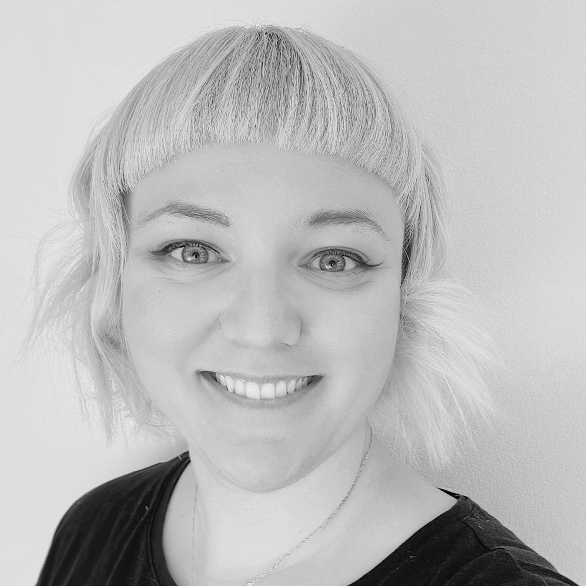
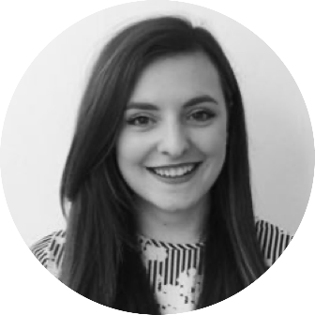
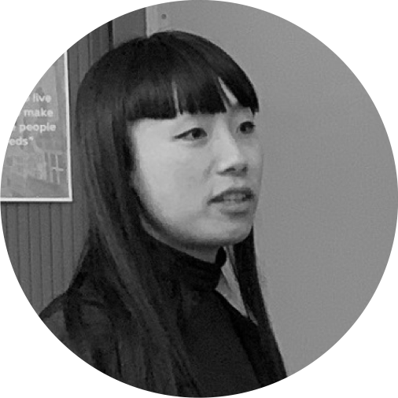
A blended team from across the council
Steve Ollier
Principal Performance Officer Health & Adult Services
Hibak Yusuf
FIS Team Leader
Children Services
Jenny Thai
Senior Product Designer
Digital and Customer Services
Lizzie Cullen Davison
Software Developer
TPX Impact
Hannah Nicholas
Software Developer
TPX Impact
Alex Sturtivant
Product Manager
Digital and Customer Services
Beth Mindham
Senior Delivery Manager
Digital and Customer Services
Alysia-Marie Annett
Senior Content Designer
Digital and Customer Services
Paul Murray
Principal Product Manager
TPX Impact
Lingjing Yin
Head of Product
Digital and Customer Services
Notes:
Darren
We’re a blended team from across the council, made up of colleagues from Adults, Childrens, Digital and from our product partner TPX Impact.
We also meet weekly with our collaborators – a mix of colleagues from Public Health, Childrens and Digital. We work with them to get regular critique and feedback on our work.

Slide 6
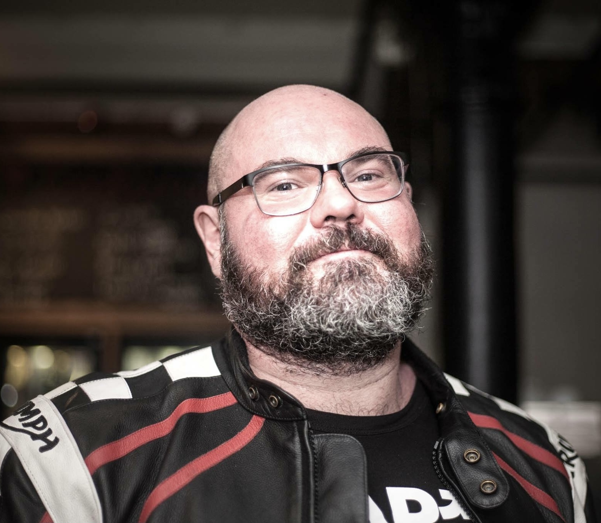
A blended team from across the council
Steve Ollier
Principal Performance Officer Health & Adult Services
Hibak Yusuf
FIS Team Leader
Children Services
Jenny Thai
Senior Product Designer
Digital and Customer Services
Lizzie Cullen Davison
Software Developer
TPX Impact
Hannah Nicholas
Software Developer
TPX Impact
Alex Sturtivant
Product Manager
Digital and Customer Services
Darren McCormac
Senior Delivery Manager
Digital and Customer Services
Alysia-Marie Annett
Senior Content Designer
Digital and Customer Services
Paul Murray
Principal Product Manager
TPX Impact
Lingjing Yin
Head of Product
Digital and Customer Services
Notes:
Darren
We’re a blended team from across the council, made up of colleagues from Adults, Childrens, Digital and from our product partner TPX Impact.
We also meet weekly with our collaborators – a mix of colleagues from Public Health, Childrens and Digital. We work with them to get regular critique and feedback on our work.

Slide 7
Our mission
To design a community directory product that:
makes it easy for residents to understand and connect to the support available in their local community
creates a more sustainable and devolved way to publish and update content for all organisations and service providers involved
is reusable and easy to adopt for other local authorities
Notes:
Darren
And we have a mission statement, that summarises what we want to achieve.
We want to design a reusable community directory product that:
makes local information, advice and services more accessible, intuitive and easy to navigate for residents
creates a more sustainable and devolved way to publish and update content for all organisations and service providers involved
This project is also part-funded by the Local Digital Fund, so that the product we create at Greenwich can be reused by other local authorities too.

Slide 8
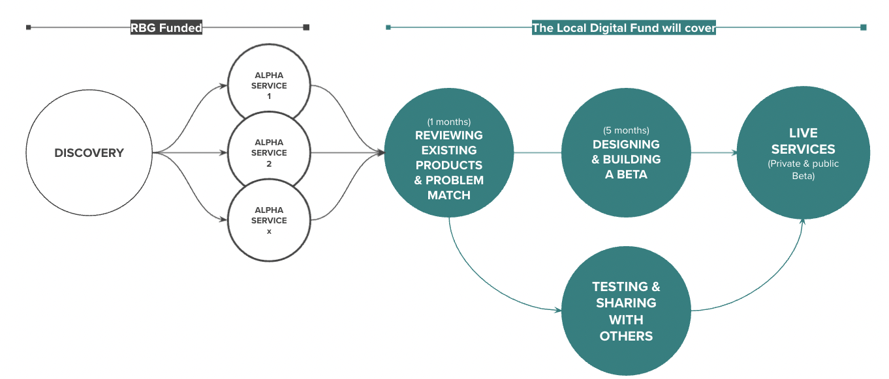
Our delivery plan
Funded by the Local Digital Fund
We’re here
DISCOVERY
ALPHA
BETA
Understand the context and problems
Test different solutions
to the problems
Build, refine and improve
the service
Notes:
A

Slide 9
What we learned from online tree testing with residents
Notes:
Alysia

Slide 10
About our tree testing
What we did
Set up an online task where we gave residents a scenario and asked them to find information using our category and subcategory labels.
Why we did it
To see if information is found in the places residents expect.
Doing this before our prototype testing meant we were able to include any questions/assumptions into our in person testing to better understand the quantitative insights from the tree tests.

Slide 11
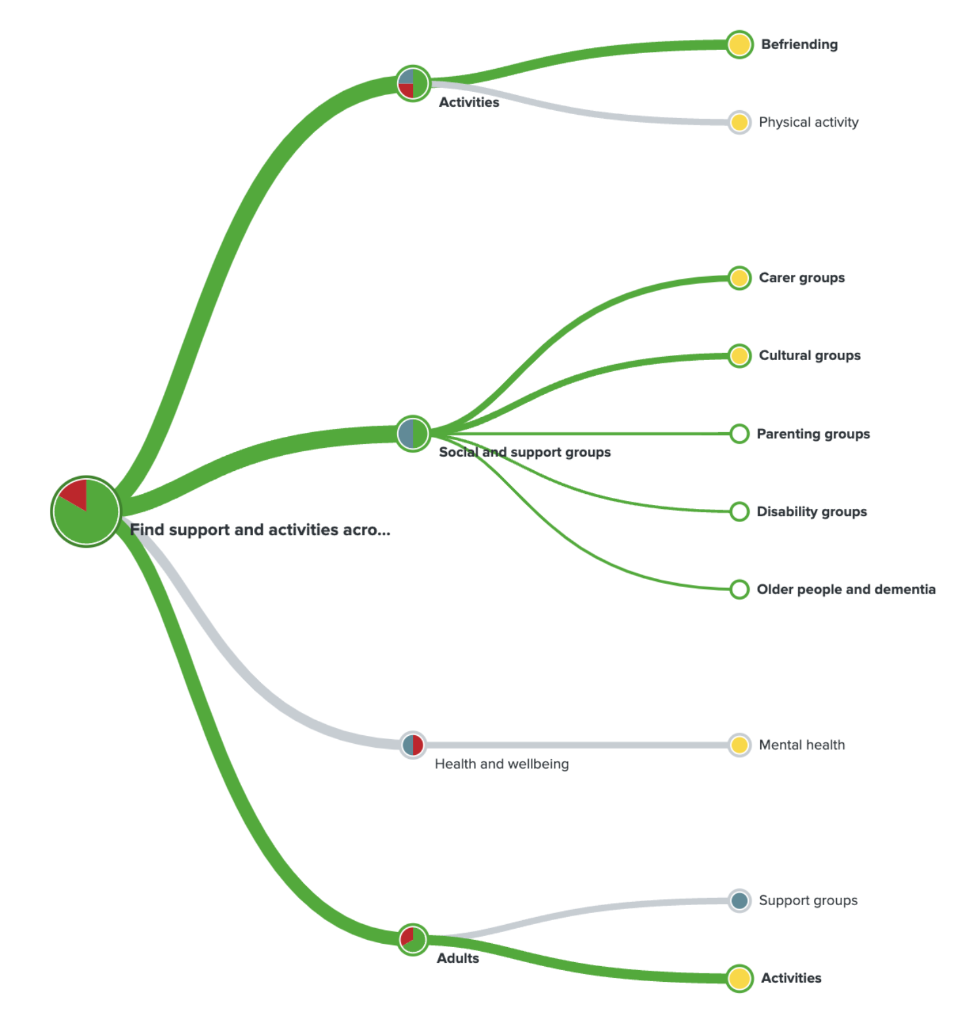
Example of routes people took
Task
You're feeling lonely and want to meet new people, where would you go to do this?
First clicks:
Activities - 38%
Social and support groups - 38%
Health and wellbeing - 25%

Slide 12
Learnings from tree testing
1. There is no 1 correct route
People's personal preferences meant they may go to different places to meet their needs
2. Most people navigated by topic
We were unsure if this was because these were listed higher than user groups
3. Some category labels are too broad
It was not clear what sort of services would be included under 'Health and wellbeing' and 'Families'

Slide 13
What we learned from testing our prototypes with residents
Notes:
Steve

Slide 14
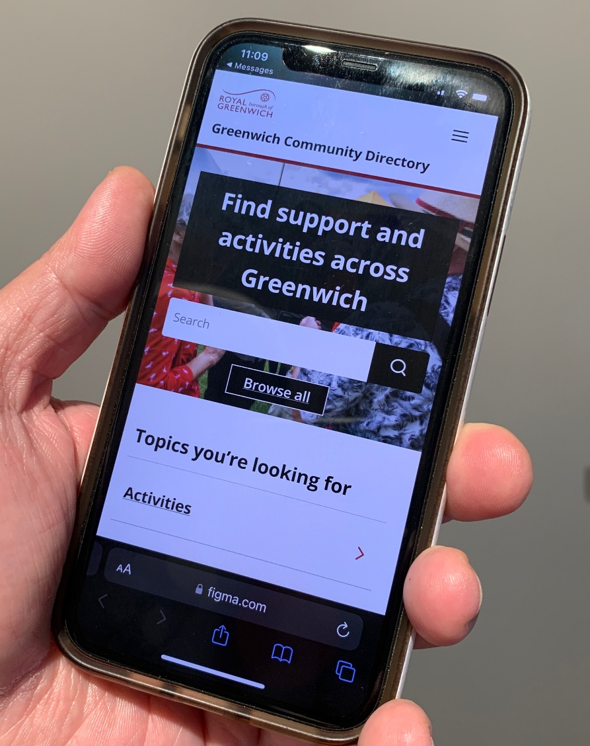
What we did
Tested our clickable prototype for Adults section with residents
Task-based which means we gave participants a scenario and task to complete using the prototype
In person, up to 1 hour sessions in the Woolwich Centre Library
£15 Love to Shop voucher for taking part
1 facilitator and 1 notetaker, along with screen and audio recording
Notes:
Steve

Slide 15
Who we tested with
8 residents
Age range from about 44-78yrs old
Mix of retired and working, 2 parents to young families
Most have used the RBG website for common services (ctax, environment)
Some had specific interests in planning, council meetings
More tuned up with the community - probably b/c where we recruited them (e.g. community champions…)
Most never heard of the GCD before, those that did never used it
Notes:
Steve

Slide 16
Assumptions we're testing with residents
Riskiest
About the proposition
People understand what the directory is, what is on it and what they can do there
People don't expect any additional information, advice and guidance.
Helping people navigate and find services
Curated and topical listings will help people find relevant services
The user type landing page makes it easier for people to find things
Information & design
There is a right level of content for people on each service listing
Tags on service listings make it easier for people to scan, find and understand what each service is
Notes:
Steve

Slide 17
What we did
Task based testing - users complete a task and are observed
Clickable prototype of the GCD end to end experience focused on services for adults. It includes:
Homepage
Landing page for adults
All service listings page (aka search results page)
Individual service listings
Topical listing page (aka collection)
Curated listing page
Notes:
Journey through Alpha, why are we creating a proof of concept?
What is a proof of concept?
What’s the scope? What are we building?

Slide 18
Research Questions
Do people understand what the GCD is?
What do people expect to find and do on the GCD?
Where do people go to find related information/advice or guidance?
Is it clear what the curated and topical listings are?
Are the curated and topical listings helpful and useful?
Does the adults landing page meet expectations and help people navigate to services?
How do people navigate and search for services/activities?
What helps people look for and find services?
What language do people use?

Slide 19
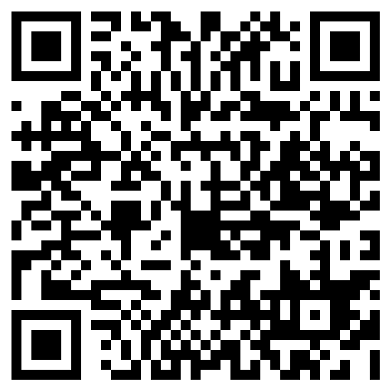
What we learned
ahaslides.com/VDFH4
Notes:
Jenny
Note to go to the link on your phone or another tab

Slide 20
What would you or residents do?
Scenario: A family member has had a fall and recently came out of the hospital. They are recovering but are struggling with their mobility and it’s difficult to do daily activities and tasks around the house. They have asked if you can find them some assistance.
Task: Using the site, find something that you think might help.
Question
What would you do?
What do you think most of the residents that we tested with did?
A: Use the search box
B: Click on Health and Wellbeing
C: Click on Care at home
D: Click on Adults
E: Call the helpline
F: Go to Google

Slide 21
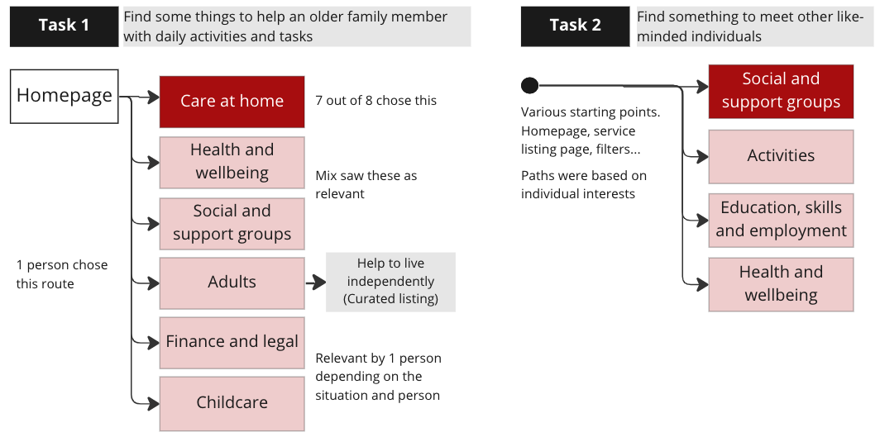
Navigation by topic was the main path residents took to start finding services
Different mental models:
The person that chose to go via Adults was thinking in a logical sequence: who is it for? What do they need?. Whereas other people went straight to thinking about specific needs.
Notes:
Jenny
But we did question if going by topic was influenced by the order people saw these on the page. If Adults was at the top above topics, would people still choose to same path?
Connected to our tree testing

Slide 22
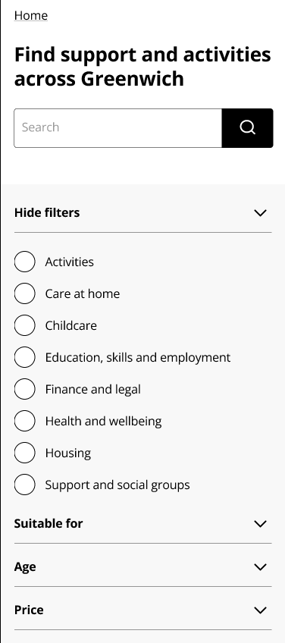
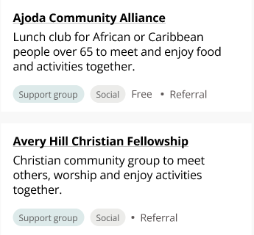
People used different design elements to help them refine and find services
The different ways people may look for things:
Navigating using main links/page links
using keyword search
filters
looking at the tags on the service listing
“Age (filter) is of interest, not sure about price. Maybe for free things.”
“I might type in 'district nurse' to see what came up.”
Tags
"I would pick on something based on what I can see and the little labels that are on the boxes.” (tags on services)
Notes:
Jenny

Slide 23
Curated and topical listings
Topical listings
A way to promote certain listings related to a specific topic.
They can also be more timely.
Curated listings
A way to help residents find groups of listings under subcategories.
Breaks down a broad topic and gives people a sense of the types of support available without a long list of results to start with.
Notes:
Jenny

Slide 24
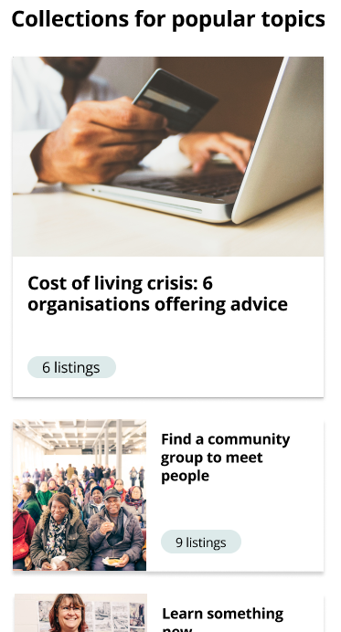
The topical listings were seen as useful topics, but the example used might not have been the right type as people thought it was missing diversity and breadth of services
We still believe it has a use case for specific topics that you can’t filter or search for yourself. For example, the cost of living topic was seen by people as good right now.
Topical listings are also not meant to be a finite list but a starting point.
“It doesn’t have everything for everyone.”
“Useful, that’s just a small amount there could be a lot more. It’s for the whole of Greenwich right?”
Notes:
Jenny

Slide 25
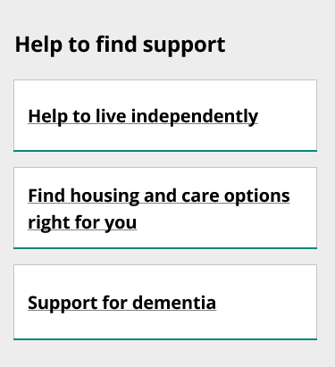
Some people expected more information and guidance at various points
Most first impressions of the GCD showed residents understood broadly the GCD is a place where you can go to find things you need in Greenwich.
But as some went through the tasks and things in more detail they expected different things:
Some expectation the curated listing to contain guidance and the ‘how’ to do something. The title of ‘help to live independently’ might not be clear and was broad.
“…interpreted as how can young people learn to live independently.”
"I'd want to find out what the family member is eligible for... So I am surprised there isn’t anything about what the council would offer."
"So for people using it, it is a starting point, not a solution but a starting point.”
Notes:
Jenny
2 of the 8 residents understood what curated listings were

Slide 26
There was a mixture of expectations about the type and scope of services you can find on the GCD
Council and/or community?
Some thought the GCD only had council services. Maybe because:
The branding with logo at top
It’s a council site and we are staff
Some might not associate the council with external services
When people learned it was more than council services, some thought it covered everything and anything.
"I would expect council offered things.”
".. why not go to Google …What is special about these ones? Are they approved by the council, are they working with the council?”
"Wouldn’t matter to me who’s running the services…as long as it’s working and fulfilling that need and serving the community.”
Notes:
Jenny

Slide 27
There was some understanding that the GCD is part of a wider journey
“Was wondering how I would get to this page, via google searching for help or care at home or the RBG site...?
“..expect to find information first then directed to this if can't be eligible for council support.”
“Expect to be able to go to the RBG site and this would come up…”
The GCD prototype was tested in isolation but we know that it should be connected to other points of interaction residents might have with places like the RBG site, finding things via google search.
It was good to hear that residents were also thinking about the wider journey and how the GCD might fit in that.
Notes:
Jenny

Slide 28
Using clearer language to guide people's expectations
Some labels were too broad and made people expect a wider range of services
Some terms are used for more than one council services like young people with SEND and adults with care needs
Descriptions under each topic may help people better know what services to expect
Some language we used to explain what content to expect was too custom and not clear
'Activities' is broad or can be vague
Oh, I was thinking someone younger, not maintaining living independently.
What is this 'collections for
popular topics'?
Notes:
Alysia

Slide 29
Level of information in listings was good but we can better prioritise information based on the service
Location of the service is more important than that of the organisation providing it
Ratings and reviews reassure people looking for services like care homes
Cost is important and it'd be good to know what is free, funded or need a referral
People who knew the GCD was a signposting tool were happy with the level of information. Those who weren't expected more detail
Information is short and precise – people don’t like information overload. They don’t want a full page of what they do.
"Cost on arrangement" is not enough info, wants to see where costs start from
Notes:
Alysia

Slide 30
Any questions?
Anything that you were surprised by?
Want to know more about what we learned?

Slide 31
Creating a proof of concept
Notes:
Alex
Before we get into the detail, I just want to refresh on who we are and what we’re trying to achieve.

Slide 32
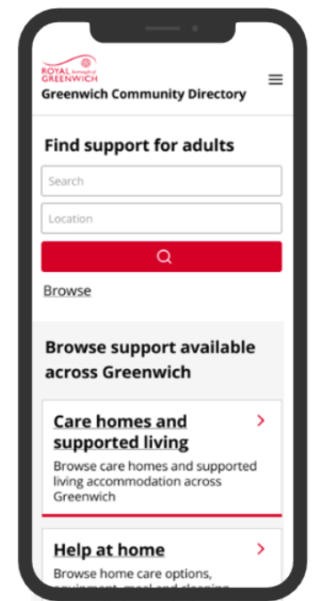
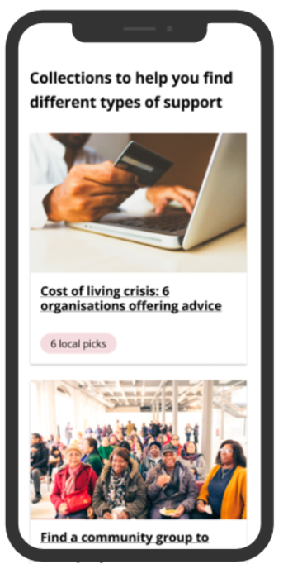
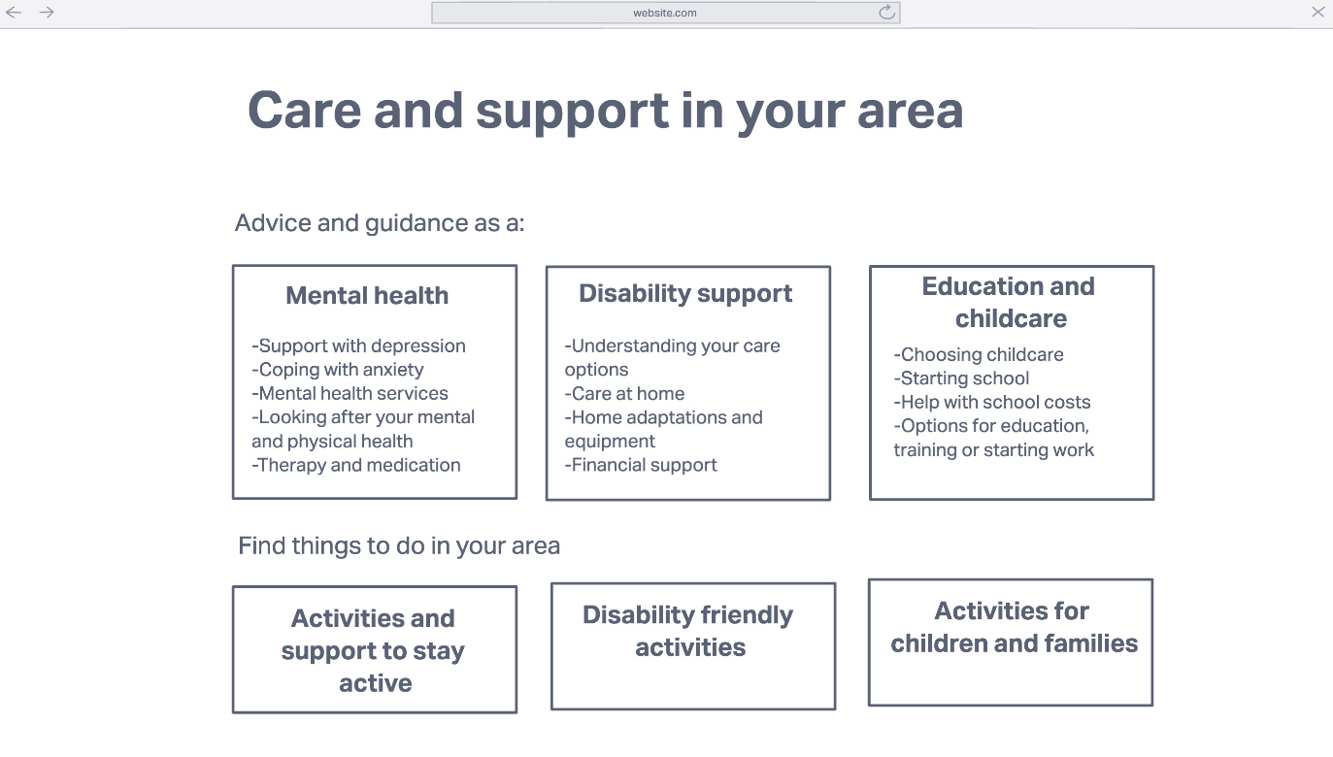
Our journey through Alpha
TBC
Initial experiments
Early prototypes
Iterated prototypes
Proof of concept
Trying out different ways to solve the problems we found in Discovery
Bringing together what worked well into initial designs for a new directory
Bringing the designs to life by focusing on ‘support for Adults’
Ensuring the directory we’ve designed is technically feasible
Notes:
Journey through Alpha, why are we creating a proof of concept?
What is a proof of concept?
What’s the scope? What are we building?

Slide 33
What we wanted to learn about with our proof of concept
Categorisation and filtering Does this work in the same way as we’ve designed it in our prototypes?
Content maintenance for RBG staff How can we make it easy for RBG staff to maintain content that doesn’t belong in Outpost? (e.g. the GCD homepage or landing pages)
Topical listings and curated listings How would we create these?
Notes:
Journey through Alpha, why are we creating a proof of concept?
What is a proof of concept?
What’s the scope? What are we building?

Slide 34
Our hypothesis
If… we build the GCD using Outpost and LocalGov Drupal
Then… we can develop the directory as we’ve prototyped it
And… RBG staff will be able to maintain all aspects of the directory in a way that’s easy and intuitive
And… we can minimise technical complexity
A product for service providers to create and manage service listings that will be on the directory. RBG staff use it to moderate listings.
Behind the scenes
A website publishing platform. Enables us to create the actual directory people see online.
Resident-facing website
Notes:
Journey through Alpha, why are we creating a proof of concept?
What is a proof of concept?
What’s the scope? What are we building?

Slide 35
Demo
Notes:
Journey through Alpha, why are we creating a proof of concept?
What is a proof of concept?
What’s the scope? What are we building?

Slide 36
What questions do you have?
Would you like us to explain anything in more detail?
Is there anything else you’d like to know about?

Slide 37
Engagement with other councils
Notes:
Alex
Before we get into the detail, I just want to refresh on who we are and what we’re trying to achieve.

Slide 38
Engaging councils who might re-use what we’re building
14
12
3
4
Local authorities we’re in conversation with
Introductory calls
Demos organised
Local authorities signed up (in principle)
The more local authorities who re-use our product, the greater the impact our work will have
We plan to hold our first community meet-up for local authorities using Outpost soon
We’ll be doing another show and tell for local authorities later in November (date TBC)

Slide 39
Next steps
Notes:
Alex
Before we get into the detail, I just want to refresh on who we are and what we’re trying to achieve.

Slide 40
Over the next 4 weeks, we plan to:
Wrap up all of our prototyping, testing and synthesis
Decide on technology direction
Make our transition from Alpha into Beta for the GCD
Notes:
Journey through Alpha, why are we creating a proof of concept?
What is a proof of concept?
What’s the scope? What are we building?

Slide 41
How to stay in touch and where to find out more...
Read our weeknotes – these are sent to all Show & Tell attendees every Friday
Come to our future Show & Tell events
Send us an email or a message on Microsoft Teams:
Darren.mccormac@royalgreenwich.gov.uk
Alex.Sturtivant@royalgreenwich.gov.uk
To learn about the early stages of the project, read weeknotes 1-7 or watch the team present in our first Show & Tell event. If you’re external, please visit our GCD project webpage.

Slide 42
Thank you for coming. Are there any questions?

