Slide 1
Rebuilding Greenwich’s
Community Directory
Show & Tell #11
11/10/2022
Please note this Show & Tell will be recorded
Notes:
Beth [press record]
Hi everyone, and welcome to today’s show and tell for the Greenwich Community Directory project on the 13th of September
Please note that this show and tell is being recorded, so if you don’t want to appear on the recording, feel free to turn your camera off.

Slide 2
What is a Show & Tell?
A regular event where we...
Get feedback from everyone, to shape what we do next
(not just those involved in the day to day work)
Make connections with other work and knowledge
Show progress early and often
Notes:
Alex
I think most people here have been to one of our show and tells before, but if you haven’t, a show and tell is an event where:
We show our progress early and often. We don’t want to hide our work away, we want to make sure everyone is really clear on what we’re doing and where we’re heading.
It’s a chance for us to get feedback from everyone, to shape what we do next. We want to hear what’s important to you, and be steered by your ideas.
And it’s a place for us to make connections with other work that’s going on, both within the council and with other councils and organisations.

Slide 3
Today’s Show & Tell
We will cover:
Prototype updates and tweaks
All things testing! Including who we've been testing with and our risky assumptions
The rationale and approach we're taking to our proof of concept work
How our reusable Show & Tell event went
So that you:
Have a sense of how we're iterating our work as we progress
Hear who we are engaging with and have an opportunity to point us towards others we might not be aware of
See some of our work in progress and have an opportunity to tell us what you think!
Notes:
Alex
In today’s show and tell, we’re going to show you the prototypes we’re currently working on, as well as bit of information about the process of prototyping and how that’s worked for us.
And we’re also going to talk about how we plan to measure the success of the new directory too.
We hope that you’ll get a good sense of how we’re putting our learnings and reflections into practice as we go, and also take the opportunity to tell us your thoughts about what we’re working on.

Slide 4
Our team + mission
Notes:
Alex
Before we get into the detail, I just want to refresh on who we are and what we’re trying to achieve.

Slide 5
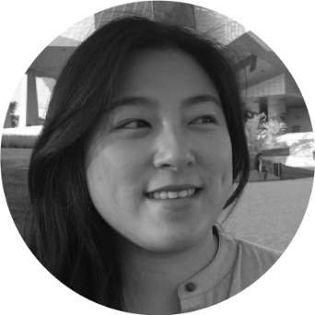
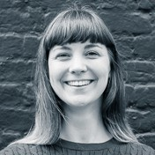
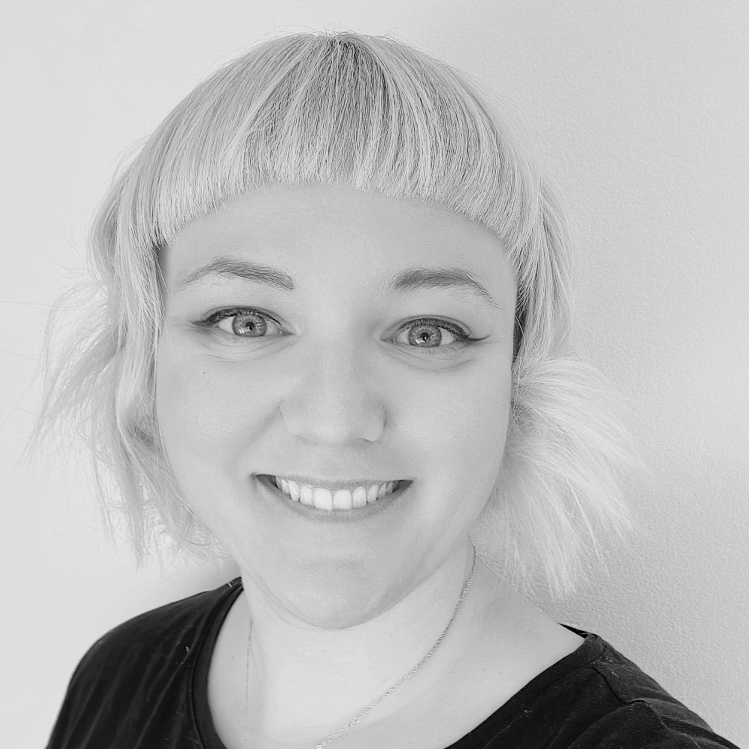
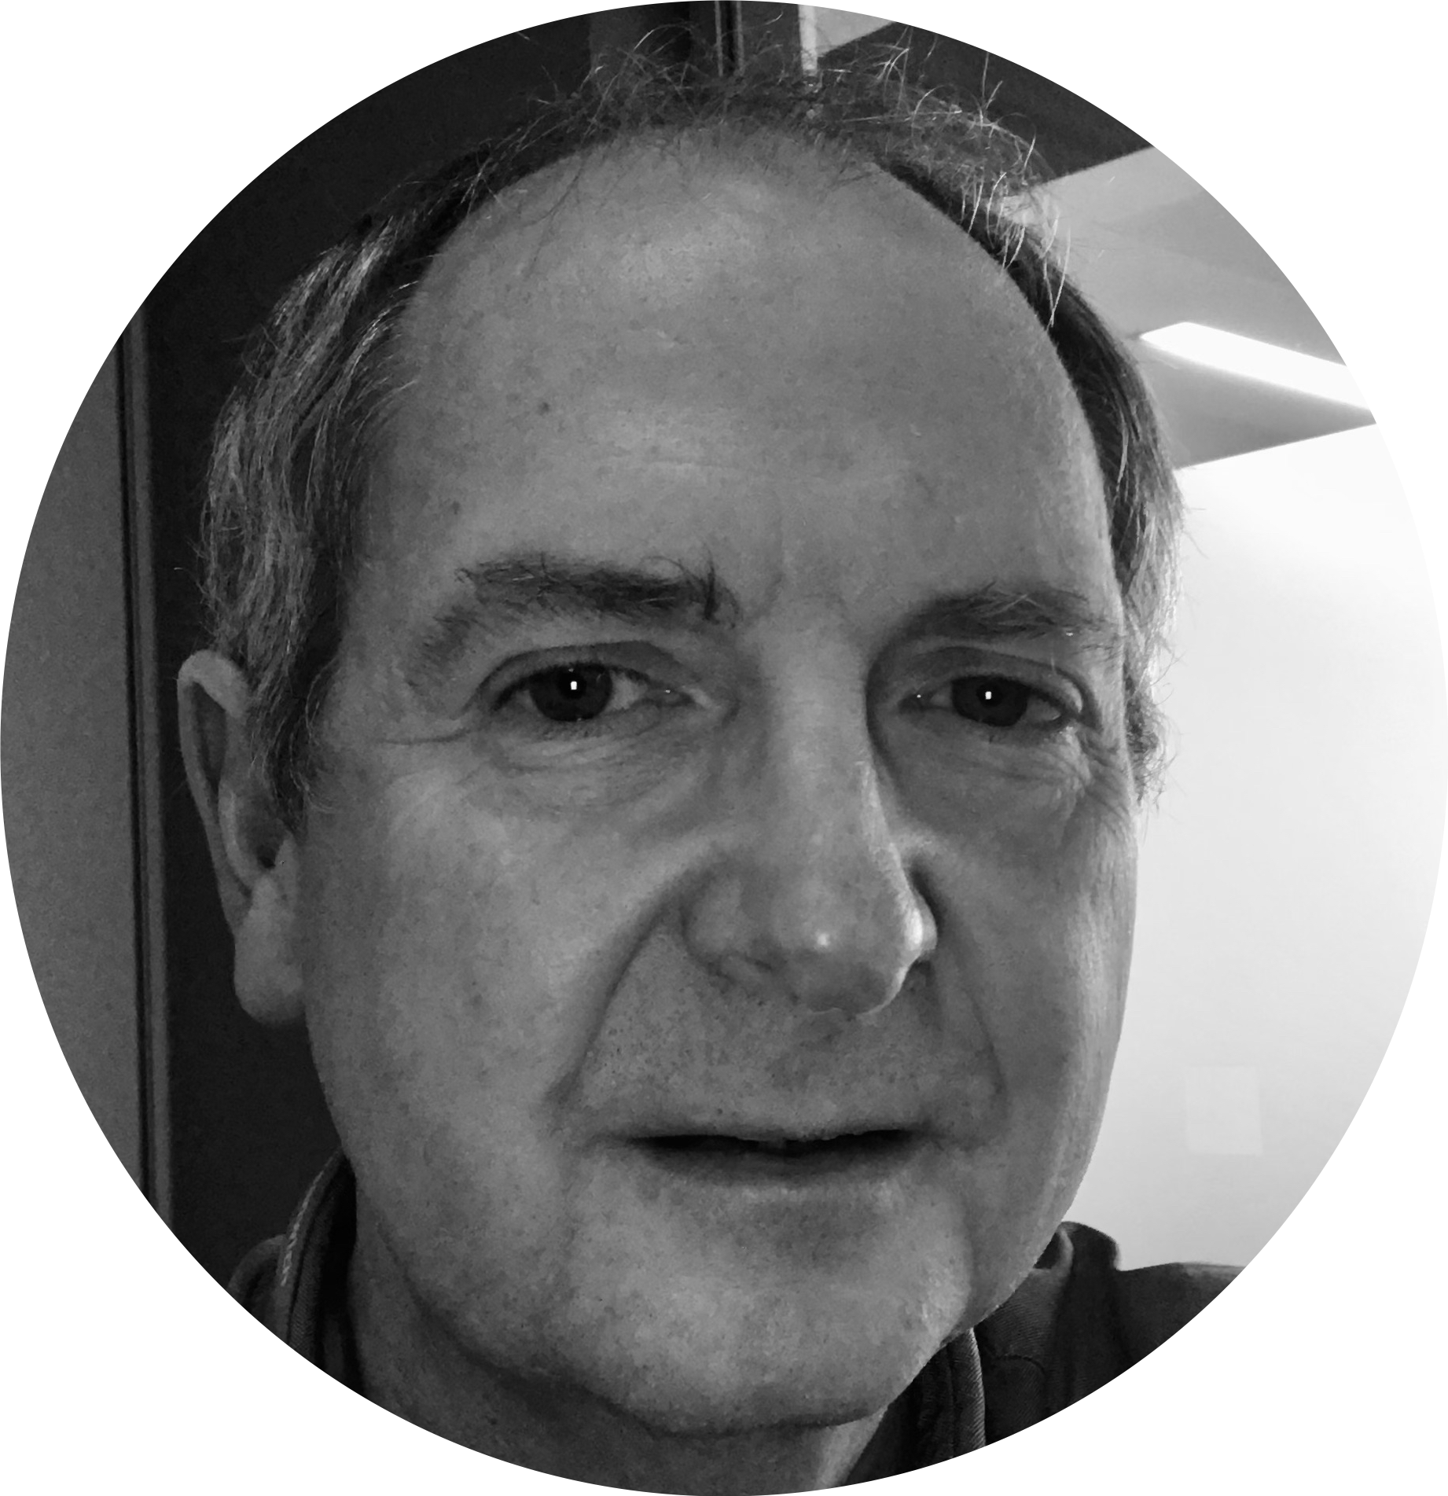
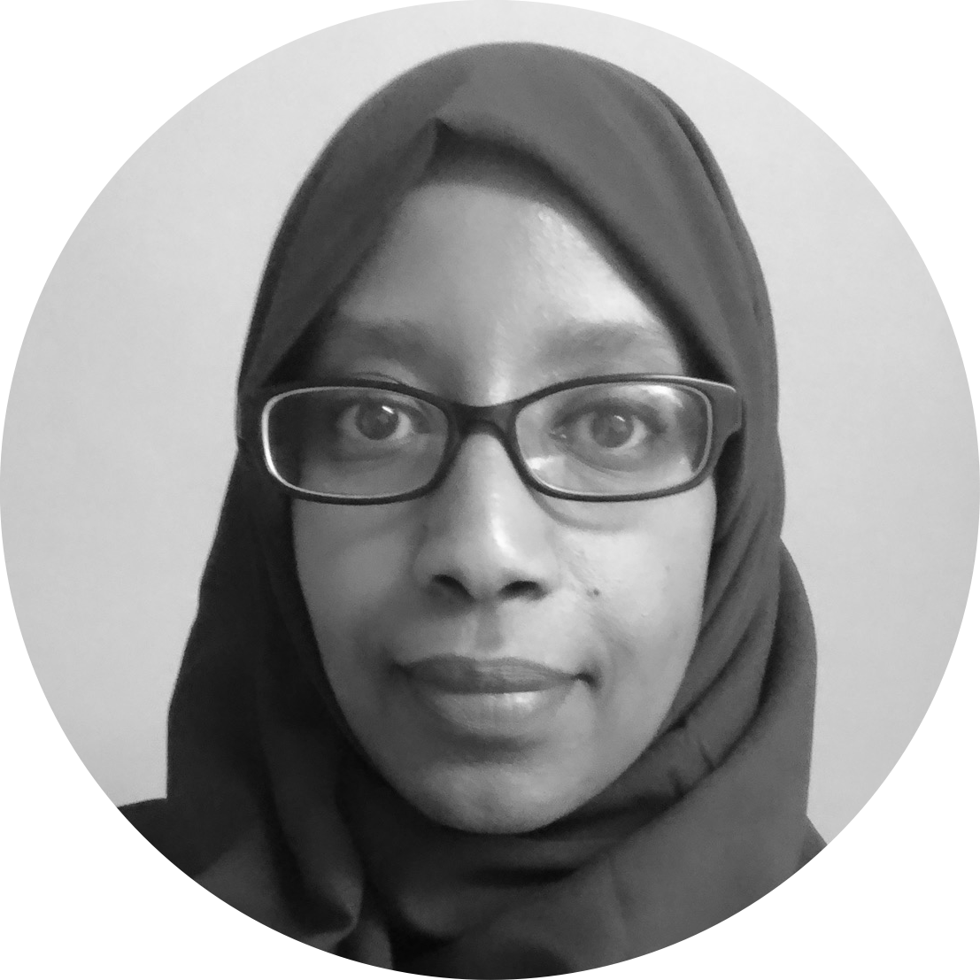
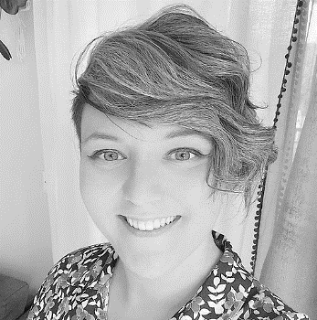
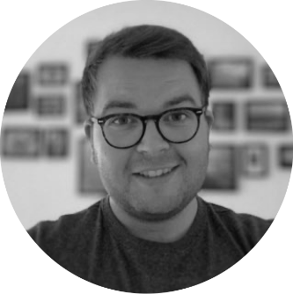
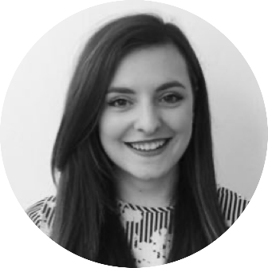
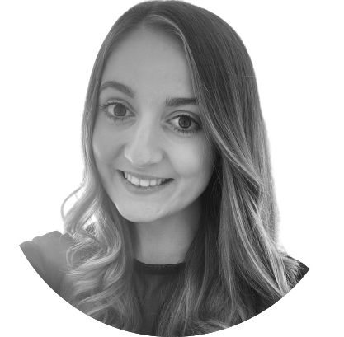
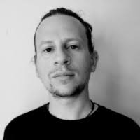
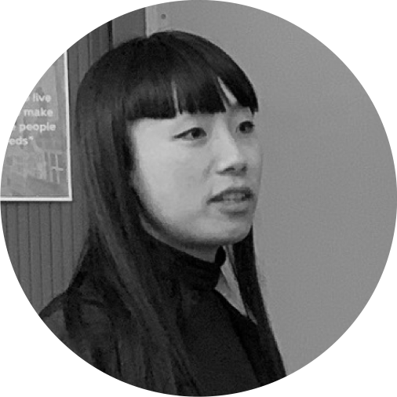
A blended team from across the council
Steve Ollier
Principal Performance Officer Health & Adult Services
Hibak Yusuf
FIS Team Leader
Children Services
Jenny Thai
Senior Product Designer
Digital and Customer Services
Lizzie Cullen Davison
Software Developer
TPX Impact
Hannah Nicholas
Software Developer
TPX Impact
Alex Sturtivant
Product Manager
Digital and Customer Services
Beth Mindham
Senior Delivery Manager
Digital and Customer Services
Alysia-Marie Annett
Senior Content Designer
Digital and Customer Services
Paul Murray
Principal Product Manager
TPX Impact
Lingjing Yin
Head of Product
Digital and Customer Services
Notes:
Alex
We’re a blended team from across the council, made up of colleagues from Adults, Childrens, Digital and from our product partner TPX Impact.
We also meet weekly with our collaborators – a mix of colleagues from Public Health, Childrens and Digital. We work with them to get regular critique and feedback on our work.

Slide 6
Our mission
To design a community directory product that:
makes it easy for residents to understand and connect to the support available in their local community
creates a more sustainable and devolved way to publish and update content for all organisations and service providers involved
is reusable and easy to adopt for other local authorities
Notes:
Alex
And we have a mission statement, that summarises what we want to achieve.
We want to design a reusable community directory product that:
makes local information, advice and services more accessible, intuitive and easy to navigate for residents
creates a more sustainable and devolved way to publish and update content for all organisations and service providers involved
This project is also part-funded by the Local Digital Fund, so that the product we create at Greenwich can be reused by other local authorities too.

Slide 7
Prototyping
Notes:
Jenny
Before we get into the detail, I just want to refresh on who we are and what we’re trying to achieve.

Slide 8
Prototyping: Homepage
Originally, navigating the homepage was by type of user. We realized this might not work if services and activities overlap and are not neatly categorized by user type.
So we iterated our homepage:
To better reflect the types of services and activities available across user types
Still provide different ways to navigate, so by topic or by user type
Adding headings
Main heading for page ‘Find support and activities…” to make it clear what this is
Topics
User type
Notes:
Jenny
And we have a mission statement, that summarises what we want to achieve.
We want to design a reusable community directory product that:
makes local information, advice and services more accessible, intuitive and easy to navigate for residents
creates a more sustainable and devolved way to publish and update content for all organisations and service providers involved
This project is also part-funded by the Local Digital Fund, so that the product we create at Greenwich can be reused by other local authorities too.

Slide 9
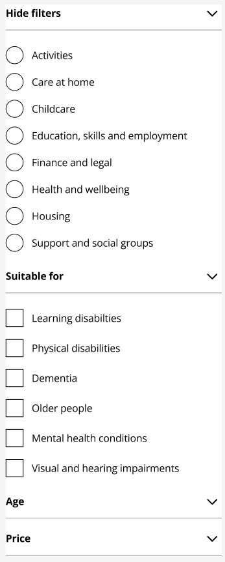
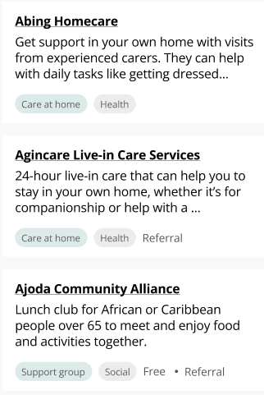
Prototyping: Updates and tweaks
Making sure the Live well helpline is there
Tags to listings to help with scanning and information about each service
Filters
Notes:
Jenny
And we have a mission statement, that summarises what we want to achieve.
We want to design a reusable community directory product that:
makes local information, advice and services more accessible, intuitive and easy to navigate for residents
creates a more sustainable and devolved way to publish and update content for all organisations and service providers involved
This project is also part-funded by the Local Digital Fund, so that the product we create at Greenwich can be reused by other local authorities too.

Slide 10
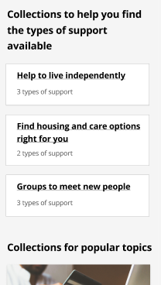
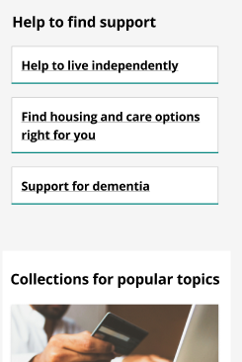
Prototyping: Updates and tweaks
Curated and topical listings – language and how we provide helpful headings
Visual design and experimenting with icons
Notes:
Jenny
And we have a mission statement, that summarises what we want to achieve.
We want to design a reusable community directory product that:
makes local information, advice and services more accessible, intuitive and easy to navigate for residents
creates a more sustainable and devolved way to publish and update content for all organisations and service providers involved
This project is also part-funded by the Local Digital Fund, so that the product we create at Greenwich can be reused by other local authorities too.

Slide 11
Prototyping: Service listing details
Some questions we had when designing this page:
What is important for the resident to know about a service/activity?
What is the priority order?
Is there a different between activities and a service?
How might we design the backend so that the information provided and displayed to users is clear?
Activity with date, time, location…
Service with no location, done via phone
Notes:
Jenny
And we have a mission statement, that summarises what we want to achieve.
We want to design a reusable community directory product that:
makes local information, advice and services more accessible, intuitive and easy to navigate for residents
creates a more sustainable and devolved way to publish and update content for all organisations and service providers involved
This project is also part-funded by the Local Digital Fund, so that the product we create at Greenwich can be reused by other local authorities too.

Slide 12
What questions do you have?
Do you have any thoughts or feedback on what we’ve shown?
Notes:
Journey through Alpha, why are we creating a proof of concept?
What is a proof of concept?
What’s the scope? What are we building?

Slide 13
Testing our prototypes with users
Notes:
Alex
Before we get into the detail, I just want to refresh on who we are and what we’re trying to achieve.

Slide 14
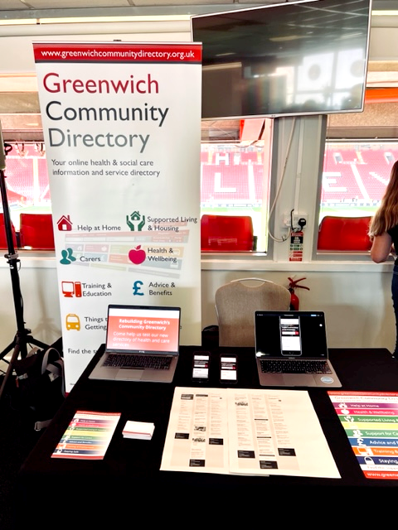
Testing our prototypes at a local event
NHS Primary Care Staff Event at Charlton Athletic FC - The Valley
GCD stall set up catching people during the arrival / lunch break.
Very well attended session - a great opportunity
Live prototypes designs set up / laptops and mobiles
Positive Feedback!
Found an appetite from professionals.
Prototype felt more structured and easier to use than the current GCD
Keep language simple
Notes:
Jenny
And we have a mission statement, that summarises what we want to achieve.
We want to design a reusable community directory product that:
makes local information, advice and services more accessible, intuitive and easy to navigate for residents
creates a more sustainable and devolved way to publish and update content for all organisations and service providers involved
This project is also part-funded by the Local Digital Fund, so that the product we create at Greenwich can be reused by other local authorities too.

Slide 15
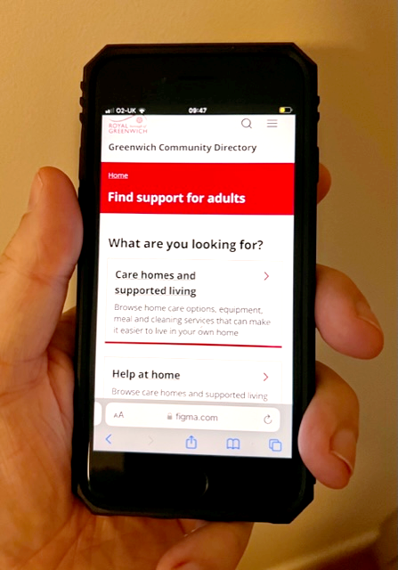
Testing our prototypes
Forwarding curated listings via text/email
Emphasized the need for telephone helpline to support people less confident with IT
More imagery needed?​
Need to promote the directory to ensure it's used across the community ​
Value of local services for signposting ​
Recruited participants in-depth testing including dedicated testing with Livewell Line coaches​
Notes:
Jenny
And we have a mission statement, that summarises what we want to achieve.
We want to design a reusable community directory product that:
makes local information, advice and services more accessible, intuitive and easy to navigate for residents
creates a more sustainable and devolved way to publish and update content for all organisations and service providers involved
This project is also part-funded by the Local Digital Fund, so that the product we create at Greenwich can be reused by other local authorities too.

Slide 16
Testing with residents
Tree testing
What it is: an online task to find information using our category and subcategory labels
Who we're testing with: Community Champions, residents from a dementia event
Why: to see if information is found in the places residents expect
Notes:
Alysia

Slide 17
Testing with residents
Prototype testing
What it is: in person interview and task to complete using our prototypes
Who we're testing with: Community champions, carers, community grants project group
Why: to test the assumptions we have about our prototypes
Notes:
Alysia

Slide 18
Assumptions we're testing with residents
Riskiest
About the proposition
People understand what the directory is, what is on it and what they can do there
People don't expect any additional information, advice and guidance.
Helping people navigate and find services
Curated and topical listings will help people find relevant services
The user type landing page makes it easier for people to find things
Information& design
There is a right level of content for people on each service listing
Tags on service listings make it easier for people to scan, find and understand what each service is
Notes:
Alysia

Slide 19
Groups we're testing with
Adult and carer groups
Children & family groups
Local Offer groups
Adult and carer groups we're testing with now
Community champions
Vision into Action group
Residents recruited from a dementia week event in the library
Carers
Community Innovations Grants project group
Professionals recruited from primary care event
Who else should we speak to?
Tell us in the chat or email us
Notes:
Alysia

Slide 20
Who else should we test with
We’re still looking for participants to test with.
Are there resident groups we haven't mentioned that you think we should speak to?
Comment in the chat or raise your hand
Notes:
We're really keen for this to be a dialogue, so please let us know in the chat as we go, about :
😍 Things you liked
🧐 Things you’d like to hear more about
🤔 Things that surprised you and questions you have

Slide 21
Creating a proof of concept
Notes:
Alex
Before we get into the detail, I just want to refresh on who we are and what we’re trying to achieve.

Slide 22
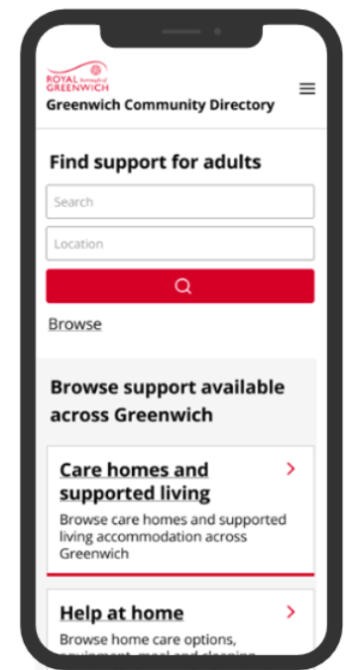
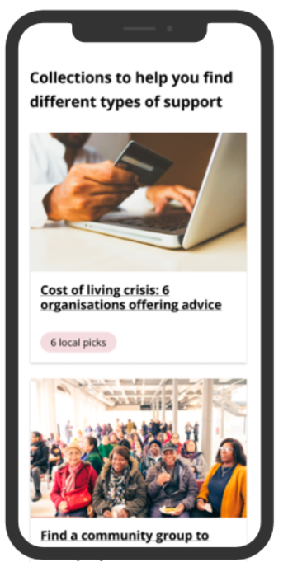
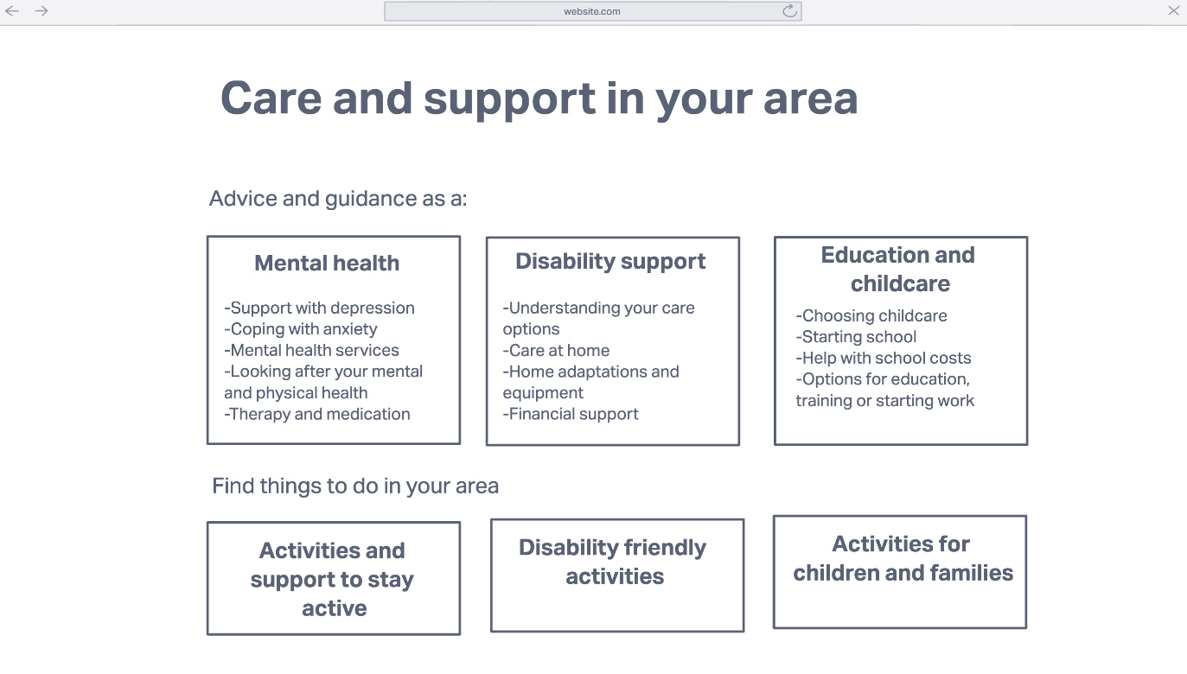
Our journey through Alpha
TBC
Initial experiments
Early prototypes
Iterated prototypes
Proof of concept
Trying out different ways to solve the problems we found in Discovery
Bringing together what worked well into initial designs for a new directory
Bringing the designs to life by focusing on ‘support for Adults’
Ensuring the directory we’ve designed is technically feasible
Notes:
Journey through Alpha, why are we creating a proof of concept?
What is a proof of concept?
What’s the scope? What are we building?

Slide 23
A proof of concept:
helps us identify potential technical or logistical issues
uses ‘real tech’
is usually quite small
is not a finished product
A proof of concept is a realisation of a certain idea in order to demonstrate feasibility
Notes:
Journey through Alpha, why are we creating a proof of concept?
What is a proof of concept?
What’s the scope? What are we building?

Slide 24
What we want to learn about with our proof of concept
We’ve prioritised the following areas:
Categorisation and filtering Does this work in the same way as we’ve designed it in our prototypes?
Topical listings and curated listings How would we create these?
Content maintenance for RBG staff How can we make it easy for RBG staff to maintain content that doesn’t belong in Outpost (e.g. the GCD homepage or landing pages)?
Notes:
Journey through Alpha, why are we creating a proof of concept?
What is a proof of concept?
What’s the scope? What are we building?

Slide 25
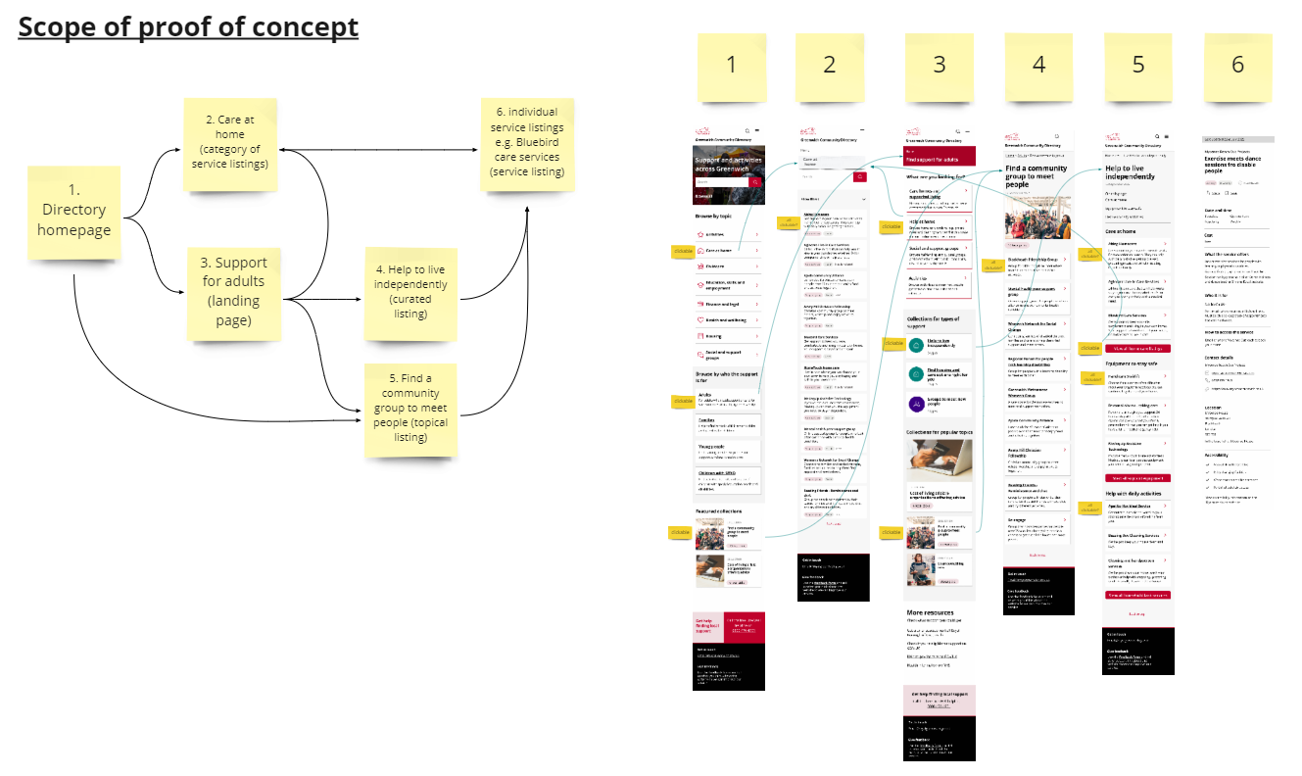
How we’re approaching it
1. Taking a slimmed down version of our prototype
2. Building it using our preferred technology
3. Testing within the team and with RBG staff:
Adults
Public Health
Families Information Service
SEND Local Offer
Notes:
Journey through Alpha, why are we creating a proof of concept?
What is a proof of concept?
What’s the scope? What are we building?

Slide 26
What questions do you have?
Would you like us to explain anything in more detail?
Is there anything else you think we should learn about with our proof of concept?
Notes:
Journey through Alpha, why are we creating a proof of concept?
What is a proof of concept?
What’s the scope? What are we building?

Slide 27
Holding a show & tell on the reusable product
Notes:
Alex
Before we get into the detail, I just want to refresh on who we are and what we’re trying to achieve.

Slide 28
We held our first show & tell for other local authorities
We talked about:
What the product is
How we’re making it easy to re-use
How other local authorities can get involved
We’re now speaking with 13 other local authorities who are interested in getting involved!
Notes:
Jenny
And we have a mission statement, that summarises what we want to achieve.
We want to design a reusable community directory product that:
makes local information, advice and services more accessible, intuitive and easy to navigate for residents
creates a more sustainable and devolved way to publish and update content for all organisations and service providers involved
This project is also part-funded by the Local Digital Fund, so that the product we create at Greenwich can be reused by other local authorities too.

Slide 29
Next steps
Notes:
Alex
Before we get into the detail, I just want to refresh on who we are and what we’re trying to achieve.

Slide 30
Over the next 4 weeks, we plan to:
complete our research with residents and synthesise our findings
build our proof of concept and review our learning goals
plan our Beta phase for building the new GCD
Notes:
Journey through Alpha, why are we creating a proof of concept?
What is a proof of concept?
What’s the scope? What are we building?

Slide 31
How to stay in touch and where to find out more...
Read our weeknotes – these are sent to all Show & Tell attendees every Friday
Come to our future Show & Tell events
Send us an email or a message on Microsoft Teams:
Bethany.Mindham@royalgreenwich.gov.uk
Alex.Sturtivant@royalgreenwich.gov.uk
To learn about the early stages of the project, read weeknotes 1-7 or watch the team present in our first Show & Tell event. If you’re external, please visit our GCD project webpage.

Slide 32
Thank you for coming. Are there any questions?

