Slide 1

Rebuilding Greenwich’s
Community Directory
Show & Tell #10
13/09/2022
Please note this Show & Tell will be recorded
Notes:
[press record]
Hi everyone, and welcome to today’s show and tell for the Greenwich Community Directory project on the 13th of September
Please note that this show and tell is being recorded, so if you don’t want to appear on the recording, feel free to turn your camera off.

Slide 2

What is a Show & Tell?
A regular event where we...
Get feedback from everyone, to shape what we do next
(not just those involved in the day to day work)
Make connections with other work and knowledge
Show progress early and often
Notes:
Alex
I think most people here have been to one of our show and tells before, but if you haven’t, a show and tell is an event where:
We show our progress early and often. We don’t want to hide our work away, we want to make sure everyone is really clear on what we’re doing and where we’re heading.
It’s a chance for us to get feedback from everyone, to shape what we do next. We want to hear what’s important to you, and be steered by your ideas.
And it’s a place for us to make connections with other work that’s going on, both within the council and with other councils and organisations.

Slide 3
Today’s Show & Tell
We will cover:
Prototypes we’re currently working on
Our thoughts and reflections on the process
How we plan to measure success of the new directory
So that you:
Have a sense of how we're putting learnings and reflections into practice as we go
See some of our work in progress and have an opportunity to tell us what you think!
Notes:
Alex
In today’s show and tell, we’re going to show you the prototypes we’re currently working on, as well as bit of information about the process of prototyping and how that’s worked for us.
And we’re also going to talk about how we plan to measure the success of the new directory too.
We hope that you’ll get a good sense of how we’re putting our learnings and reflections into practice as we go, and also take the opportunity to tell us your thoughts about what we’re working on.

Slide 4
Our team + mission
Notes:
Alex
Before we get into the detail, I just want to refresh on who we are and what we’re trying to achieve.

Slide 5
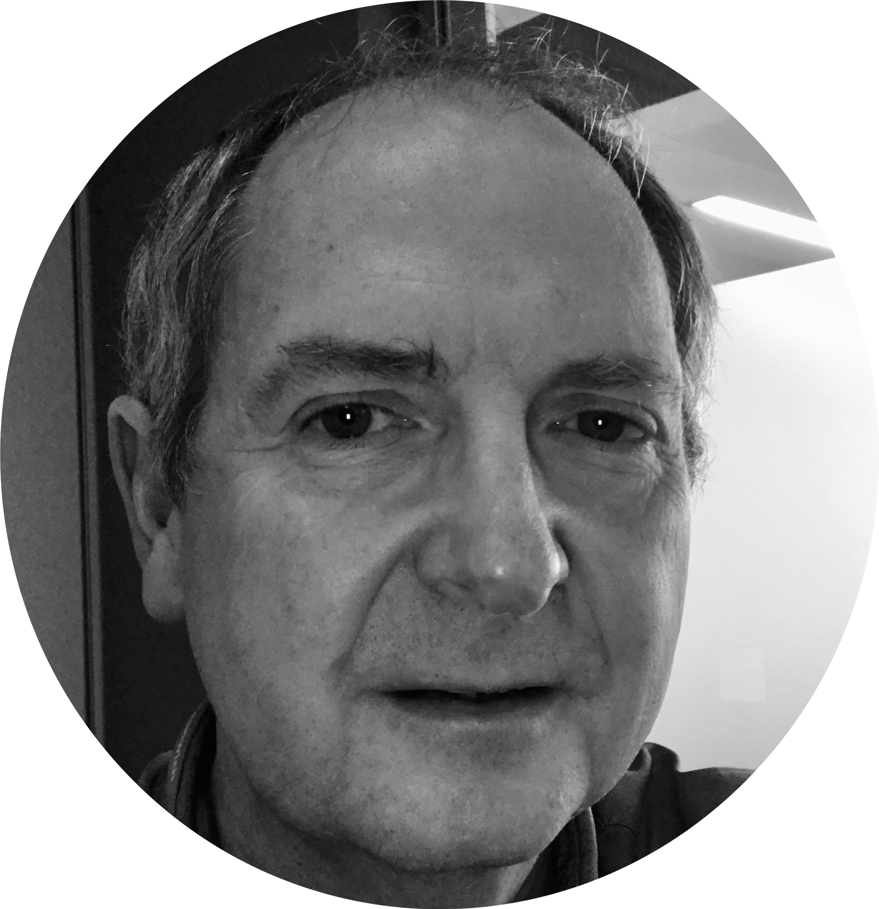
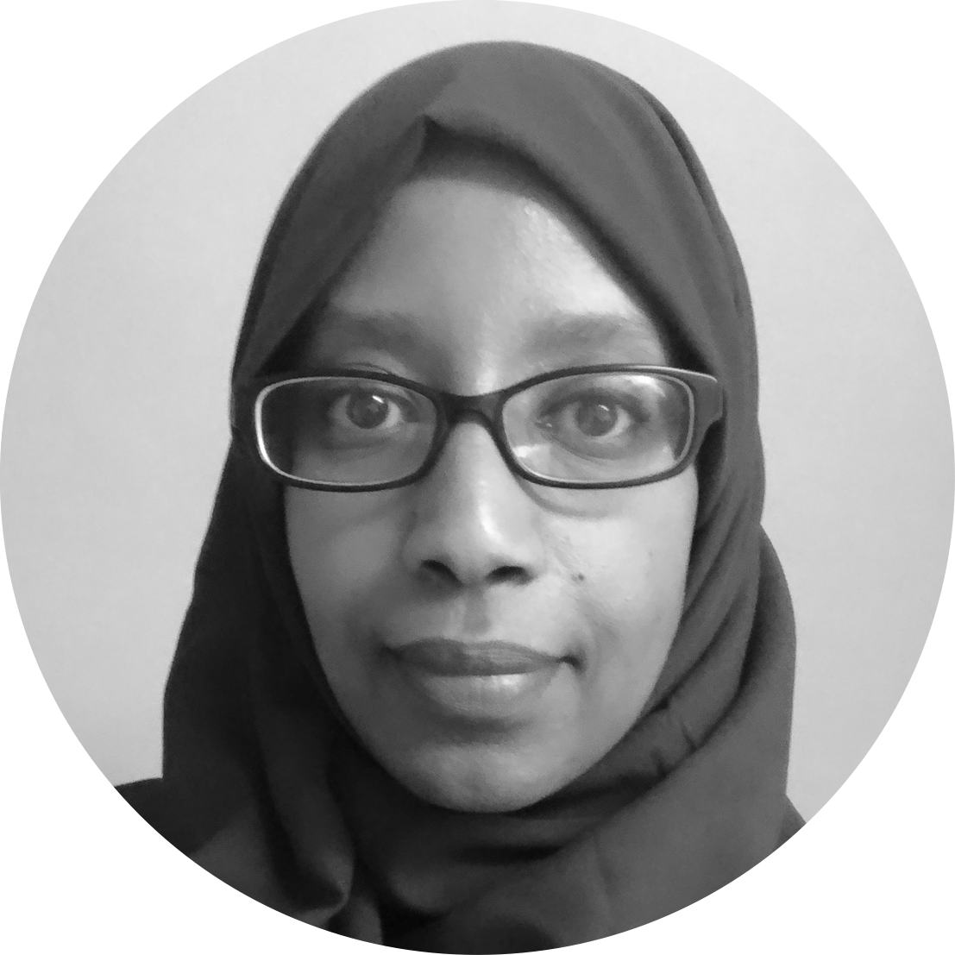
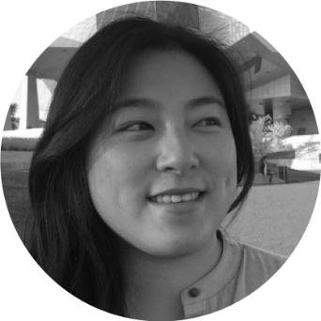


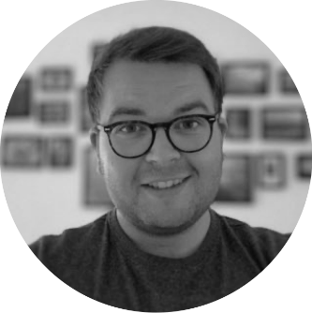
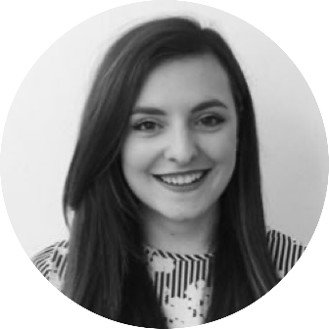


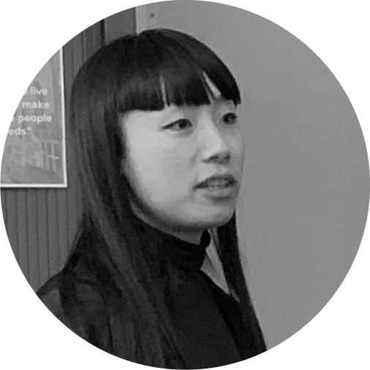
A blended team from across the council
Steve Ollier
Principal Performance Officer
Health & Adult Services
Hibak Yusuf
FIS Team Leader
Children Services
Jenny Thai
Senior Product Designer
Digital and Customer Services
Lizzie Cullen Davison
Software Developer
TPX Impact
Hannah Nicholas
Software Developer
TPX Impact
Alex Sturtivant
Product Manager
Digital and Customer Services
Beth Mindham
Senior Delivery Manager
Digital and Customer Services
Alysia-Marie Annett
Senior Content Designer
Digital and Customer Services
Paul Murray
Principal Product Manager
TPX Impact
Lingjing Yin
Head of Product
Digital and Customer Services
Notes:
Alex
We’re a blended team from across the council, made up of colleagues from Adults, Childrens, Digital and from our product partner TPX Impact.
We also meet weekly with our collaborators – a mix of colleagues from Public Health, Childrens and Digital. We work with them to get regular critique and feedback on our work.

Slide 6

Our mission
To design a reusable community directory product that:
makes local information, advice and services more accessible, intuitive and easy to navigate for residents
creates a more sustainable and devolved way to publish and update content for all organisations and service providers involved
Notes:
Alex
And we have a mission statement, that summarises what we want to achieve.
We want to design a reusable community directory product that:
makes local information, advice and services more accessible, intuitive and easy to navigate for residents
creates a more sustainable and devolved way to publish and update content for all organisations and service providers involved
This project is also part-funded by the Local Digital Fund, so that the product we create at Greenwich can be reused by other local authorities too.

Slide 7
Prototyping the new directory
Notes:
Alex
So, that’s all the context we need to cover, so to kick us off, I’m going to hand over to Jenny who’s going to talk to you about our current prototypes

Slide 8
What we’re prototyping and why
Prototyping the Adults section
We chose to prototype Adults services for the directory because it is content we are more familiar with and ties into the Adult Social Care work that is currently happening.
Prototyping in detail and across a journey
Exploring more detailed designs using real content
Building on content types and designs we prototyped before
Focusing on a users journey and experience end to end from home page to finding services
Things are still in progress and not finalised
We might need to check in/involve comms –we are still exploring visual design
Nothing has been tested with residents just yet
Notes:
Explain that we’re prototyping the Adults section
Adults is one of the sections that came out of our card sorting
Starting with a section with content we’re more familiar with and ties into the ASC work
This work has been built on the content types we prototyped before
With more of a focus on the journey and the experience for the user
A bit of disclaimer about needing to work with comms on branding and that nothing has been tested with residents yet – anything can still change

Slide 9
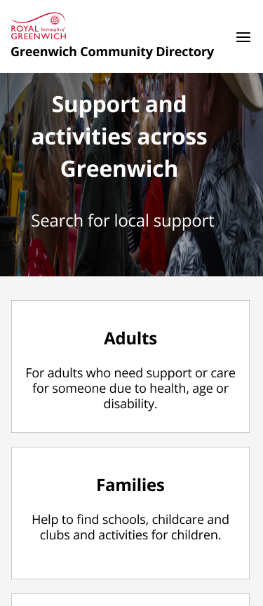
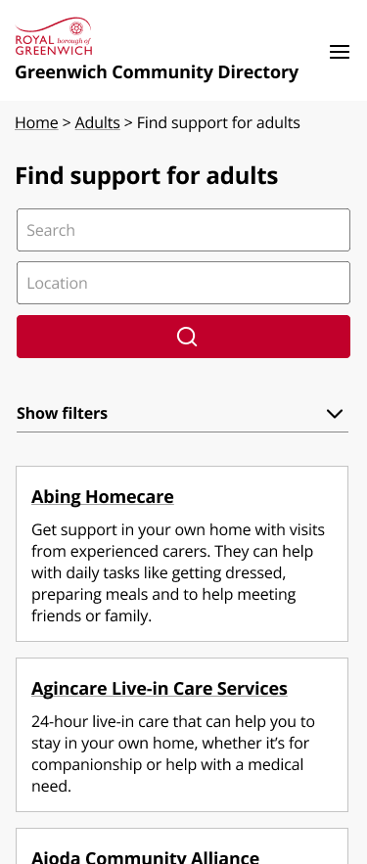
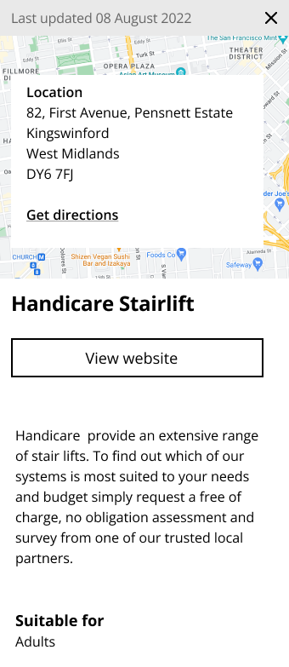
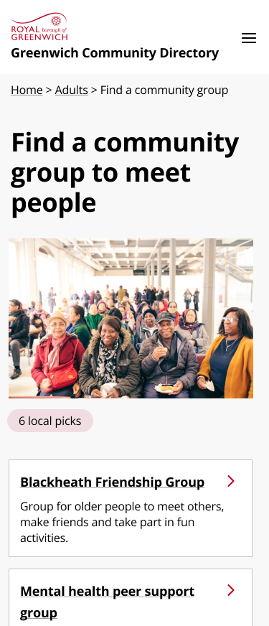
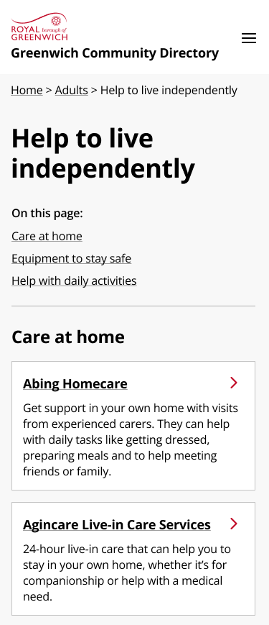
Prototyping a section – iteration 1
Home
Landing page for adults section
With categories and ways to navigate to topics/service types
Service listing page for all services/search
Single service listing page
Topical & curated listing pages
List of services and subset of services around specific topics or service areas/needs
Notes:
(not many slides needed for this section)
Show designs on the landing page (and how we went from card sorting to the landing page)
Show the adults journey, e.g. landing page, service listings, topical listings
Showing the prototypes in: Figma; more detail/longer

Slide 10
Our current prototype
Notes:
(not many slides needed for this section)
Show designs on the landing page (and how we went from card sorting to the landing page)
Show the adults journey, e.g. landing page, service listings, topical listings
Showing the prototypes in: Figma; more detail/longer

Slide 11
Tell us your thoughts
What do you think of the prototype/designs?
Anything that stood out to you?
Notes:
Show designs on the landing page (and how we went from card sorting to the landing page)
Show the adults journey, e.g. landing page, service listings, topical listings
Showing the prototypes in: Figma; more detail/longer

Slide 12
Reflections on the prototyping process

Slide 13
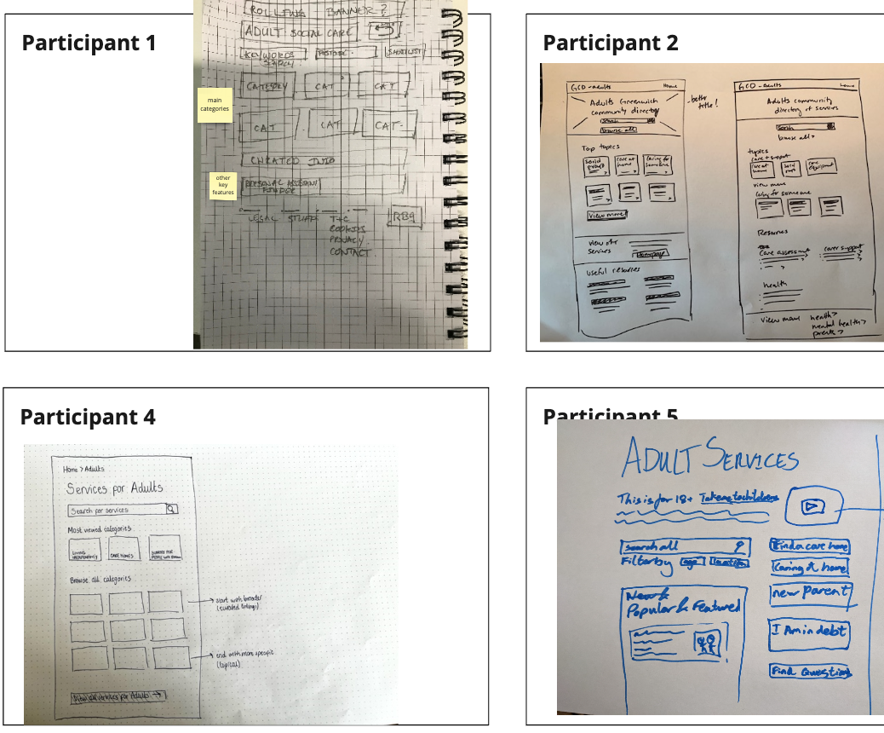
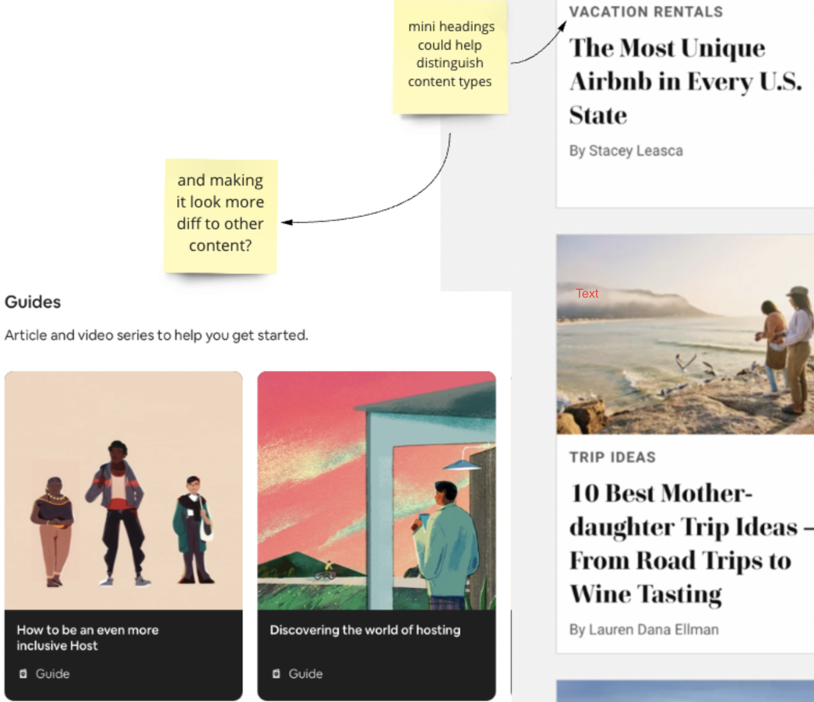
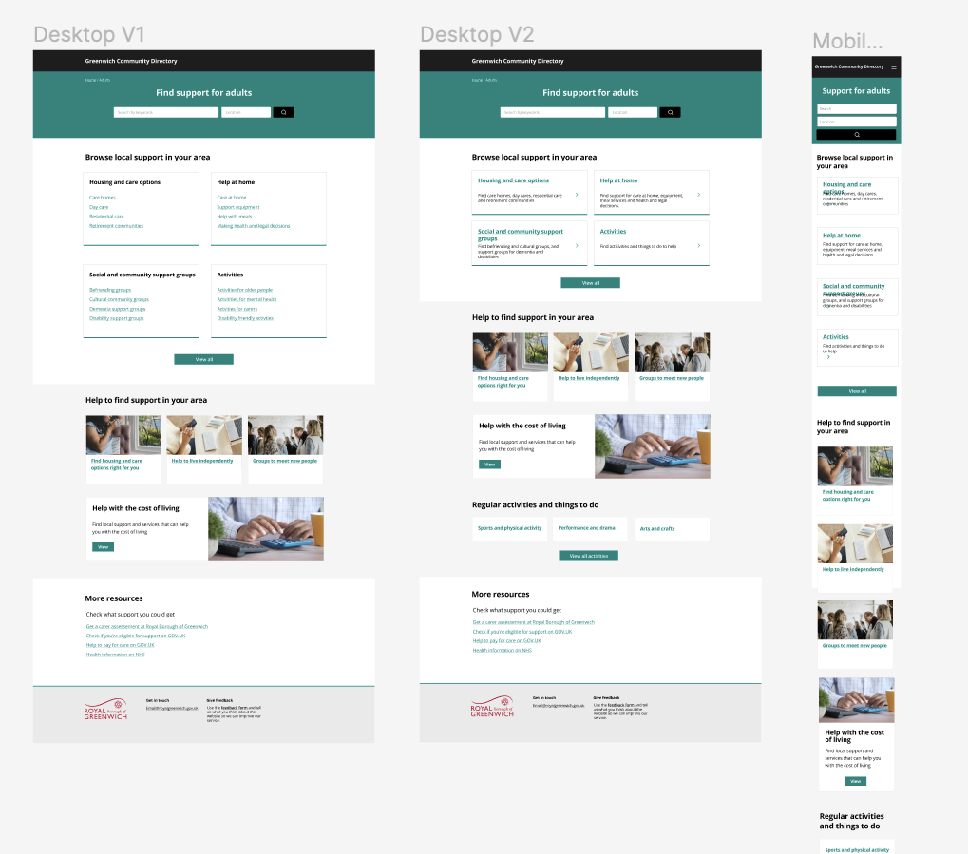
The prototyping process
Sketching our ideas
Finding inspiration
Prototyping
Notes:
(not many slides needed for this section)
Show designs on the landing page (and how we went from card sorting to the landing page)
Show the adults journey, e.g. landing page, service listings, topical listings
Showing the prototypes in: Figma; more detail/longer

Slide 14
Iterating our prototypes
This is old RBG branding/ colours
To be decided with comms
language and design elements that hints at the type of content
Will people think this is info/advice?
How do we differentiate content types?
Notes:
(not many slides needed for this section)
Show designs on the landing page (and how we went from card sorting to the landing page)
Show the adults journey, e.g. landing page, service listings, topical listings
Showing the prototypes in: Figma; more detail/longer

Slide 15
Questions that have come up during prototyping
How do we make navigation clear between content types?
Should we be treating activities and service listings differently?
What are our branding requirements? What imagery should we use and is this easy to maintain?
How can we make use of functionality and tech to make it easier to maintain content?
Does navigating by user type exclude overlapping content?
Notes:
- Ask for questions before we move on

Slide 16
Measuring our success with KPIs

Slide 17
Taking an outcome-led approach
An outcome-led approach is where we measure our success by the impact of our work as opposed to the ‘thing’ we deliver
For the GCD, we’ve defined a set of outcomes we want to achieve, based on the problems we found during our discovery phase
For each outcome we’ve identified a set of key performance indicators (KPIs) – these are what we will track to understand whether we’re achieving our desired outcomes
We want to share these with you so you can understand how we’re defining success for the new directory
Notes:
Why are we doing this? (to measure success)
How are we going to do it

Slide 18



The outcomes we want to achieve
For residents
For referrers
Online information
For service providers
For RBG staff
Make it easier to find local services which will have a positive impact on their lives
Make it easier to find local services for people they’re working with
Increase the accuracy and relevancy of public-facing information about local services in Greenwich
Minimize the effort required to publish up-to-date information about their service
Minimize the effort required to quality control and maintain information about local services
Notes:
Visualise connection between problems and outcomes

Slide 19
What we plan to measure
Outcome 1: Make it easier for residents to find local services which will have a positive impact on their lives
% of residents who tell us they found what they were looking for on the GCD
*
Monthly Survey
Hotjar
% of residents who tell us they found support on the GCD which had a positive impact on them
*
Monthly Survey
Hotjar
Notes:
(not many slides needed for this section)
Show designs on the landing page (and how we went from card sorting to the landing page)
Show the adults journey, e.g. landing page, service listings, topical listings
Showing the prototypes in: Figma; more detail/longer

Slide 20
What we plan to measure
Outcome 2: Make it easier for referrers to find local services which will have a positive impact on the life of someone they're working with
Referrers score of 'ease of finding what you needed on the GCD'
*
Monthly Survey
Hotjar
% of referrers who tell us they found support on the GCD which had a positive impact
*
Monthly Survey
Hotjar
Notes:
(not many slides needed for this section)
Show designs on the landing page (and how we went from card sorting to the landing page)
Show the adults journey, e.g. landing page, service listings, topical listings
Showing the prototypes in: Figma; more detail/longer

Slide 21
What we plan to measure
Outcome 3: Increase the accuracy and relevancy of public-facing information about local services in Greenwich
% of listings that have been updated within the last 6 months
*
Monthly Survey
Data from product
% of listings which include out of date information
*
Monthly Survey
Data from product
Notes:
(not many slides needed for this section)
Show designs on the landing page (and how we went from card sorting to the landing page)
Show the adults journey, e.g. landing page, service listings, topical listings
Showing the prototypes in: Figma; more detail/longer

Slide 22
What we plan to measure
Outcome 4: Minimize the effort required by Local Service Providers to publish up-to-date, relevant information about their services, so they can connect with their targeted audiences faster
Service Provider's score 'ease of maintaining content on GCD'
*
Ad hoc
Interview /Survey
Time spent by Service Providers adding and maintaining content on the GCD
*
Ad hoc
Interview/ Survey
Notes:
(not many slides needed for this section)
Show designs on the landing page (and how we went from card sorting to the landing page)
Show the adults journey, e.g. landing page, service listings, topical listings
Showing the prototypes in: Figma; more detail/longer

Slide 23
What we plan to measure
Outcome 5: Minimize the effort required by RBG staff to quality control and maintain information about local services
RBG staff score 'ease of maintaining content on GCD'
*
Ad hoc
Interview /Survey
Time spent by RBG staff adding and maintaining content on the GCD
*
Ad hoc
Interview/ Survey
Notes:
(not many slides needed for this section)
Show designs on the landing page (and how we went from card sorting to the landing page)
Show the adults journey, e.g. landing page, service listings, topical listings
Showing the prototypes in: Figma; more detail/longer

Slide 24
Over to you
What do you think is the most important KPI for us to measure?
Do you think there’s anything else we should be measuring?
Notes:
(not many slides needed for this section)
Show designs on the landing page (and how we went from card sorting to the landing page)
Show the adults journey, e.g. landing page, service listings, topical listings
Showing the prototypes in: Figma; more detail/longer

Slide 25
Next steps
Notes:
Beth or Alex
Today we're going to be showing you the work we're doing to test out solutions to the biggest problems we learned about in Discovery.

Slide 26
Over the next 4 weeks, we plan to:
Test our prototypes with residents, RBG staff and Primary Care staff
Iterate our prototypes for the Adults section
Build working prototypes using the technology we plan to use for the new directory
Continue to collect KPI data and work on our plan for the GCD Beta
We’re also starting an additional series of show and tell events, focused on the reusable product for the local gov sector, on Weds 28 September.
Notes:
Over the next 4 weeks, we plan to:
Test our prototypes with residents, Greenwich staff and primary care staff – we have a couple of events coming up where we’ll be doing that
We’ll then be taking that feedback and iterating our prototypes further which will help us get closer to defining an experience we’re happy with
We plan to build some working prototypes using the tech we want to use. This to help us understand some of the technical unknowns we currently have
And finally we have some more work to do collecting KPI data and defining our plan for the Beta phase of the Greenwich Community Directory
One final note – we’re also starting an additional series of show and tell events, focused on the reusable product we’re building for the local gov sector on Wednesday 28th September. These will be an opportunity for other local authorities to understand more about what we’re building and how you’ll be able to get involved in the development of the product and reuse it at your council. It’s still open to anyone, so let us know if you don’t have an invite but would like one

Slide 27
How to stay in touch and where to find out more...
1. Read our weeknotes – these are sent to all Show & Tell attendees every Friday
2. Come to our future Show & Tell events
3. Send us an email or a message on Microsoft Teams:
  Bethany.Mindham@royalgreenwich.gov.uk
  Alex.Sturtivant@royalgreenwich.gov.uk
If you'd learn about the early stages of the project, read weeknotes 1-7 or watch the team present in their first Show & Tell event or look at the slides here. If you are external, please visit our GCD project webpage here.

Slide 28
Thank you for coming.
Are there any questions?

Slide 29
Rebuilding Greenwich’s
Community Directory
Come help us test our new directory of health and care services
Notes:
[press record]
Hi everyone, and welcome to today’s show and tell for the Greenwich Community Directory project on the 13th of September
Please note that this show and tell is being recorded, so if you don’t want to appear on the recording, feel free to turn your camera off.

