Slide 1
Rebuilding Greenwich’s
Community Directory
Show & Tell #8
19/07/2022
Please note this Show & Tell will be recorded
Notes:
Beth slides 1-8

Slide 2
What is a Show & Tell?
A regular event where we...
Get feedback from everyone, to shape what we do next
(not just those involved in the day to day work)
Make connections with other work and knowledge
Show progress early and often
Notes:
It’s a way to share learning from a project as you go. Often, change programmes or technology projects will do all the work, and then tell everyone only when the change is about to go live
This is different – it's about sharing the analysis, thinking and learnings continuously.
First one today will be a bit different – setting the scene and introducing the work, with only a little bit about our findings.
you can expect:
Us to show our progress – what have we been doing, and what have we learned?
To have a chance to influence the work. We want to hear what's important to you, and what we’ve missed
To be able to draw links to other projects or initiatives that we might not know about

Slide 3
Today’s Show & Tell
We will cover:
Our results from testing since our last Show & Tell
Some of our current thinking and design ideas for a new GCD
So that you:
Have a sense of how we're putting learnings and reflections into practice as we go
See some of our work in progress and have an opportunity to us what you think!

Slide 4
What we're not covering today
Detailed context behind our work
An in-depth update or explanation of everything we’ve done since our last Show & Tell
If you want to learn more about the context of this work you can read weeknotes 1-7 covering the early stages of the project, watch the team present in their first Show &Tell event or look at the slides here.

Slide 5
Our team + mission

Slide 6
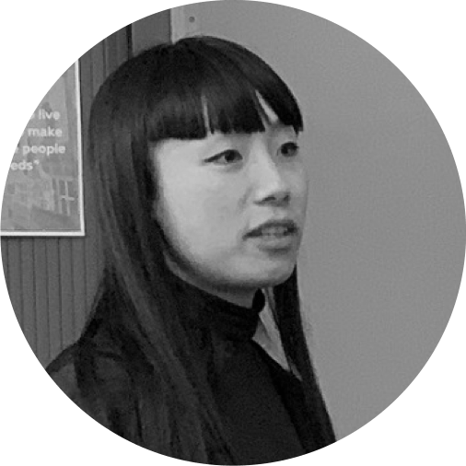
A blended team from across the council
Steve Ollier
Principal Performance Officer Health & Adult Services
Rebecca Layng
Programme Manager
Health & Adult Services
Alexia Fergus
Senior Manager
Health & Adult Services
Hibak Yusuf
Early Help Team Leader
Children Services
Lizzie Cullen Davison
Software Developer
TPX Impact
Lingjing Yin
Head of Product
Digital and Customer Services
Alex Sturtivant
Product Manager
Digital and Customer Services
Beth Mindham
Delivery Manager
Digital and Customer Services
Alysia-Marie Annett
Senior Content Designer
Digital and Customer Services
Connie Wroe
User Researcher
Digital and Customer Services
Yu Hsuan
Service Designer
Digital and Customer Services
Jenny Thai
Senior Product Designer
Digital and Customer Services

Slide 7
Our mission
To design a reusable community directory product that:
makes local information, advice and services more accessible, intuitive and easy to navigate for residents
creates a more sustainable and devolved way to publish and update content for all organisations and service providers involved

Slide 8
Results from prototype testing
Notes:
Sharon
Today we're going to be showing you the work we're doing to test out solutions to the biggest problems we learned about in Discovery.

Slide 9
Test with service providers
How might we keep content up to date and increase trust with users?
▶︎ Idea 1: Make service listings easily shareable on other channels
Service providers have set up teams to share information and maintain the content across platforms
▶︎ Idea 2: Nudge service providers to keep content up to date
The nudge by itself is not compelling enough. We need to change their perception on the GCD - it's a platform their audience are using
We learned that the problem would be solved by making GCD easy to use
Notes:
So first just to give you a quick recap on our testing with the service providers,
We know that to keep the content up to date on GCD, we have to first encourage service providers to use GCD more often,
We focused on how to Incentivise local service providers by making it easy to share listings to different channels (online social media, websites and offline, e.g. printed).
Use social norms as different nudges to encourage service providers to update their listings.
However, from the testing, we realise that
Making the process easier and simpler to share their service and nudging them to update contents are the later solutions. Service providers would only use GCD if they know it’s a platform their audience are using.
We have to first make a good GCD that helps people to find information so more people are aware of this platform can connect them to the local support. As a result, we change our focus to– How might we make information easier to navigate on the directory?

Slide 10
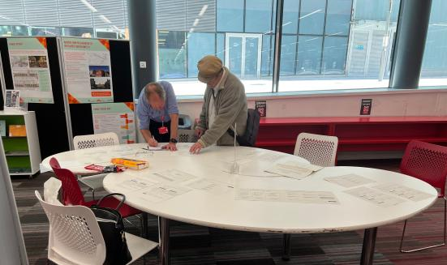
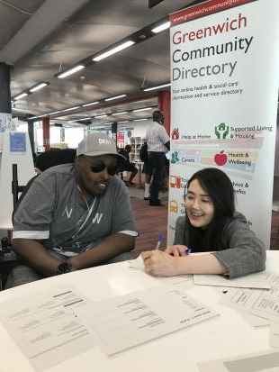
Test with referrers and residents
We have tested with 5 referrers
and 25 residents.
Notes:
So we brought our ideas in front of the 5 referrers and 25 residents at the children centre, library, and carer centre to ask their honest feedback on these prototypes, what they are thinking when navigating on the website

Slide 11
Test with referrers and residents
How might we make information easier to navigate on the directory?
▶︎ Idea 1: Categorising content by user type or need will show users where to go and what is available on this website
▶︎ Idea 2: Curated content will help residents find information and services that are relevant to them
▶︎ Idea 3: Curated groups of listings - categorising services into different sections would be easier for residents to browse through
Notes:
These are the 3 main ideas we were testing with residents and referrers
And now I’m going to dive into each idea and run through what we have learned from the testing

Slide 12
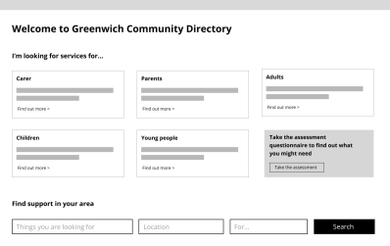
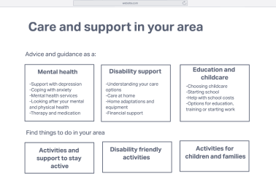
Test with referrers and residents
By user
How might we make information easier to navigate on the directory?
▶︎ Idea 1: Categorising content by user type or need will show users where to go and what is available on this website
By topic
Notes:
The first idea we were testing is Categorising content by user type or need will show users where to go and what is available on this website
as we believe that it provides a clear overview of GCD, which will help residents and referrers know what's available and where to go.
On the right hand side

Slide 13
Test with referrers and residents
▶︎ Idea 1: Categorising content by user type or need will show users where to go and what is available on this website
What we learned2
Categorisation is not hugely important for referrers as they usually use search function.
Residents have different preference on navigation, it depends on if they have specific needs
What does it mean
Make the search function prominent
Have different categorisations that directs to different navigation routes
Ability to go straight to the service listing is important for people who know what they want
Notes:
Categorisation is not hugely important for referrers as they usually use search function.
For the residents, they have different preference on navigation, it depends on if they have specific needs. If they know what they are looking for, navigation by topic can capture their eyes and direct them to the solution. While if they are unsure what to look for, starting from the user group can help them explore more.
What does it mean
Make the search function prominent so the referrers can straightly use it to search specific things
Keeping different categorisations is important, for residents who have specific needs and who don’t, can follow different navigation routes to find things they want to know
Ability to go straight to the service listing is important for the users to find the particular solution to their request

Slide 14
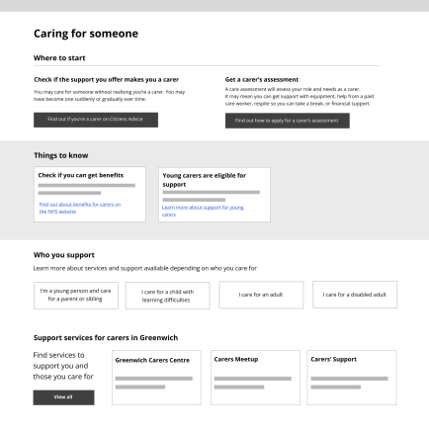
Test with referrers and residents
Curated content for carer
How might we make information easier to navigate on the directory?
▶︎ Idea 2: Curated content will help residents find information and services that are relevant to them
Notes:
The 2nd idea is curating content by life events and needs will help residents quickly and easily find relevant information and services by themselves
As we know that life events (having a baby, the loved one just got diagnosed with illness) are often the trigger points for residents to look for things. There are lots of information and services out there and it is hard for residents to know where to start and find things for them easily.
The screenshot is an example of the curated content for a person who just became a carer and this page can prepare them to the new situation by showing

Slide 15
Test with referrers and residents
▶︎ Idea 2: Curated content will help residents find information and services that are relevant to them
What we learned2
Curated content can be a powerful tool for residents to self-serve
Referrers can directly signpost residents to this page for further exploration
Having information, advice, and service in one place doesn’t strictly mean to one platform, but simply links in a right way at the right time
What does it mean
We can use the curated content to signpost residents to the platforms that already hold the information to avoid the content duplication
Notes:
Curated content can be a powerful tool for residents to self-serve , especially when they don’t know what they need and for the referrers they find the page useful as they can directly signpost residents to this page for further exploration
More importantly. For residents, Having information, advice, and service in one place doesn’t strictly mean in one platform, but simply signpost resident to the information in a right way at the right time, which means that GCD doesn’t have to hold all the information and advice itself.
It also means that We can use the curated content to signpost residents to the platforms that already hold the information to avoid the content duplication across Greenwich Council website, Gov.uk website, NHS, and Live well

Slide 16
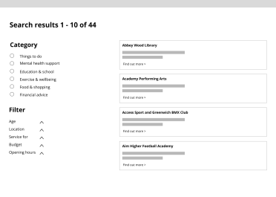
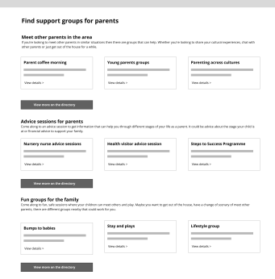
Test with referrers and residents
List
How might we make information easier to navigate on the directory?
▶︎ Idea 3: Curated groups of listings - categorising services into different sections would be easier for residents to browse through.
Curated
Notes:
categorising results into different sections as we think it would be easier for residents to browse the results.
We believe it is true because residents told us they are often overwhelmed by the search results in the first glance and have to check it one by one.
On the right hand side
- A traditional way to go through a list of results with the filters
- A curated listing – on the page we break down a broad topic into more specific bits of information.

Slide 17
Test with referrers and residents
▶︎ Idea 3: Curated groups of listings - categorising services into different sections would be easier for residents to browse through.
What we learned2
Listings are a useful end point, however, residents and referrers sometimes feel overwhelmed by a list of results
Browsing services are categorised under different topics can give residents a clear overview of available support
What does it mean
We can use the curated listings as a page comes before the whole service listings
Notes:
From the testing, we know that Residents are familiar with browsing the contents on a list but they do find the curated listing less intimidating and can Help them better understand the different types of support available in the community, so they know where to go to without clicking on each listing.
From this, we understand this is a useful page to come before the whole listing, so we don’t overwhelm the users

Slide 18
Over to you
What surprises you?
What do you find interesting?
What do you want to know more about?
Are there any questions?

Slide 19
Ideas for a new GCD based on what worked well in testing
Notes:
Alex
Today we're going to be showing you the work we're doing to test out solutions to the biggest problems we learned about in Discovery.

Slide 20
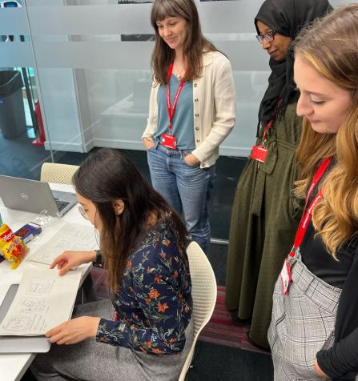
A team day to get into the detail
We booked out a whole day to:
discuss our findings from testing prototypes
sketch out new user journeys
compare our ideas
figure out what we still needed to test

Slide 21
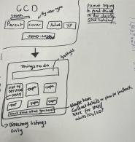
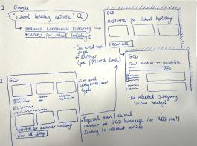
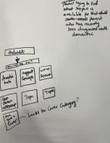
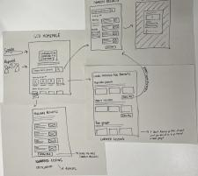
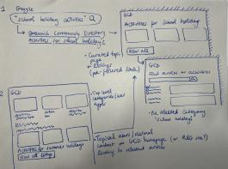
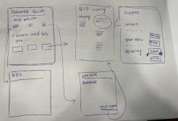
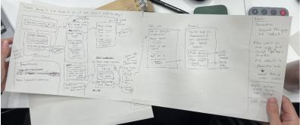
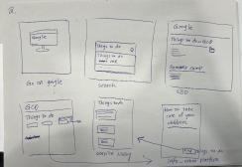
We sketched what we imagined the future user journey would be

Slide 22
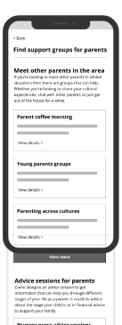
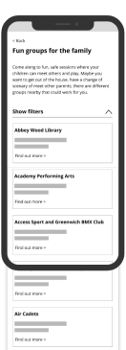
We combined our thinking to create new prototypes
6 content types from our sketches:
GCD homepage
All service listings
Single service listing
Curated groups of listings
Topical listings
Curated guides
Curated groups of listings
Topical listings

Slide 23
Over to you
What surprises you?
What do you find interesting?
What do you want to know more about?
Are there any questions?

Slide 24
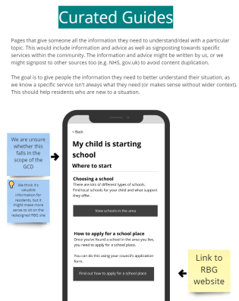
We’re unsure about one of our content types
We want to understand the extent of information and advice to include on the Greenwich Community Directory
What information is needed to help people find a service on the GCD?
What information already exists in other places such as the RBG website, LiveWell, NHS, or gov.uk?
Where would residents expect to find the information?

Slide 25
Figuring out what information should sit on the GCD - interactive activity
S&T 8 slido link
Notes:
Alysia, Alex and Beth
Today we're going to be showing you the work we're doing to test out solutions to the biggest problems we learned about in Discovery.

Slide 26
Next steps
Notes:
Beth or Alex
Today we're going to be showing you the work we're doing to test out solutions to the biggest problems we learned about in Discovery.

Slide 27
Over the next 4 weeks, we will:
Test out a new Information Architecture (IA) for the GCD
Use the new IA to pick a small ‘slice’ of the GCD to prototype in detail – using the prototypes we showed you today as our starting point
Use the next round of prototyping to better understand where additional information and advice should sit
Set up separate show & tells to go into the detail of the reusable element of this project – let us know if you’d like an invite!

Slide 28
How to stay in touch...
Read our weeknotes – these are sent to all Show & Tell attendees every Friday
Come to our future Show & Tell events: GCD Show&Tell feedback form
Send us an email or a message on Microsoft Teams:
Bethany.Mindham@royalgreenwich.gov.uk
Alex.Sturtivant@royalgreenwich.gov.uk

Slide 29
Thank you for coming. Any questions?

