Slide 1
Rebuilding Greenwich’s
Community Directory
Show & Tell #4
29/03/2022
Please note this Show & Tell will be recorded
Notes:
Beth slides 1-8

Slide 2
Before we go any further let’s answer the question:
What is a Show and Tell?
Notes:
Before we get into it, it’s worth saying a bit about what a ‘show and tell’ is for.

Slide 3
A Show & Tell is a regular event where...
You "tell”
Tell us what you think:
Things we may have missed
Offer knowledge we may not have
Support areas we are struggling with
We "show”
Share approach and rationale
Demo ongoing work
Share insights gathered

Slide 4
Why do we do them?
Get feedback from everyone, to shape what we do next
(not just those involved in the day to day work)
Make connections with other work and knowledge
Show progress early and often
Notes:
It’s a way to share learning from a project as you go. Often, change programmes or technology projects will do all the work, and then tell everyone only when the change is about to go live
This is different – it's about sharing the analysis, thinking and learnings continuously.
First one today will be a bit different – setting the scene and introducing the work, with only a little bit about our findings.
you can expect:
Us to show our progress – what have we been doing, and what have we learned?
To have a chance to influence the work. We want to hear what's important to you, and what we’ve missed
To be able to draw links to other projects or initiatives that we might not know about

Slide 5
Today we want to cover:
The approach we're taking for the rest of our Discovery phase and how we came to that decision
User research – what we’re at so far
An in-depth look at prototyping and how we currently envisage using them

Slide 6
The team

Slide 7
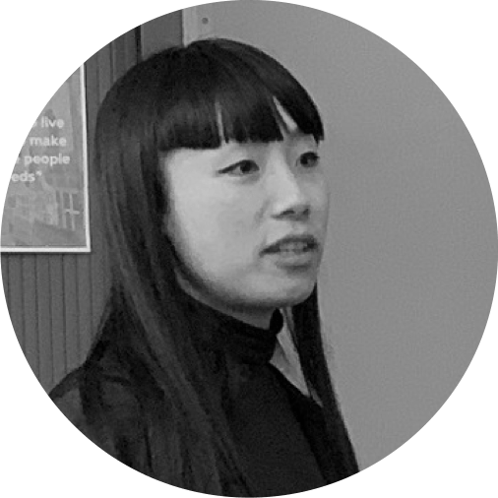
A blended team from across the council
Steve Ollier
Principal Performance Officer Health & Adult Services
Rebecca Layng
Programme Manager
Health & Adult Services
Alexia Fergus
Senior Manager
Health & Adult Services
Hibak Yusuf
Early Help Team Leader
Children Services
Lingjing Yin
Head of Product
Digital and Customer Services
Alex Sturtivant
Product Manager
Digital and Customer Services
Beth Mindham
Delivery Manager
Digital and Customer Services
Alysia-Marie Annett
Senior Content Designer
Digital and Customer Services
Connie Wroe
User Researcher
Digital and Customer Services
Yu Hsuan
Service Designer
Digital and Customer Services
Jenny Thai
Senior Product Designer
Digital and Customer Services

Slide 8
Our ask of you for the next hour…
Be as present as you can
Actively participate but also leave room for others
We have one 'prompt question' section today, please engage with them as you wish to
This is our fourth Show & Tell at Greenwich - we want to set an encouraging and open space where we as the team and you as the audience feel brave enough to say ‘I don’t know’ if something isn’t clear or we don’t have the answer yet.

Slide 9
Context
Notes:
Beth handing to Lexi

Slide 10
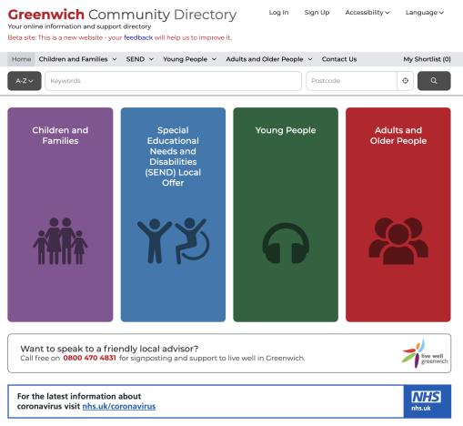
What is the Greenwich Community Directory?
A directory of health, social care and community services in Greenwich, launched in Spring 2015 that:
signposts people of all ages to support
focuses on the voluntary sector
is a key part of prevention - early intervention
is used by both public and professionals
has over 2,600 live listings
had over 8,000 sessions per month
Live Well Greenwich – Telephone support from Charlton Athletic Community Trust 2017.
Families Information Service Helpline – Telephone support.
It merged with the Families Information Services and Local Offer in 2019.
Notes:
Lexi slides 10-12
The Greenwich Community Directory is a directory of health, social care and community services in Greenwich:
Initially it was a response to the Care Act requiring LA to sign post residents to services available across the community in particular those provided by the voluntary sector. It gave residents access to info on social care, health and wellbeing.
The voluntary sector play a key role in prevention and early intervention (for example supporting people with Dementia).
The Directory is also used by professionals: RBG staff, NHS staff, GPs to support their work – through Social Prescribing. For example Community Centres are encouraged to list activities which can assist with social isolation – most recently the Carers Centre page has been updated with December's activities.
With over 2600 live listings on the directory there is a rich mix of advice and support services.
GCD is a crucial digital product to allow communities find local service information. It connects to the core services council offers too.
Since the launch of the Directory there has been a significant increase in its usage from just over 1000 sessions per month in 2016 to over 8000 by 2020. Increasingly it is recognised by the voluntary sector and local organisations as a good place to list services, activities and events.
In 2019 the Directory was expanded by merging with the Families Service Directory and SEND Local Offer offering listings across all age groups and we'll hear more about that from Hibak in a few minutes.
The Directory includes a telephone support service provided by Live Well Greenwich – delivered by CACT. This helps members of the community who are perhaps less confident with computers/IT.

Slide 11
About our project
Why are we doing it?
Residents will be able to access services they’d benefit from more easily
Local service providers will find it easier and more efficient to promote their services
RBG staff and community professionals will be able to refer residents to services faster
Information within the borough will be up-to-date, accurate and with less duplication.
Our mission
To design a reusable community directory product that:
Makes local information, advice and services more accessible, intuitive and easy to navigate for residents
Creates a more sustainable and devolved way to publish and update content for organisations and service providers.
Notes:
The Greenwich Community Directory is a directory of health, social care and community services in Greenwich:
Initially it was a response to the Care Act requiring LA to sign post residents to services available across the community in particular those provided by the voluntary sector. It gave residents access to info on social care, health and wellbeing.
The voluntary sector play a key role in prevention and early intervention (for example supporting people with Dementia).
The Directory is also used by professionals: RBG staff, NHS staff, GPs to support their work – through Social Prescribing. For example Community Centres are encouraged to list activities which can assist with social isolation – most recently the Carers Centre page has been updated with December's activities.
With over 2600 live listings on the directory there is a rich mix of advice and support services.
GCD is a crucial digital product to allow communities find local service information. It connects to the core services council offers too.
Since the launch of the Directory there has been a significant increase in its usage from just over 1000 sessions per month in 2016 to over 8000 by 2020. Increasingly it is recognised by the voluntary sector and local organisations as a good place to list services, activities and events.
In 2019 the Directory was expanded by merging with the Families Service Directory and SEND Local Offer offering listings across all age groups and we'll hear more about that from Hibak in a few minutes.
The Directory includes a telephone support service provided by Live Well Greenwich – delivered by CACT. This helps members of the community who are perhaps less confident with computers/IT.

Slide 12
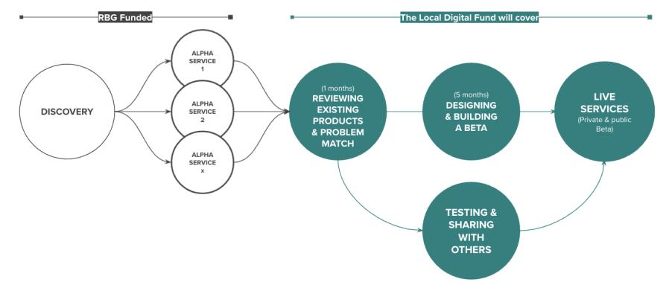
Our delivery plan
Funded by the Local Digital Fund
We’re here
And about to start some Alpha activities
DISCOVERY
ALPHA
BETA
Understand the context and problems
Test different solutions
to the problems
Build, refine and improve
the service
Notes:
A

Slide 13
Choosing an approach for the rest of our Discovery
Notes:
Lexi handing to Alex

Slide 14
Why do we need to narrow our focus?
We need to get into the detail of specific journeys our users go on when looking for information and services, so we can understand their needs
2600+ services on the Greenwich Community Directory
95+ categories of different services on the Greenwich Community Directory
But the scope of the directory is too big for us to get into the detail of everything
Notes:
Alex

Slide 15
Options we decided weren’t right
Look at a current
top-level category of the GCD
Focus on a specific service area
Focus on how service providers share service info with us
Notes:
Alex

Slide 16
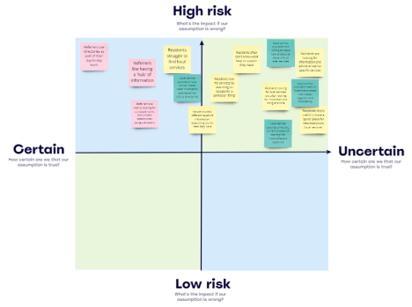
Our approach for the rest of Discovery
1) Research with residents around 3-4 specific user needs
Ask residents how they look for information around the user need
Test our assumptions about their needs and behavior
Use a mix of research and prototyping techniques
Build empathy and understanding of the experience residents have
2) Research with a range of service providers
Exploring how service providers share information to directories
Test our assumptions about their needs and behavior
Use a mix of research and prototyping techniques
Build empathy and understanding of the experience they have
Notes:
Alex

Slide 17
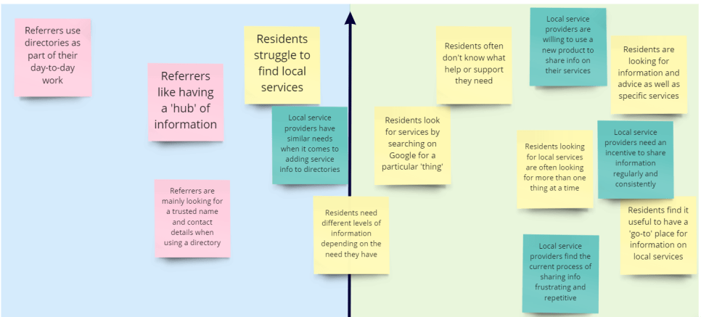
High Risk
Known
Unknown
Notes:
Service designer Sharon
----
To progress our new approach, we’ve been looking into our risky assumptions.
A risky assumption is something we think is true, has a big impact on our work, but we might not have much evidence to back it up.
We examined each assumption we have on the risk level, which is “What's the impact if our assumption is wrong? And “How certain are we that our assumption is true”?
” to prioritise them on our matrix.
This will help us identify the highest priority for us to test.
_____________________________________ Some of our most risky assumptions about residents needs and behaviours are, (in yellow) as you can see from the top right corner
Residents look for services by searching on Google for a particular 'thing'
Residents often don't know or aren't clear on what help they need
Residents are looking for information and advice as well as specific services
___________________________________________
On the other end, Some of our most risky assumptions about local service providers that you can see in green post-its are
Local service providers would be willing to use a new directory product to share info on their services
Local service providers need an incentive to share service information regularly and consistently

Slide 18
Applying a principle of ‘testing through design’
For some areas, we think we can learn faster if we take our design ideas to our users to get quick feedback.
We have an idea about what the user might need
We create a quick mock-up of how it might work
We get feedback on what we create from our user
Notes:
Sharon
----
Now we are applying a principle of “testing through design”, preparing to validate our assumptions around the needs and behaviours from the conversations we have with residents and local service providers, and potentially show our low-fidelity prototype, which is like a quick mock-up of our new product, to understand how user groups perceive our early ideas. This will help us visualise ideas to seek feedback and improve the product early before it’s fully built
As we are going to embed our test through design principle in our approach, starting by the user research
I’ll hand over to Steve to talk more about our user research approach.

Slide 19
User research
Notes:
Steve Intro
Since our last Show and Tell we’ve now started to progress our user research.
We’re doing a mix of research with service providers and also a range of residents.
We’re getting closer to the user by going to places they go - to ensure we’re designing the product for the right people.
As well as this we’re also drawing from some existing research which has just been completed by colleagues Health and Adults.

Slide 20
Existing research:
Carers Survey – Adults Services
Notes:
Steve:
Also linked up with Performance colleagues in Health and Adults Services who recently carried out statutory survey to Carers in the borough. One of the questions covered access to information about support, services and benefits.
46% found it easy to get info - lower than the previous survey (62%) and the London average (60%)
Change to 54% found it difficult to find information and advice was 38% and the typo signification

Slide 21
Findings from the carers survey
Notes:
Steve:
These are the range of comments from the Carers survey.
No knowing what info is out there
More advertising on what services are available
Elderly – don't know how to use the internet
Didn't know who to turn to for help
No direct ways to find info
Having printed info
In addition over 50 people from the HAS Carers survey are willing to be contacted to take part in further research.

Slide 22
Resident and service provider research
Resident research
Service provider research
Intercept research - short 5 minute chats in the community
In depth user interviews – to understand how they work and their publishing process
In-depth user interviews to learn more about how residents look for information
Test out service listing management tools like Outpost
Get residents to use a prototype
Notes:
Steve
A lot of our objectives are around better understanding residents and service providers and testing some of our assumptions about these groups.
We’ll explain these in the next few slides but our research will be made up of intercept research, in depth interviews and testing prototypes.
I’ll now hand to Connie to talk about the resident side of the research in more detail.

Slide 23
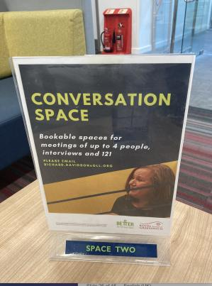
Resident research - taking a user centered approach
What is an intercept?
It's a type of quick-fire research where you stop people as and when you see them. It gives you access to a broad range of demographics in a short amount of time.
Why are we doing intercepts?
1) Test risky assumptions
2) Recruit for further research
3) Build empathy
This is a whole team empathy building exercise.
Notes:
Connie notes:
How we're going about doing this:
This is place-based research going to the places and spaces that residents go to, this has included:
The Woolwich Centre Library
Children's Centres (Vista, Alderwood, Brookhill, Eglinton)
Greenwich Carer's Centre
Day Services Adult Disability

Slide 24
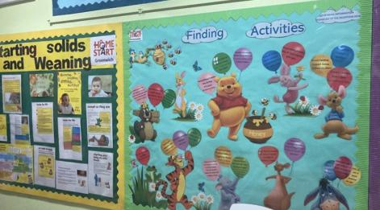
We’ve chatted to over 35 residents in the last 2 weeks to enhance our learning
This is place-based research going to the places and spaces that residents go to, this has included:
The Woolwich Centre Library
Children's Centres (Vista, Alderwood, Brookhill, Eglinton)
Greenwich Carer's Centre
Sherard Road Day Services (Adult Learning Disabilities)
Notes:
This is not new news

Slide 25
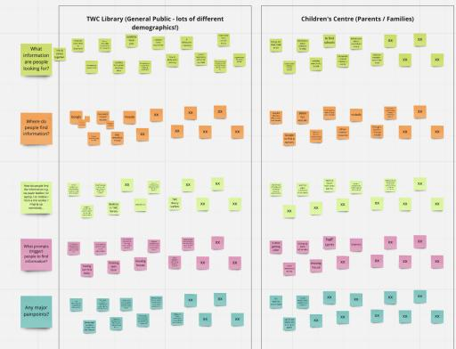
Resident research – broad learnings
People are looking for:
Activities for children, volunteer opportunities, jobs, Covid info, local school/nursery/childminders.
People find information from:
Google, Council website, printed newsletter, paper leaflets, YouTube, Facebook, word of mouth.
Triggers (life event):
Moving house, school holidays, changing schools, unemployment, starting a family, children growing older.
Pain points:
Out of date info, abundance of information, and lack of human contact under services
Notes:
This is not new news.

Slide 26
Service provider research
What we want to learn ​
About their role and responsibilities
How they create, maintain and publish information ​
What they use to share information ​
This could later help us prototype and test things like the publishing process​
We'll do this in a 1-hour interview where we'll:
1. Ask about their day-to-day work
2. Map out how they create and share info
3. Observe how they use the GCD
4. Test a backend process using a prototype
Notes:
Connie handing over to Alysia

Slide 27
Over to the audience
Any thoughts so far? ​ ​
Has anything surprised you? ​ ​
Does any of this relate to your work?
Notes:
Me

Slide 28
Prototyping to test our riskiest assumptions
Notes:
Jenny – Hi, I’m a product designer..
Before we move on to talking about prototyping to test our riskiest assumptions…
So our team also had a session together to go over and get familiar with type of research and prototyping methods and tools.
This was to bring some knowledge around what we mean when we say prototype,what it is, possibilities with prototyping, what we can do which can help us think about how we can prototype in our project to learn.
We have a number of assumptions and unknowns, how will we test those. Prototyping is a way to help us.
So before I talk about how we think we will go about testing our assumptions with prototyping, I am going to give a very quick overview of what prototyping is.

Slide 29
What is prototyping?
A prototype is a tangible form of an idea that you can use to get feedback on by testing.
An easy and quick way of mocking up ideas to experiment and learn
Makes your ideas and concepts more tangible.
Not about making something perfect or a final solution
Should be disposable
Gives you a way to test ideas and get feedback from real users
Can be done at various points in your work– from early on to implementation
It is a way of managing risk. Prototyping and testing allows you to learn what does work but more importantly what doesn’t work.
“A prototype is a question embodied.”
- Diego Rodriguez, IDEO, design consultancy
Notes:
It’s about making ideas tangible so that you can test and get real feedback from users.
<go through the points on slide>
I like the quote …””… because a prototype that you create is a tangible form of your question and what you want to learn
Value of prototyping helps us manage the risk of our work, it tells us not only what works, but more importantly what doesn’t work. We need to be open to learning this.

Slide 30
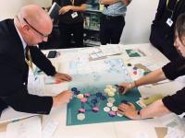
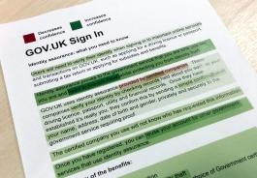
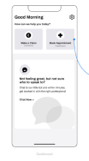
You can prototype anything
Often people think of digital prototypes & screen interactions but it can be much more .
If you can be open to have a mindset of experimentation - test, learn, and iterate. You can prototype anything!
Policy
Services
Digital product
Content
Physical spaces
Team structures
Processes
Technology
….
Testing out a policy deliberation tool
Content design
Digital products /sites
Spaces, ways of working, team (McDonalds kitchen)
Notes:
You can prototype anything, often people think of digital products and services like software, websites, apps
But you can prototype anything because it is a just making an idea tangible
There are also many types of prototypes, many ways to prototypes depending on what you need.
If you have a the mindset of experimentation, you can prototype anything…<list of things>
Example images sources:
Example of a highlighting test, from “A Simple Technique for Evaluating Content.”
Policy lab https://openpolicy.blog.gov.uk/2019/01/11/co-design-in-policy-learning-by-doing/

Slide 31
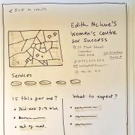
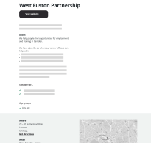
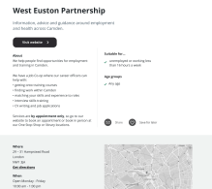
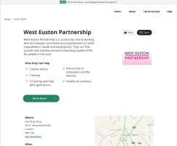
Fidelity of prototypes
Fidelity refers to the level of detail. Prototypes can sit across a scale of fidelity.
Focus on concept and the core design
Simple quick to make/update
often low tech
Low on details, less about visual design
Focus on the details of the design
Looks and works more like a final product
Testing more likely around usability and evaluation of the design
Low fidelity
High fidelity
Notes:
When thinking about prototypes there are a few things to think about. Fidelity and type/format.
Fidelity refers to the level of detail you have
Lower fidelity also helps with testing and focusing on the core design at hand rather than details of the design.
A lot of people get stuck at how things look - like colours and imagery – lower fidelity lets us focus on and test the functionality, purpose, expectations and needs of users without getting stuck at how things look.

Slide 32
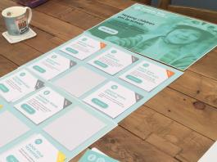
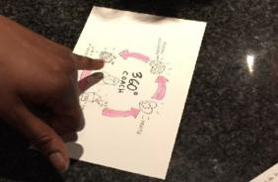
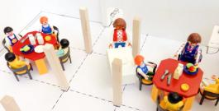
Types of prototypes
Paper prototypes
Clickable prototypes
Service / experience simulations
Content design and evaluation
Storyboard / sketch
Coded / real platforms and tech
Video
Provocations
Choosing the type and also fidelity depends on what you need to test & learn and what you have available at hand (resource, time).
Notes:
The focus is not about “what are we prototyping”, it is a question of “what are we testing? What do we need to learn? What assumptions do we need to validate?”

Slide 33
How we will be using prototyping
Learning by doing and testing through design, using prototypes to help us:
Test and validate our assumptions
Better understand our users and their needs – prototyping can help us pull these out a bit more
Think and shape what the directory should/needs to be
We can:
test service listing journeys with service providers.
mock up some ideas and journeys to test with residents
Notes:
Have a mindset of experimentation and getting comfortable with a constant rhythm of testing, learning, and iterating.

Slide 34
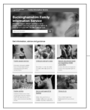
Learning by doing
In practice what this might look like is testing our assumptions with different prototypes. We are also at the stage of the project where we are still trying to figure out what the product/service will need to be and what users need.
Example:
Assumption: Residents are looking for information and advice as well as services.
Prototype: Sketch out some different flows and pages of information, advice and service listings.
Landing page
Information page
Directory
Service listing page
Mocking up some RBG landing and information pages
Mocking up directory and service listing pages
Notes:
We might design some different flows and journeys navigating thorugh content
We will likely mock up- sketch out new types of pages/content and directory pages
Put this in front of various users to test and learn what works and what doesn’t
Example – service providers we might use some current tech/platforms already out there to help us test their journey of uploading and updating services to a directory
It may be a iterative approach as well, so it might include multiple experiments or rounds of testing we run, where we change prototypes/designs based on feedback and test further.

Slide 35
Next steps
Notes:
Hibak to speak through next steps

Slide 36
Over the next 4 weeks, we will…
Continue our research with residents in different places in Greenwich
Prototype new resident-facing journeys to test
Do research with service providers to understand how we can improve their experience of sharing service information with RBG
Try out some existing products we’d like to know more about (such as Outpost – a product for service providers to manage directory listings)

Slide 37
Questions and feedback
Notes:
Beth

Slide 38
Over to you!
We'd love to know your thoughts and answer any questions you might have.
Comment in the chat or speak up 🙂
What stood out to you?
What questions do you have?
Notes:
We're really keen for this to be a dialogue, so please let us know in the chat as we go, about :
😍 Things you liked
🧐 Things you’d like to hear more about
🤔 Things that surprised you and questions you have

Slide 39
Thank you for coming!
Ways to stay in touch:
Read our weeknotes – these are sent to all Show & Tell attendees every Friday
Come to our future Show & Tell events
Send us an email or a message on Microsoft Teams:
Bethany.Mindham@royalgreenwich.gov.uk
Alex.Sturtivant@royalgreenwich.gov.uk

