Slide 1
Rebuilding Greenwich’s
Community Directory
Show & Tell #3
15/02/2022
Please note this Show & Tell will be recorded.
Notes:
Beth

Slide 2
Before we go any further let’s answer the question:
What is a Show and Tell?
Notes:
Before we get into it, it’s worth saying a bit about what a ‘show and tell’ is for.

Slide 3
A Show & Tell is a regular event where...
You "tell”
Tell us what you think:
Things we may have missed
Offer knowledge we may not have
Support areas we are struggling with
We "show”
Share approach and rationale
Demo ongoing work
Share insights gathered

Slide 4
Why do we do them?
Get feedback from everyone, to shape what we do next
(not just those involved in the day to day work)
Make connections with other work and knowledge
Show progress early and often
Notes:
It’s a way to share learning from a project as you go. Often, change programmes or technology projects will do all the work, and then tell everyone only when the change is about to go live
This is different – it's about sharing the analysis, thinking and learnings continuously.
First one today will be a bit different – setting the scene and introducing the work, with only a little bit about our findings.
you can expect:
Us to show our progress – what have we been doing, and what have we learned?
To have a chance to influence the work. We want to hear what's important to you, and what we’ve missed
To be able to draw links to other projects or initiatives that we might not know about

Slide 5
Today we want to cover:
Quick recap – the team and context
A summary of our mid-Jan playback day
Where we are now
Our current challenge: Navigating through complexity
What we are proud of
Next steps

Slide 6
The team

Slide 7
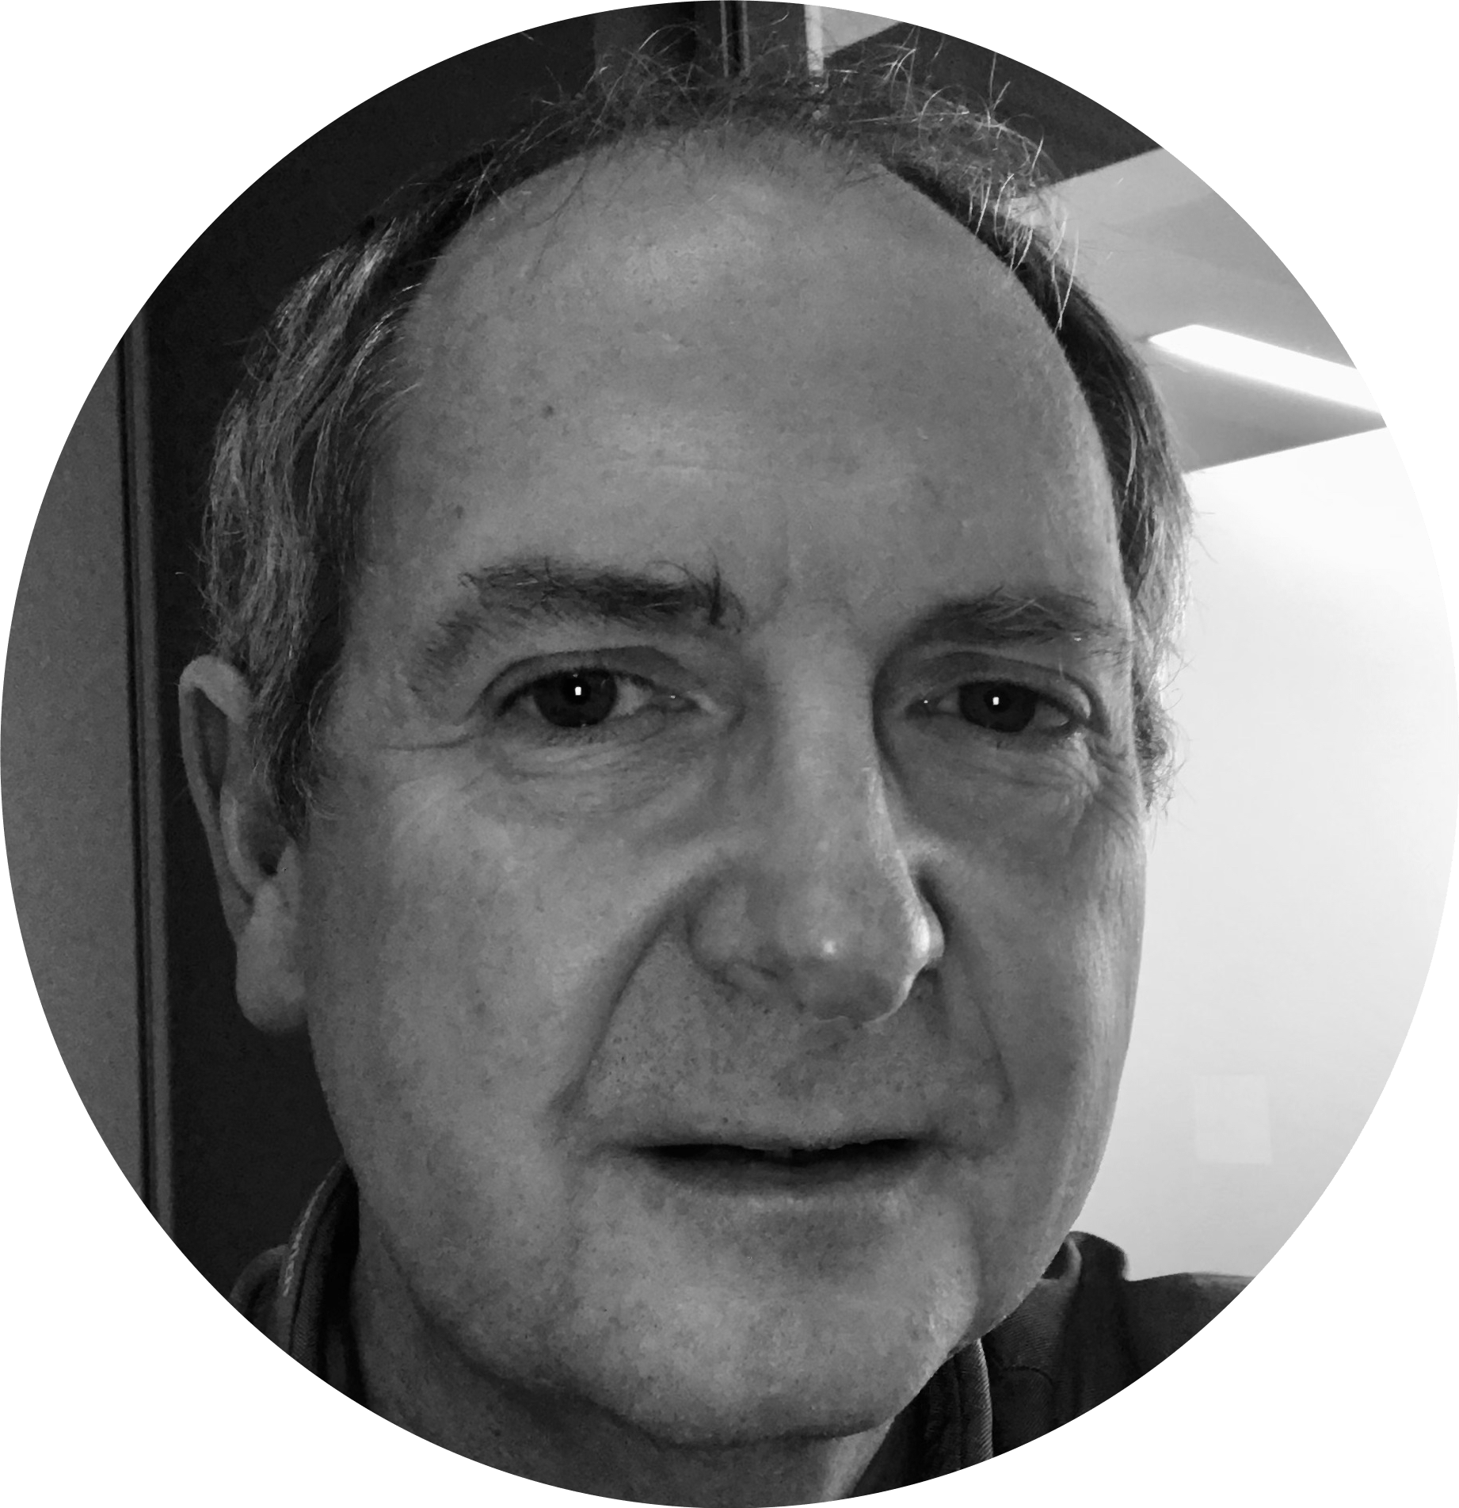
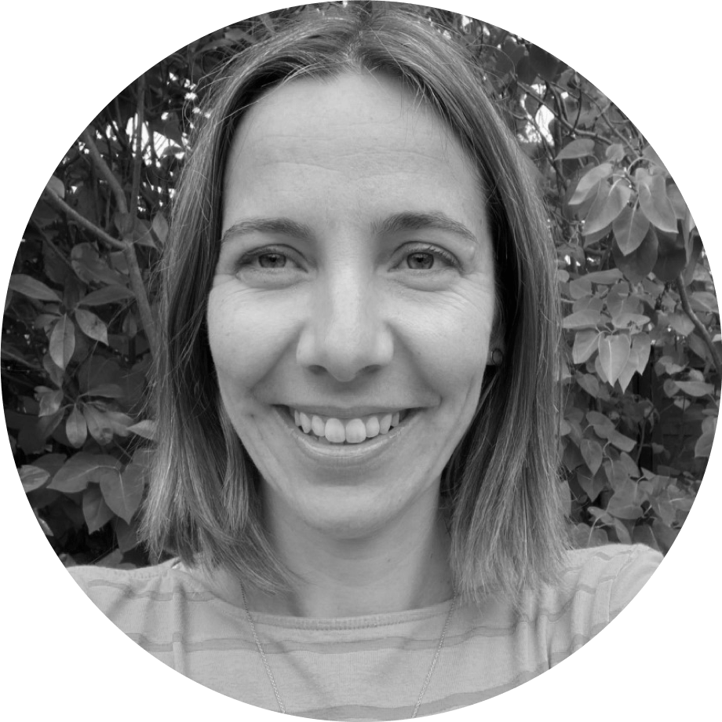
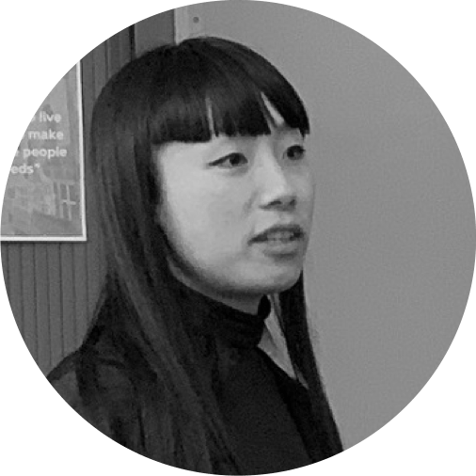
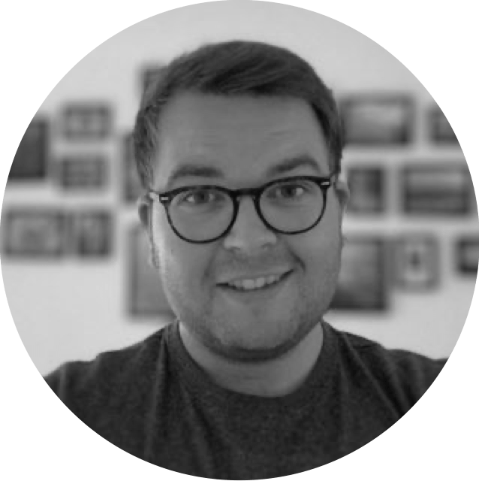
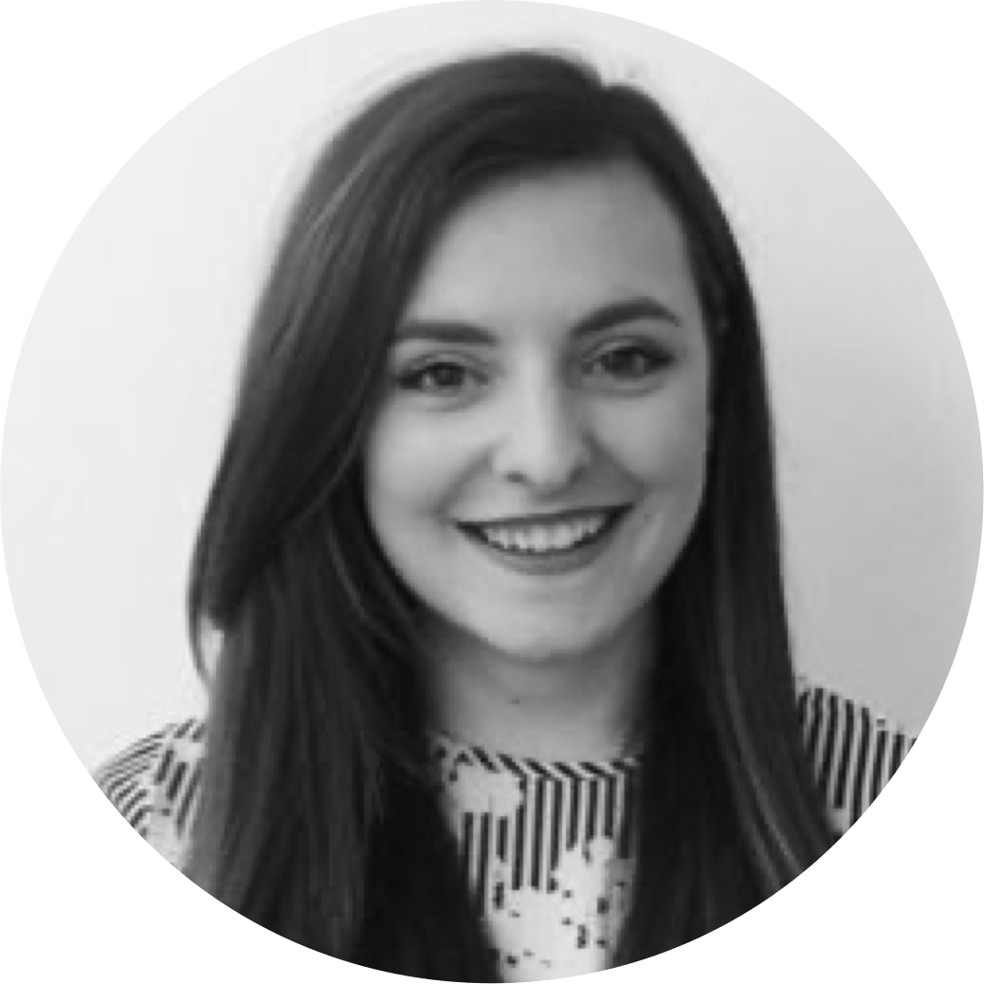
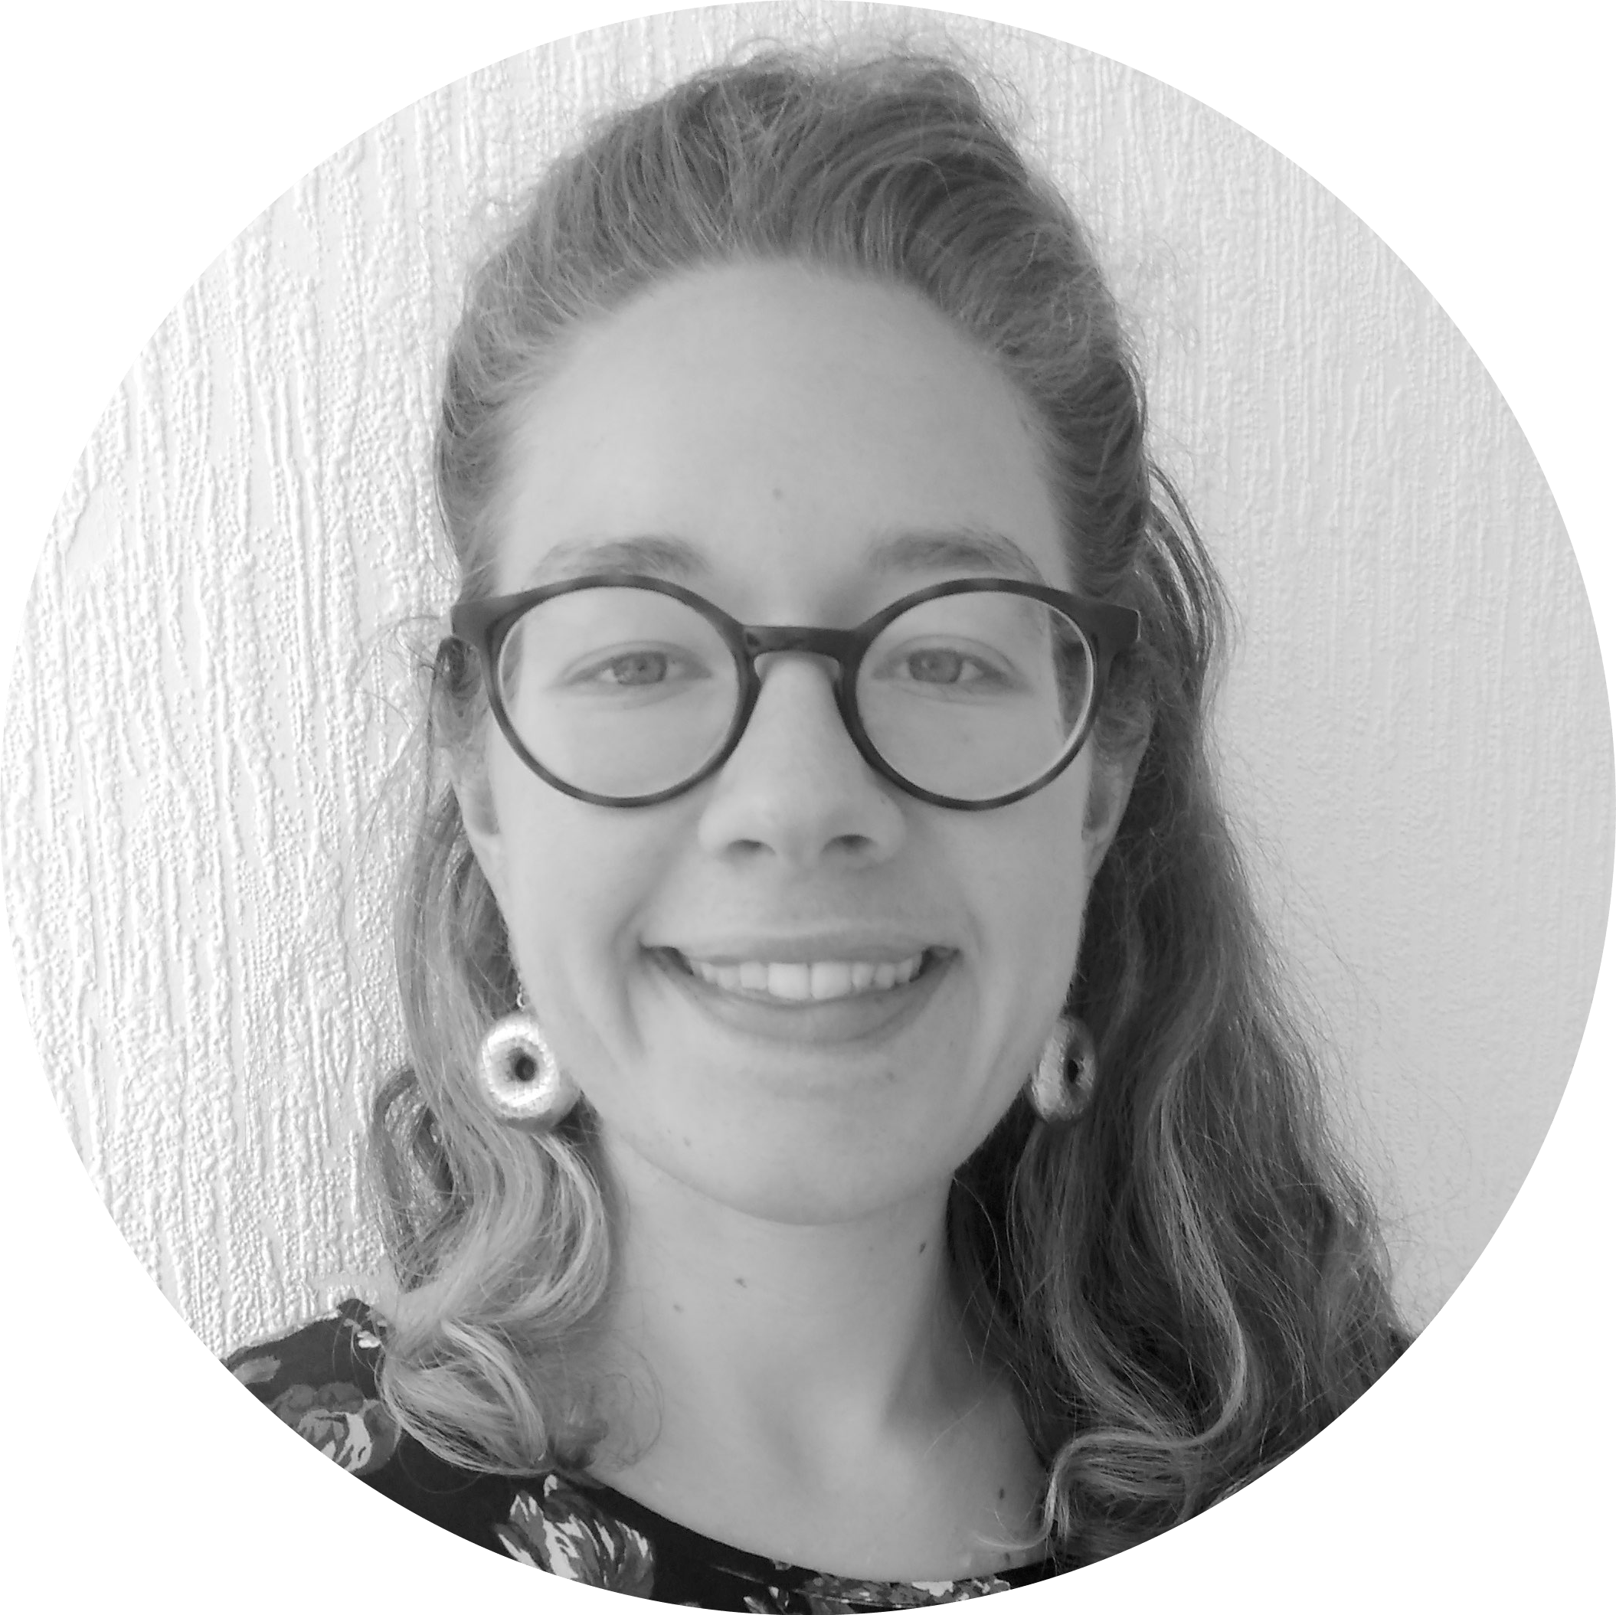
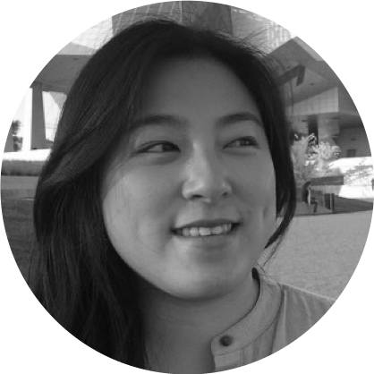
A blended team from across the Council
Steve Ollier
Principal Performance Officer Health & Adult Services
Rebecca Layng
Programme Manager
Health & Adult Services
Alexia Fergus
Senior Manager
Health & Adult Services
Hibak Yusuf
Early Help Team Leader
Children Services
Lingjing Yin
Head of Product
Digital and Customer Services
Alex Sturtivant
Product Manager
Digital and Customer Services
Beth Mindham
Delivery Manager
Digital and Customer Services
Alysia-Marie Annett
Senior Content Designer
Digital and Customer Services
Connie Wroe
User Researcher
Digital and Customer Services
Yu Hsuan
Service Designer
Digital and Customer Services
Jenny Thai
Senior Product Designer
Digital and Customer Services

Slide 8
Our ask of you for the next hour…
Be as present as you can
Actively participate but also leave room for others
We have one 'prompt question' section today, please engage with them as you wish to
This is our third Show & Tell at Greenwich - we want to set an encouraging and open space where we as the team and you as the audience feel brave enough to say ‘I don’t know’ if something isn’t clear or we don’t have the answer yet.

Slide 9
Context

Slide 10
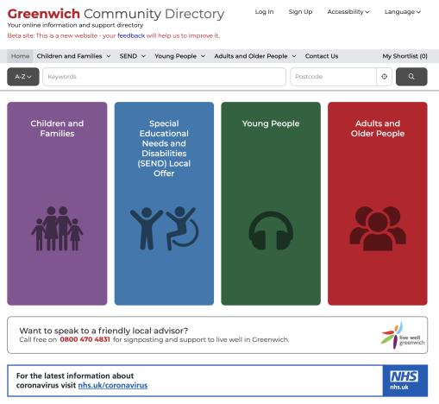
What is the Greenwich Community Directory?
A directory of health, social care and community services in Greenwich, launched in Spring 2015 that:
signposts people of all ages to support
focuses on the voluntary sector
is a key part of prevention - early intervention
is used by both public and professionals
has over 2,600 live listings
had over 8,000 sessions per month (2020)
Live Well Greenwich – Telephone support from Charlton Athletic Community Trust 2017.
It merged with the Families Information Services and Local Offer in 2019.
Notes:
The Greenwich Community Directory is a directory of health, social care and community services in Greenwich:
Initially it was a response to the Care Act requiring LA to sign post residents to services available across the community in particular those provided by the voluntary sector. It gave residents access to info on social care, health and wellbeing.
The voluntary sector play a key role in prevention and early intervention (for example supporting people with Dementia).
The Directory is also used by professionals: RBG staff, NHS staff, GPs to support their work – through Social Prescribing. For example Community Centres are encouraged to list activities which can assist with social isolation – most recently the Carers Centre page has been updated with December's activities.
With over 2600 live listings on the directory there is a rich mix of advice and support services.
GCD is a crucial digital product to allow communities find local service information. It connects to the core services council offers too.
Since the launch of the Directory there has been a significant increase in its usage from just over 1000 sessions per month in 2016 to over 8000 by 2020. Increasingly it is recognised by the voluntary sector and local organisations as a good place to list services, activities and events.
In 2019 the Directory was expanded by merging with the Families Service Directory and SEND Local Offer offering listings across all age groups and we'll hear more about that from Hibak in a few minutes.
The Directory includes a telephone support service provided by Live Well Greenwich – delivered by CACT. This helps members of the community who are perhaps less confident with computers/IT.

Slide 11
About the re-building Greenwich Community Directory project
Why are we doing it?
Make it easier for residents to meet their needs and the needs of others
Save money and make the directory cheaper and easier to maintain
Build online services with extra help for those who need it for our Digital Strategy
Build a reusable in house product to solve common problems
Our mission
Make local information, advice and services more accessible, intuitive and easy to navigate for residents
Create a more sustainable and devolved way to publish and update content for organisations and service providers
Notes:
The Greenwich Community Directory is a directory of health, social care and community services in Greenwich:
Initially it was a response to the Care Act requiring LA to sign post residents to services available across the community in particular those provided by the voluntary sector. It gave residents access to info on social care, health and wellbeing.
The voluntary sector play a key role in prevention and early intervention (for example supporting people with Dementia).
The Directory is also used by professionals: RBG staff, NHS staff, GPs to support their work – through Social Prescribing. For example Community Centres are encouraged to list activities which can assist with social isolation – most recently the Carers Centre page has been updated with December's activities.
With over 2600 live listings on the directory there is a rich mix of advice and support services.
GCD is a crucial digital product to allow communities find local service information. It connects to the core services council offers too.
Since the launch of the Directory there has been a significant increase in its usage from just over 1000 sessions per month in 2016 to over 8000 by 2020. Increasingly it is recognised by the voluntary sector and local organisations as a good place to list services, activities and events.
In 2019 the Directory was expanded by merging with the Families Service Directory and SEND Local Offer offering listings across all age groups and we'll hear more about that from Hibak in a few minutes.
The Directory includes a telephone support service provided by Live Well Greenwich – delivered by CACT. This helps members of the community who are perhaps less confident with computers/IT.

Slide 12
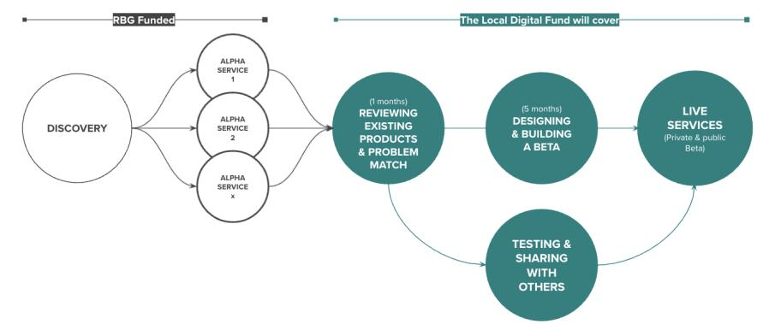
Our delivery plan
Funded by the Local Digital Fund
We’re here
DISCOVERY
ALPHA
BETA
Understand the context and problems
Test different solutions
to the problems
Build, refine and improve
the service
Notes:
Alex

Slide 13
Playback day
Notes:
Steve Intro

Slide 14
We started with 6 weeks of broad research
We’ll be ready to move onto the next stage of our Discovery when:
We have a list of all the services that have a touchpoint in the GCD
We understand what content on the GCD is most and least looked for
We’ve identified the different current main user groups of the GCD
We’ve identified the different ‘potential’ user groups of the GCD
We’ve documented the technical make-up of the existing GCD
We’ve met with other local authorities to learn from their experience of developing directories
We understand the legal and technical constraints of the project
We understand what Scout, Outpost, LocalGov Drupal and Open Referral UK are
We’ve prioritised the services for further exploration
We’ve written our objectives for what to do next
Notes:
Steve:
Before the Playback Day we started with 6 weeks of broad research so that we would be ready to move forward to our next stage.
Here's a quick recap...
A list of all services that have a touchpoint in the GCD
An understanding of content on the GCD is most and least looked for
Identified the different current main user groups of the GCD
Identified the different ‘potential’ user groups of the GCD
Documented the technical make-up of the existing GCD
Met with other local authorities to learn from their experience of developing directories
Understand the legal and technical constraints of the project
Understand what Scout, Outpost, LocalGov Drupal and Open Referral UK are
Prioritised the services for further exploration
Written our objectives for what to do next

Slide 15
Taking time to pause, share and reflect, so we can decide where to begin our focused Discovery
Notes:
Steve:
Following 6 weeks of initial broad discovery...
The day was an opportunity to take time to pause, share and reflect so that we can decide where to begin our focused Discovery.

Slide 16
Structure of Playback day
Opportunity to share and evaluate initial broad discovery research
5 Workstream lightning talks covering objectives, what we did, findings, observations and reflections:
Users
Content and Services
Technical
Constraints
Learning from other Local Authorities
Cards on the table / Thinking out loud session
Notes:
Steve
We allocated a full day for our Playback Day to review all the team's progress so far.
A great deal of work has gone into the initial broad discovery phase of the project and this was seen as an opportunity to share and evaluate our findings.
The day was divided into a series of workstream lightening talks.
By lightening talks we mean 20 mins for each workstream with links to relevant documents/ info and findings
Each lightening talk presented their objectives, what we did, what we found out, observations and reflections
Lightening talks covered:
Users of Greenwich Community Directory – current and potential, its Content and Services
The technical workstream covered the technical options available to Greenwich including Local gov Drupal, Scout and Outpost, Open Referral and Open Place.
Constraints: so for each section of the Community Directory we looked at the parameters we’re working with.
Learning from other Local Authorities including 8 councils and a Show and Tell with Local Gov Drupal with 30 other Councils.
There was also explorative time allocated on what had been presented – basically cards on the table slot! Thinking out loud session where we each shared what was on the top of our minds and what we think our learnings so far might mean for the direction of the project

Slide 17
Playback day ways of working reflection
First playback day a few of us had taken part in – new way of working
Such a big team – nice to come together for a whole day to share what we’ve all been working on
Great opportunity to brainstorm as a team and talk through ideas – dedicated time to be creative and innovative
Felt 100% comfortable to share anything on your mind – safe and non-judgmental space
Notes:
Introduce myself!
Siloed working quite common in such a big team, each focusing on our discrete areas.

Slide 18
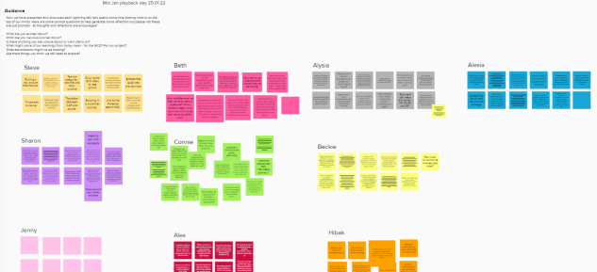
Playback day reflections – 'All cards on the table' session
What are you excited about?
What are you nervous/worried about?
Is there anything you are unsure about or want clarity on?
What might some of our learnings from today mean - for the GCD? For our project?
What assumptions might we be holding?
Are there things you think we still need to explore?

Slide 19
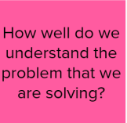
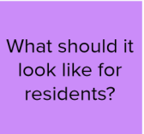
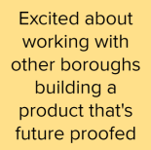
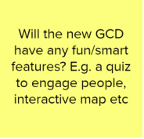
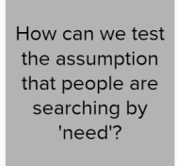
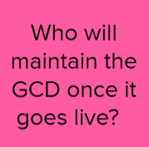
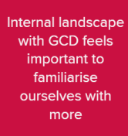
Playback day reflections – Unanswered questions

Slide 20
Over to the audience
Any thoughts so far?
Has anything surprised you?
Does any of this relate to your work?

Slide 21
Where are we now?

Slide 22
We thought after our playback day it would be clear what we should do next…
… but things still felt complex!

Slide 23
Navigating the complexity

Slide 24
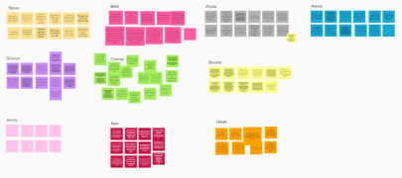
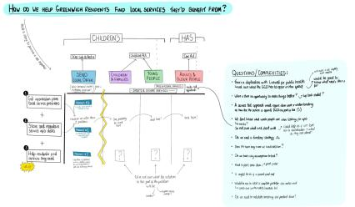
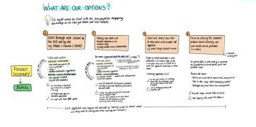
We quickly produced 4 options for our next steps

Slide 25
We quickly produced 4 options for our next steps
Our options were to focus on:
A top-level category of the GCD (e.g. Adults and Older People)
A specific user need or service (e.g. I need to find a childminder)
The SEND Local Offer
The common problem of collecting service information from local service providers

Slide 26
But when we spoke through our options, we realised….
We were focusing on logistics rather than learning
We didn’t have a common language in the team
We didn’t know enough about other directories in Greenwich
We were making a lot of assumptions

Slide 27
Creating a common language
Defining our most used terms will help us learn in the fastest possible way.
We've refined what we mean by a:
'Services' - what's on offer, and something that helps users do / achieve.
'Needs' are personal requirements that can be met with a service.
You may know you need help, but be unsure exactly what you need and when.
'Life event' are things that trigger a need e.g. having a baby, retiring, losing a loved one.
Notes:
We realised that we needed to define terms and think about how we can learn in the fastest possible way.
We came up with these distinctions:
'services' help users do something
'needs' are personal requirements we can help the user meet with a service
'life events' are things that trigger a need
Now we have these definitions we can find common examples of each.
This should help us to decide what options we should explore in more detail. Either on their own or as part of a broader bit of research with user groups.
What do they mean?
We agree that 'services' help users do something and that we should try to avoid confusing them with the team in the council who deliver them.
We agree that 'needs' are personal requirements we can help the user meet with a service. We think 'needs' may sometimes overlap with 'outcomes' and that people may not necessarily know what their 'need' is. They may know they need 'help getting meals at home' but not that it's related to a wider need around living independently. Needs can be very small things like 'I need meals delivered to my home' or be quite broad like 'I need support with my mental health'.
'Life events' are things that trigger a need. We acknowledge that not everything will fit into a life event but it's something that we can still explore through content if research shows this is a way people look for information. Users may not identify a trigger point for their needs as a life event. Someone looking for mental health support may not have just had a life event like getting a diagnosis.
Note: These are not public facing definitions and are not informing categories or structure of a future directory. Users will not necessarily know what these mean or find them useful. It's just to help us work

Slide 28
For example, in the adult social care context...
There is the team who delivers a service, like HAS (council team).
Something offered to satisfy a need, like 'Get an adult social care assessment' (service).
The need itself prompts you to use a service, like 'additional help at home' (need).
The prompt that triggered the need like 'I've been diagnosed with dementia' (life event).
These definitions are our own internal team language to help us find common examples of each service, need and life event, which will lead us to start prototyping ideas.
Notes:
We realised that we needed to define terms and think about how we can learn in the fastest possible way.
We came up with these distinctions:
'services' help users do something
'needs' are personal requirements we can help the user meet with a service
'life events' are things that trigger a need
Now we have these definitions we can find common examples of each.
This should help us to decide what options we should explore in more detail. Either on their own or as part of a broader bit of research with user groups.
What do they mean?
We agree that 'services' help users do something and that we should try to avoid confusing them with the team in the council who deliver them.
We agree that 'needs' are personal requirements we can help the user meet with a service. We think 'needs' may sometimes overlap with 'outcomes' and that people may not necessarily know what their 'need' is. They may know they need 'help getting meals at home' but not that it's related to a wider need around living independently. Needs can be very small things like 'I need meals delivered to my home' or be quite broad like 'I need support with my mental health'.
'Life events' are things that trigger a need. We acknowledge that not everything will fit into a life event but it's something that we can still explore through content if research shows this is a way people look for information. Users may not identify a trigger point for their needs as a life event. Someone looking for mental health support may not have just had a life event like getting a diagnosis.
Note: These are not public facing definitions and are not informing categories or structure of a future directory. Users will not necessarily know what these mean or find them useful. It's just to help us work

Slide 29
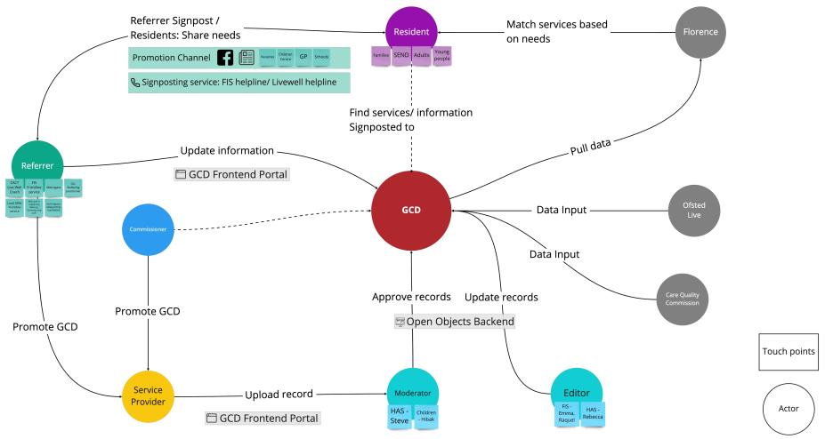
Look into the ecosystem of GCD
Sharon's map of relationships to the GCD
Sharon's map/diagram of product ecosystem
Notes:
Hi I’m Sharon, I’m the service designer in the digital and customer services team.
Apart from defining the service terms and the common language, we also move to holistic perspective to figure out what makes GCD special and what is our next focus area.
So We look into the ecosystem, trying to understand how the main actors, like residents, referrers, service providers, the editors who maintain the content on GCD, and the platforms that integrate data from their own place onto our directory.
From this, we can have a comprehensive overview to see through the relationships between the different actors, what kind of channels help them access GCD, and where are the gaps that we need more clarification.

Slide 30
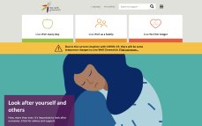
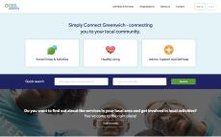
Put the GCD in the context of other tools
GCD | Live Well | Simply Connect | Greenwich Get Active
Provide a comprehensive list of services in Greenwich | Provide public health related information | Support social prescribing across the UK | Provide different ways for people to stay active in Greenwich
Notes:
We also dived into the existing digital products that help residents to find support or information in Greenwich, their product features and proposition.
Some platforms we have been looking into are:
Live well, which provides lots of guidance and information related to public health
Simply Connect: Support social prescribing across the UK, mainly focus on voluntary sector
Greenwich Get Active: Provide different ways (activities, community groups) for people to stay active in Greenwich

Slide 31
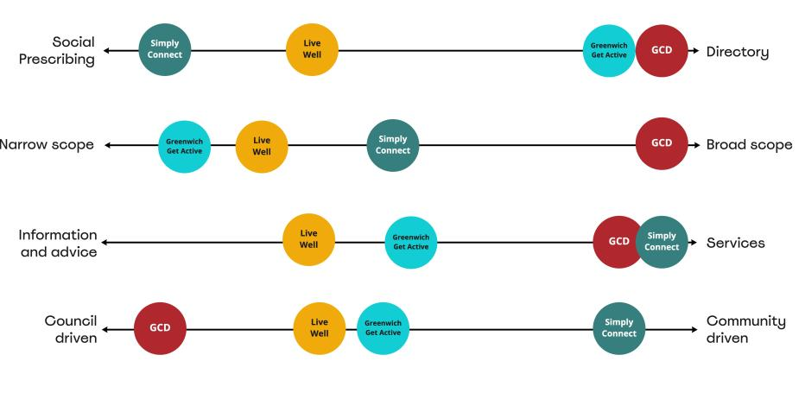
Put the GCD in the context of other tools
Notes:
Then we visualized the diagrams to see where GCD is situated in compared with the other existing products, from the scope of the product, content types, to the delivery aspect.
and we will deep dive into the information that sit in different platforms to understand the duplication of the content.
This would give us an initial thoughts about our current proposition in the context. Now i’d like to hand over to jenny to talk the assumptions we have along with our work.

Slide 32
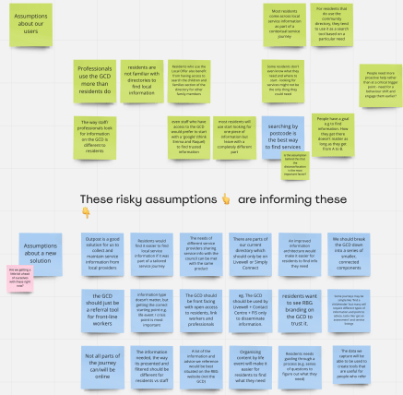
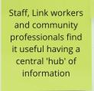
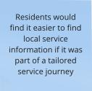
Explore our assumptions
An assumption is an informed guess or hunch that is unproven.
Checking assumptions is important because things can fail if they are based on assumptions that haven’t been validated early on.
We held a lot of assumptions and we just needed to get them all down.
Notes:
Assumptions are really important to identify and communicate especially early on
If you base a decision or building something based on a assumption that might be wrong and not validated that can decrease the success of a product
Especially if you start to design and build/implement and you find out later on, maybe too late something you could have learned much earlier
We all had a lot of assumptions and questions and ideas floating in our heads that we needed to get out
We reflected on what we learned from the playback day and the user needs work and other research from other local authorities. (Connie's user needs work and other LA research )
We put down all of our assumptions down.
All sorts of assumptions, from assumptions about who the users were, be it residents, staff, referrers or the solutions itself

Slide 33
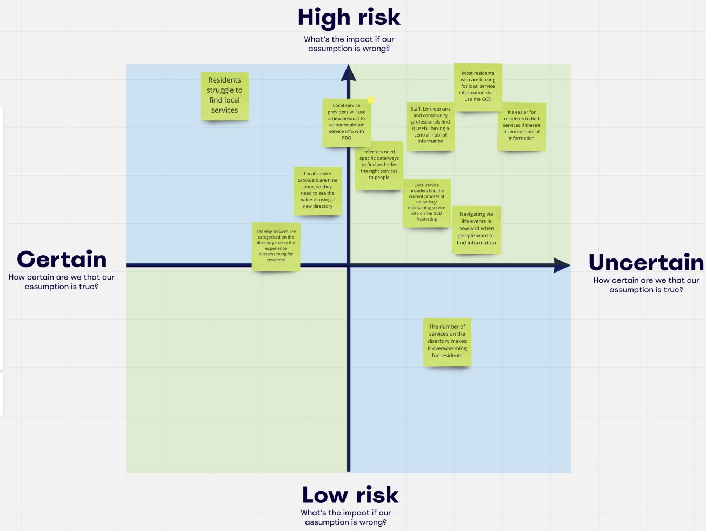
Explore our risky assumptions
Next we started to map them to explore what our riskiest assumptions are.
A risky assumption is something we think is true, has a big impact on our work, but we might not have much evidence to back it up.
When we identify our risky assumptions, we can test them to find out if they're true or not.
This de-risks our work.

Slide 34
Refining our initial 4 options
We’re working on a refined set of options with the goal of:
Making sure we are learning as fast as possible
Testing our assumptions
Not over complicating it
Not make it too narrow or too wide

Slide 35
Despite this complexity we are proud of...

Slide 36
Having healthy debates
Adapting our skillsets
Sharing unrefined ideas
Flexing our ways of working
Supporting each other through ambiguity
Embracing reflection and critical thinking

Slide 37
Next steps

Slide 38
Over the next 4 weeks, we will…
Decide which option we’ll take for the rest of our Discovery (this week)
Do focused research with residents, link workers and service providers
Understand how they look for information, advice and services
Understand how they use the current community directory
Identify the biggest opportunities for improvement
Begin to test our riskiest assumptions
Map out the next phase of our work (Alpha)

Slide 39
Questions and feedback

Slide 40
Over to you!
We'd love to know your thoughts and answer any questions you might have.
Comment in the chat or speak up 🙂
What stood out to you?
What questions do you have?
Notes:
We're really keen for this to be a dialogue, so please let us know in the chat as we go, about :
😍 Things you liked
🧐 Things you’d like to hear more about
🤔 Things that surprised you and questions you have

Slide 41
Thank you for coming.
Ways to stay in touch:
1. Read our weeknotes – these are posted in the Digital MS Teams 'Weekly round-ups and de-briefs' Channel and are sent to all Show & Tell attendees every Friday.
2. Come to our future Show & Tell events.
3. Send us an email or MS Teams chat: Bethany.Mindham@royalgreenwich.gov.uk
& Alex.Sturtivant@royalgreenwich.gov.uk

