Slide 1
Rebuilding Greenwich’s
Community Directory
Show & Tell #6
10/05/2022
Please note this Show & Tell will be recorded
Notes:
Beth slides 1-8

Slide 2
What is a Show & Tell?
A regular event where we...
Get feedback from everyone, to shape what we do next
(not just those involved in the day to day work)
Make connections with other work and knowledge
Show progress early and often
Notes:
It’s a way to share learning from a project as you go. Often, change programmes or technology projects will do all the work, and then tell everyone only when the change is about to go live
This is different – it's about sharing the analysis, thinking and learnings continuously.
First one today will be a bit different – setting the scene and introducing the work, with only a little bit about our findings.
you can expect:
Us to show our progress – what have we been doing, and what have we learned?
To have a chance to influence the work. We want to hear what's important to you, and what we’ve missed
To be able to draw links to other projects or initiatives that we might not know about

Slide 3
Today’s Show & Tell
We will cover:
The research synthesis we’re working on
A tool we’ve been using to capture users' pain points, needs and desires
An interactive discussion and activity based on how we're connecting the problems we've observed
So that you:
Get an in-depth look at some of our current work in progress, learn about the tools we're using and tell us what you think!
Play an active role in helping us to progress with one of our current challenges – which problem to prioritise focusing in on next

Slide 4
What we're not covering today
Detailed context behind our work
An in-depth update or explanation of everything we’ve done since our last Show & Tell
If you want to learn more about the context of this work you can read weeknotes 1-7 covering the early stages of the project, watch the team present in their first Show &Tell event or look at the slides here.

Slide 5
Our team + mission

Slide 6
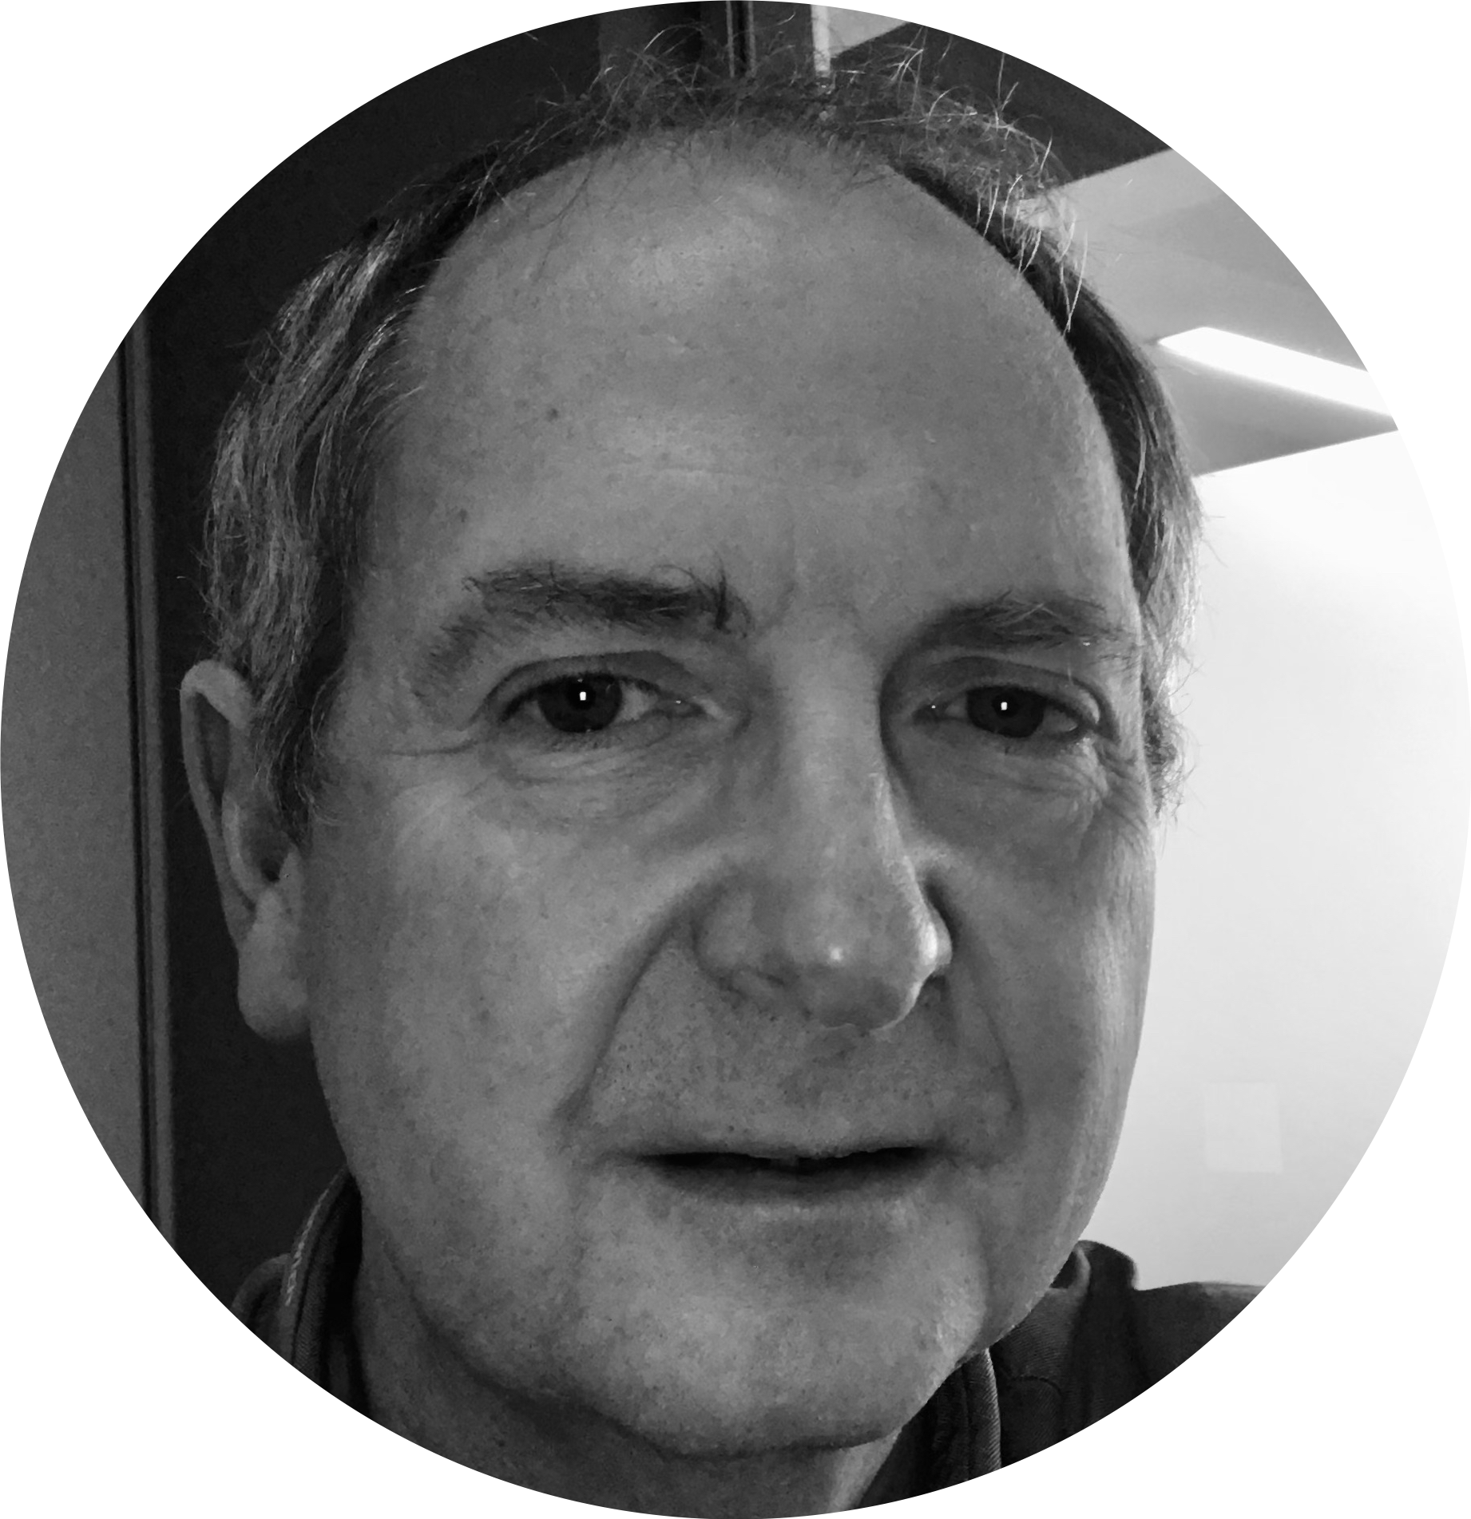
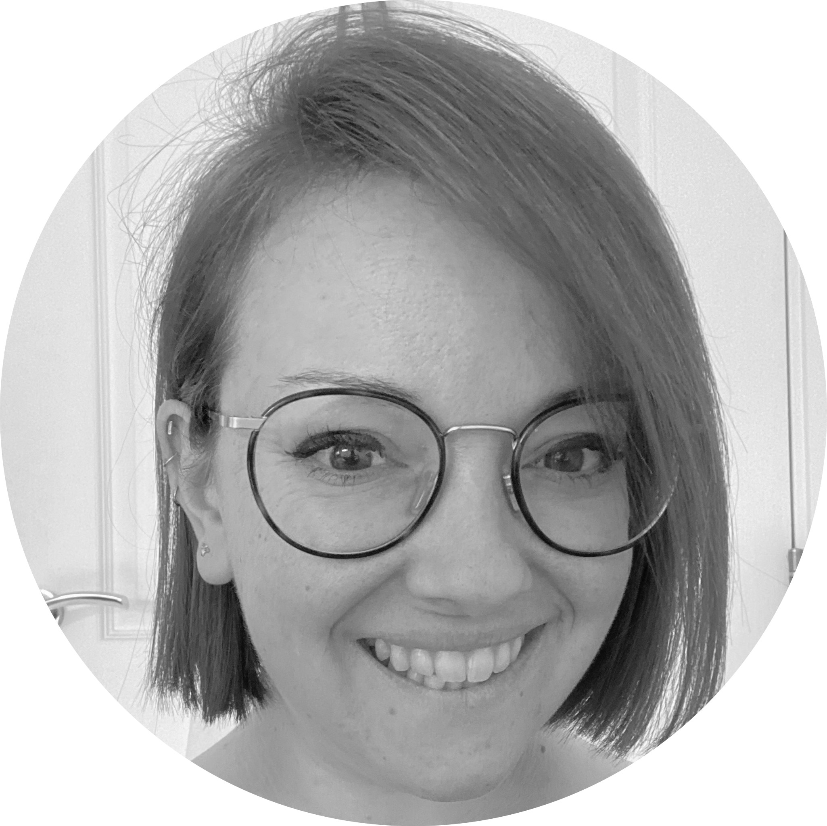
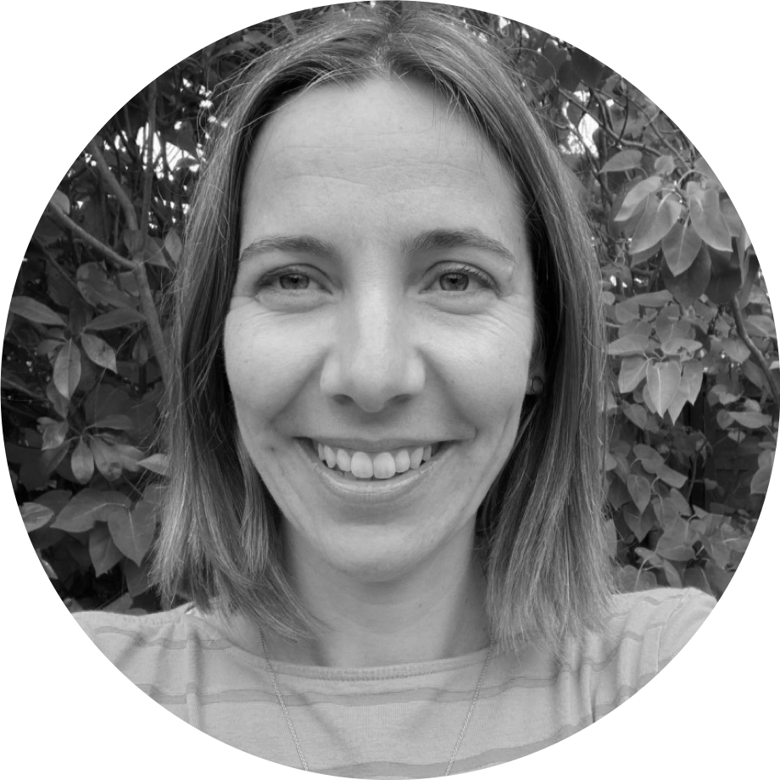
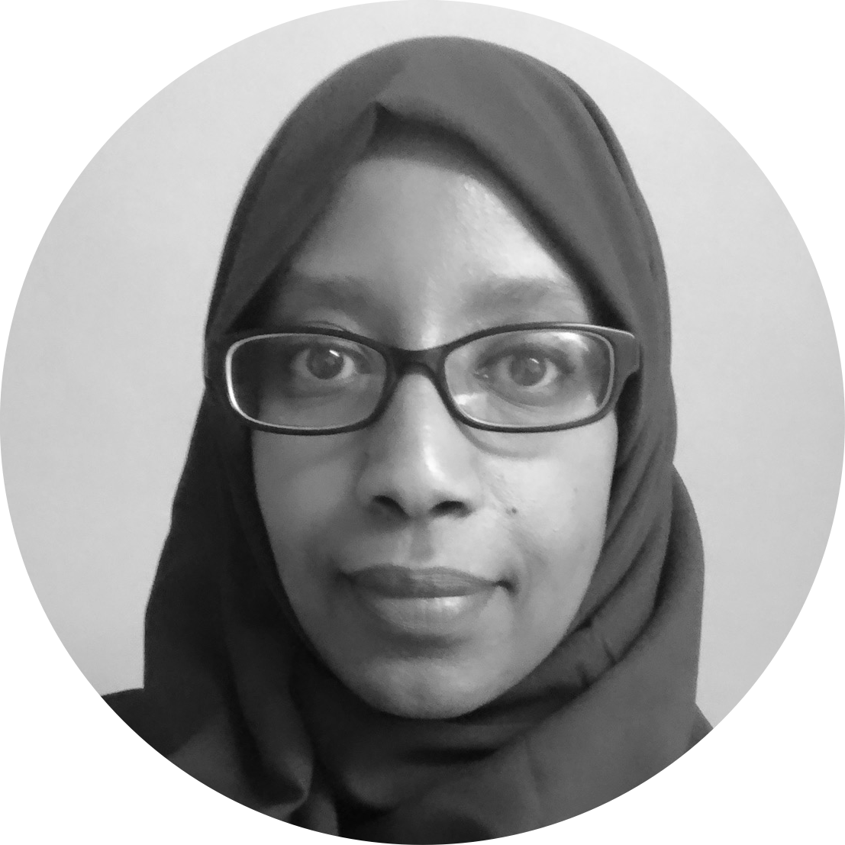
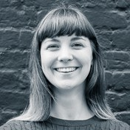
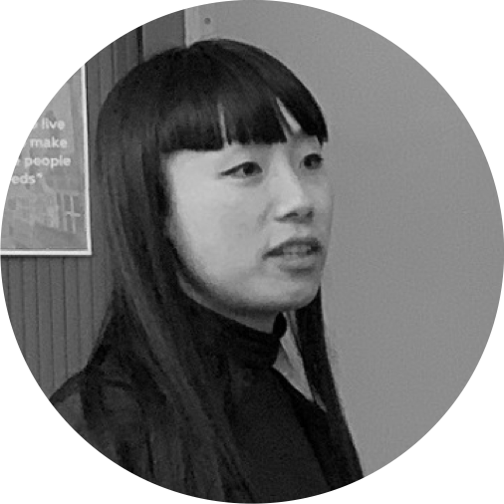
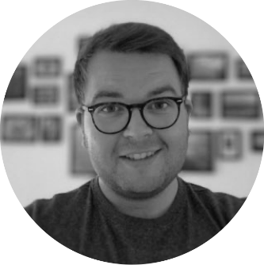
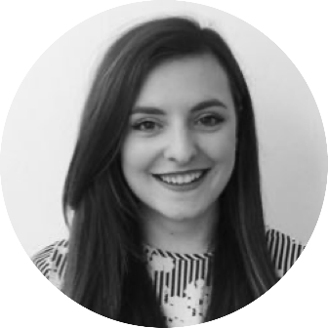
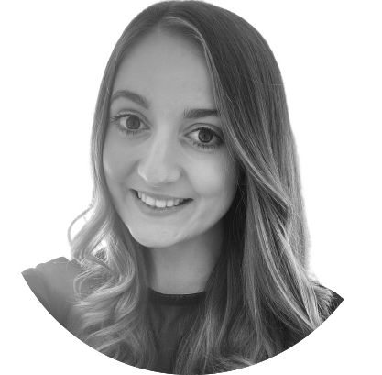
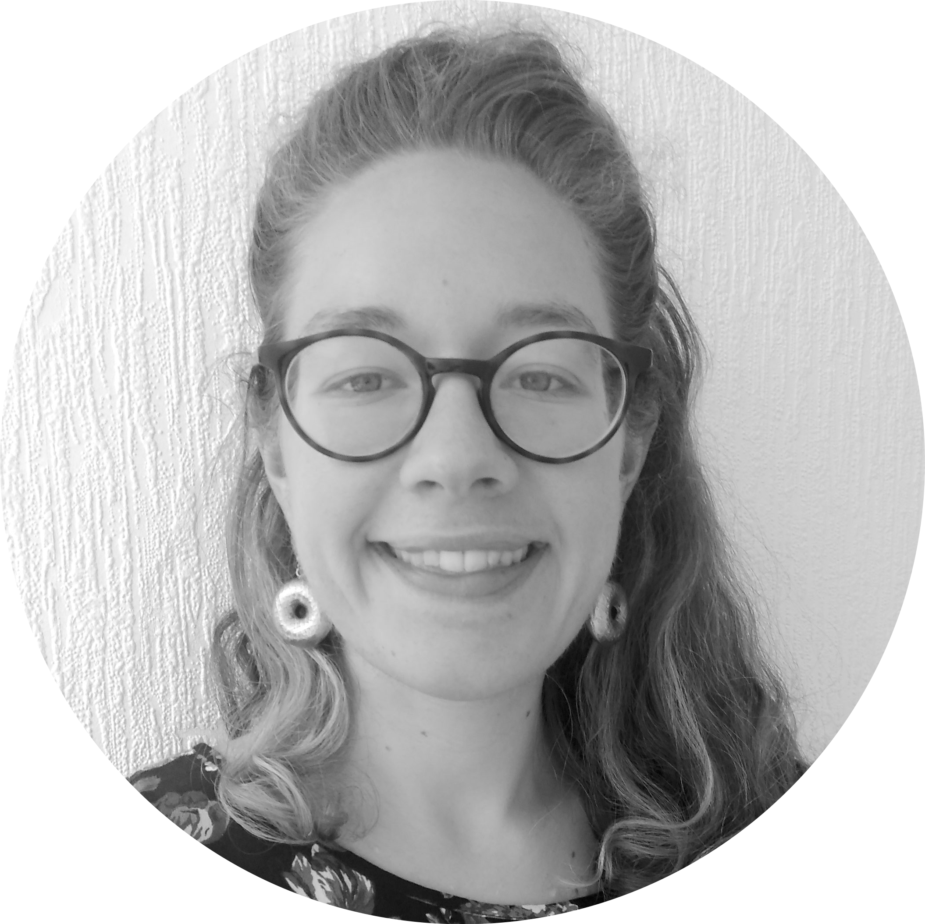
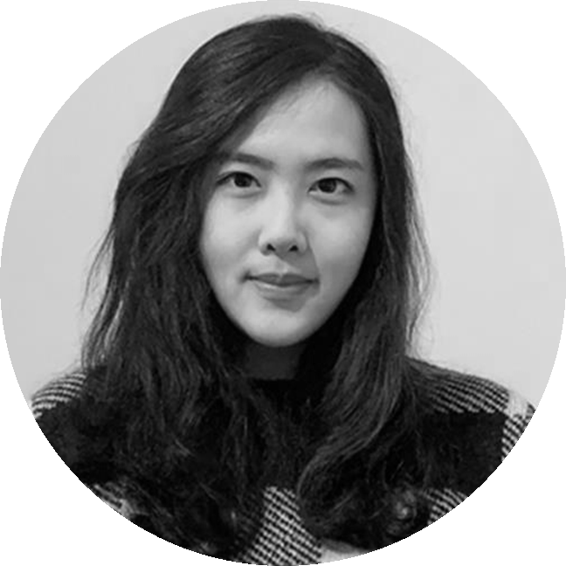
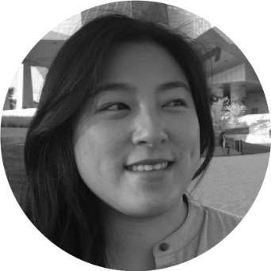
A blended team from across the council
Steve Ollier
Principal Performance Officer Health & Adult Services
Rebecca Layng
Programme Manager
Health & Adult Services
Alexia Fergus
Senior Manager
Health & Adult Services
Hibak Yusuf
Early Help Team Leader
Children Services
Lizzie Cullen Davison
Software Developer
TPX Impact
Lingjing Yin
Head of Product
Digital and Customer Services
Alex Sturtivant
Product Manager
Digital and Customer Services
Beth Mindham
Delivery Manager
Digital and Customer Services
Alysia-Marie Annett
Senior Content Designer
Digital and Customer Services
Connie Wroe
User Researcher
Digital and Customer Services
Yu Hsuan
Service Designer
Digital and Customer Services
Jenny Thai
Senior Product Designer
Digital and Customer Services

Slide 7
Our mission
To design a reusable community directory product that:
makes local information, advice and services more accessible, intuitive and easy to navigate for residents
creates a more sustainable and devolved way to publish and update content for all organisations and service providers involved
Notes:
Alex

Slide 8
Today’s theme: synthesis
Notes:
Alex?

Slide 9
Our focus right now is drawing insights from our research
We started our project with a high-level understanding of the problems
We’ve run lots of research to try and better understand those problems
Over 50 residents, inc. 7 in-depth interviews
7 local service providers
5 referrers
15 RBG staff members
We’re now trying to connect the dots together to see what problems are the most important for us to solve if we want to achieve our mission

Slide 10
Capturing our users’ needs, pain points, and desires
Notes:
Alex?

Slide 11
Value Proposition Canvas
Their desires
What they need to do
Their pain points
How our product will meet their needs, pain points and desires
(not filled out yet)

Slide 12
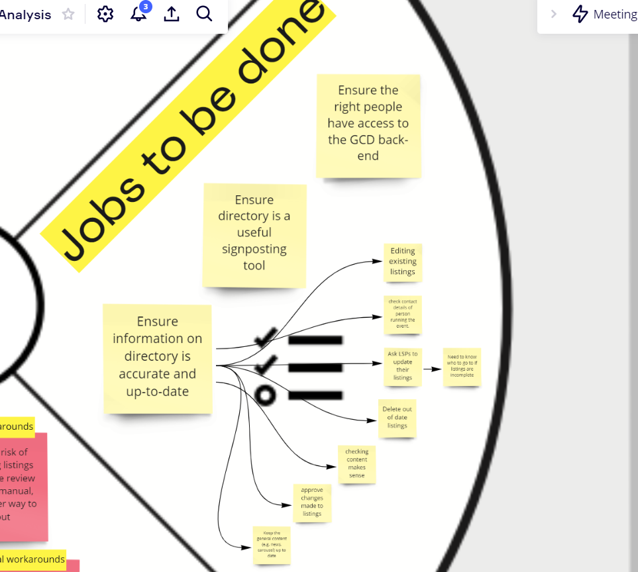
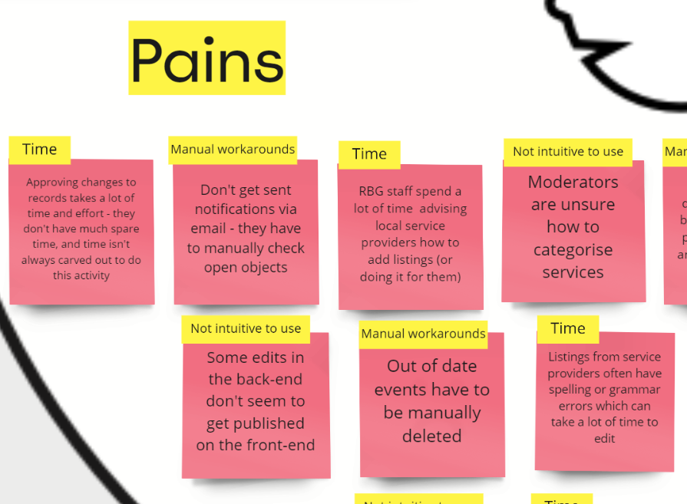
Value Proposition Canvas

Slide 13
Connecting the problems we’ve observed
Notes:
Alex?

Slide 14
Problem map
Causes
Problem
Consequences

Slide 15
Problem map – focused reading time
We're now going to give you 10-15mins to read through our problem map in more detail. You can do this by either:
a) opening the image we've just posted in the chat
b) staying on the call and following our screen
Feel free to add comments or questions in the chat as you read. After 10mins of reading we will open for discussion to hear your thoughts. We are now going to post some (optional) prompt questions for you to consider whilst reading.
After the discussion, we have another small interactive activity but we will explain this when we get to it!

Slide 16
Next steps
Over to you!
Update our problem map with today’s feedback
Create written problem statements
Prioritise the problems – what do we need to answer now?
Run experiments to try and solve the prioritised problems
We'd love to know your thoughts and answer any questions you might have.
Comment in the chat or speak up 🙂
What stood out to you?
What questions do you have?
Notes:
Stepping back to see how problems relate to each other
Prioritising areas we should do more testing in
Validating that we’re solving a complete problem for users

Slide 17
Thank you for coming!
Ways to stay in touch:
Read our weeknotes – these are sent to all Show & Tell attendees every Friday
Come to our future Show & Tell events
Send us an email or a message on Microsoft Teams:
Bethany.Mindham@royalgreenwich.gov.uk
Alex.Sturtivant@royalgreenwich.gov.uk

