Slide 1
Rebuilding Greenwich’s
Community Directory
Show & Tell #5
21/04/2022
Please note this Show & Tell will be recorded
Notes:
Beth slides 1-8

Slide 2
Before we go any further let’s answer the question:
What is a Show and Tell?
Notes:
Before we get into it, it’s worth saying a bit about what a ‘show and tell’ is for.

Slide 3
A Show & Tell is a regular event where...
You "tell”
Tell us what you think:
Things we may have missed
Offer knowledge we may not have
Support areas we are struggling with
We "show”
Share approach and rationale
Demo ongoing work
Share insights gathered

Slide 4
Why do we do them?
Get feedback from everyone, to shape what we do next
(not just those involved in the day to day work)
Make connections with other work and knowledge
Show progress early and often
Notes:
It’s a way to share learning from a project as you go. Often, change programmes or technology projects will do all the work, and then tell everyone only when the change is about to go live
This is different – it's about sharing the analysis, thinking and learnings continuously.
First one today will be a bit different – setting the scene and introducing the work, with only a little bit about our findings.
you can expect:
Us to show our progress – what have we been doing, and what have we learned?
To have a chance to influence the work. We want to hear what's important to you, and what we’ve missed
To be able to draw links to other projects or initiatives that we might not know about

Slide 5
Today we want to:
Recap what the community directory is and why we’re replacing it
Share our headline findings from our 3 weeks of rapid research phase with residents and our plan for the next phase
Explain the approach we are taking for research with local service providers, including a recap on Outpost and why we are testing it
Share some work in progress around the shape of the team
Explain what we're doing next
Hear your thoughts, questions and feedback

Slide 6
The team

Slide 7
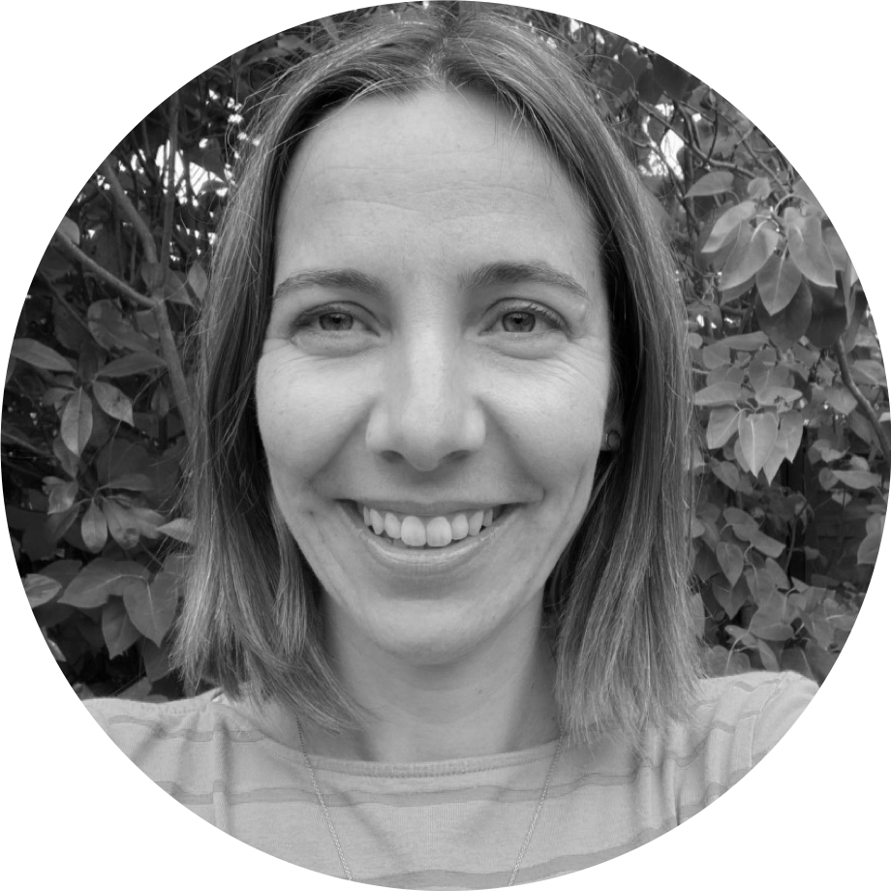
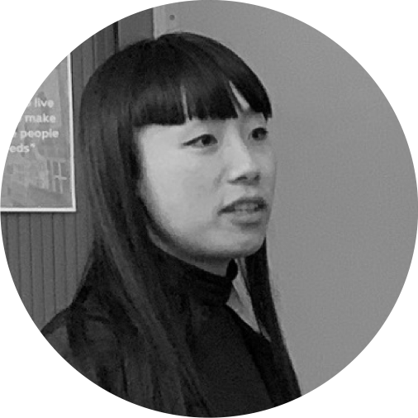
A blended team from across the council
Steve Ollier
Principal Performance Officer Health & Adult Services
Rebecca Layng
Programme Manager
Health & Adult Services
Alexia Fergus
Senior Manager
Health & Adult Services
Hibak Yusuf
Early Help Team Leader
Children Services
Lizzie Cullen Davison
Software Developer
TPX Impact
Lingjing Yin
Head of Product
Digital and Customer Services
Alex Sturtivant
Product Manager
Digital and Customer Services
Beth Mindham
Delivery Manager
Digital and Customer Services
Alysia-Marie Annett
Senior Content Designer
Digital and Customer Services
Connie Wroe
User Researcher
Digital and Customer Services
Yu Hsuan
Service Designer
Digital and Customer Services
Jenny Thai
Senior Product Designer
Digital and Customer Services

Slide 8
Our ask of you for the next hour…
Be as present as you can
Actively participate but also leave room for others
This is our fifth Show & Tell at Greenwich - we want to set an encouraging and open space where we as the team and you as the audience feel brave enough to say ‘I don’t know’ if something isn’t clear or we don’t have the answer yet.

Slide 9
Context
Notes:
Alex?

Slide 10
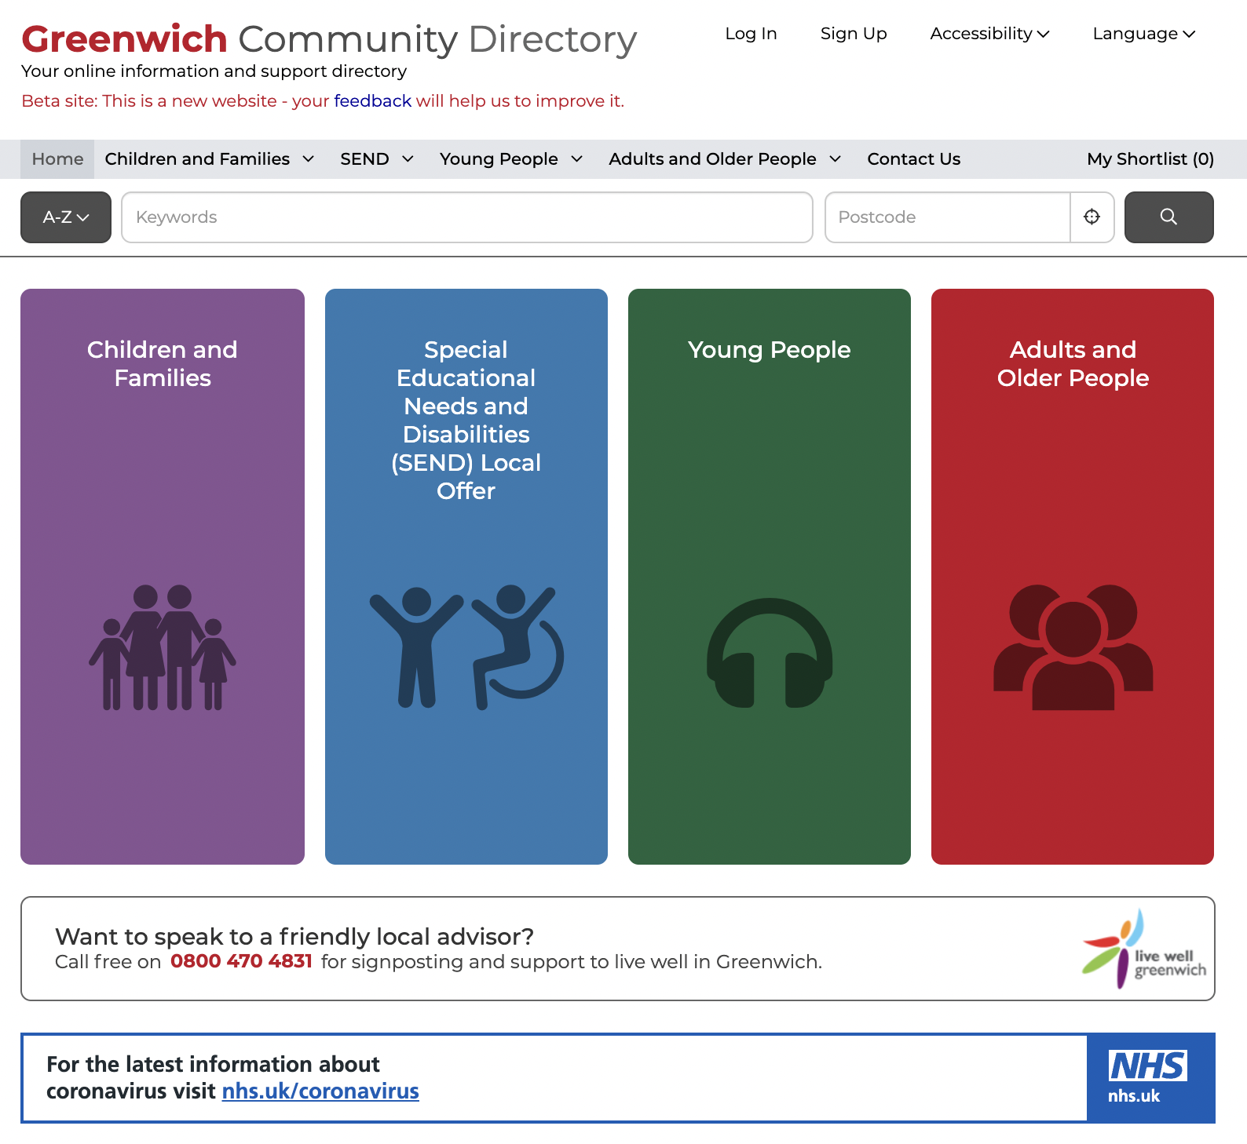
What is the Greenwich Community Directory?
First launched in 2015, the GCD is a directory of health, social care and community services in Greenwich that:
signposts people of all ages to support
focuses on the voluntary sector
is a key part of prevention - early intervention
is used by both public and professionals
has over 2,600 live listings
has over 8,000 sessions per month
Residents can call the Live Well Greenwich or Families Information Service Helpline for additional support over the phone too.
There are certain statutory requirements for us to maintain a directory of local services for residents.
Notes:
Alex
The Greenwich Community Directory is a directory of health, social care and community services in Greenwich:
Initially it was a response to the Care Act requiring LA to sign post residents to services available across the community in particular those provided by the voluntary sector. It gave residents access to info on social care, health and wellbeing.
The voluntary sector play a key role in prevention and early intervention (for example supporting people with Dementia).
The Directory is also used by professionals: RBG staff, NHS staff, GPs to support their work – through Social Prescribing. For example Community Centres are encouraged to list activities which can assist with social isolation – most recently the Carers Centre page has been updated with December's activities.
With over 2600 live listings on the directory there is a rich mix of advice and support services.
GCD is a crucial digital product to allow communities find local service information. It connects to the core services council offers too.
Since the launch of the Directory there has been a significant increase in its usage from just over 1000 sessions per month in 2016 to over 8000 by 2020. Increasingly it is recognised by the voluntary sector and local organisations as a good place to list services, activities and events.
In 2019 the Directory was expanded by merging with the Families Service Directory and SEND Local Offer offering listings across all age groups and we'll hear more about that from Hibak in a few minutes.
The Directory includes a telephone support service provided by Live Well Greenwich – delivered by CACT. This helps members of the community who are perhaps less confident with computers/IT.

Slide 11
Why are we replacing the GCD and why now?
What problems are we solving?
Navigating local services and information can be overwhelming for residents
The way content is currently managed is not fit-for-purpose and causing frustration
The content on the directory is inconsistent in its format and categorisation
The current GCD platform is inflexible and outdated
What outcomes are we trying to achieve?
Make it easier for residents to find and access services they’d benefit from
Make it more efficient for service providers in Greenwich to promote their services
Make it easier for RBG staff and community professionals to refer residents to the right service
Ensure service information within the borough is up-to-date, accurate and with less duplication
Notes:
Alex

Slide 12
Our mission
To design a reusable community directory product that:
makes local information, advice and services more accessible, intuitive and easy to navigate for residents
creates a more sustainable and devolved way to publish and update content for all organisations and service providers involved
£350,000 central gov funding to boost our product development capability
Notes:
Alex

Slide 13
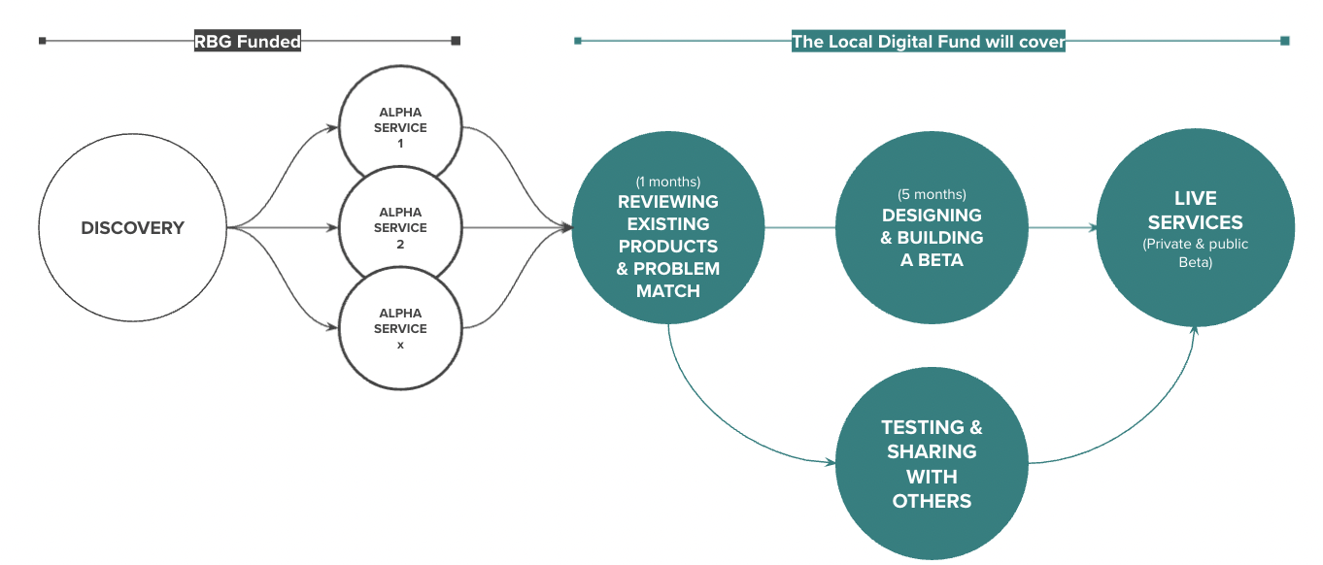
Our delivery plan
Funded by the Local Digital Fund
We’re here
And about to start some Alpha activities
DISCOVERY
ALPHA
BETA
Understand the context and problems
Test different solutions
to the problems
Build, refine and improve
the service
Notes:
A

Slide 14
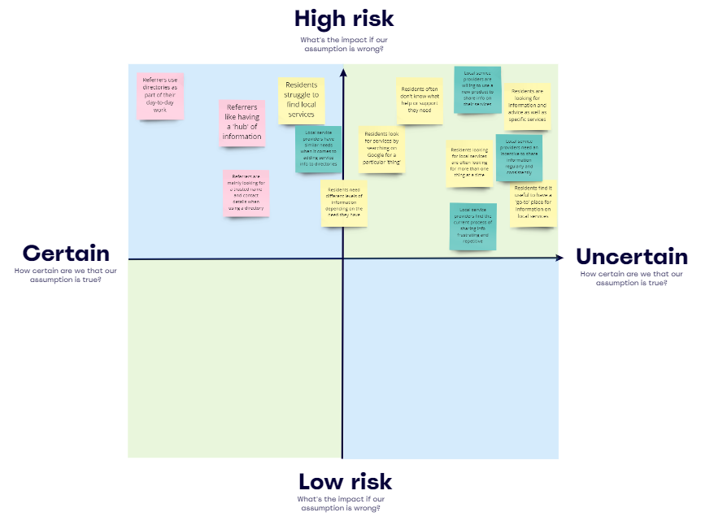
Our current focus
1) Research with residents around 3-4 specific user needs
Ask residents how they look for information around the user need
Test our assumptions about their needs and behavior
Use a mix of research and prototyping techniques
Build empathy and understanding of the experience residents have
2) Research with a range of service providers
Exploring how service providers share information to directories
Test our assumptions about their needs and behavior
Use a mix of research and prototyping techniques
Build empathy and understanding of the experience they have
Notes:
Alex – then going into the two different focuses

Slide 15
Resident focus -
Wrapping up
rapid research phase
Notes:
Steve

Slide 16
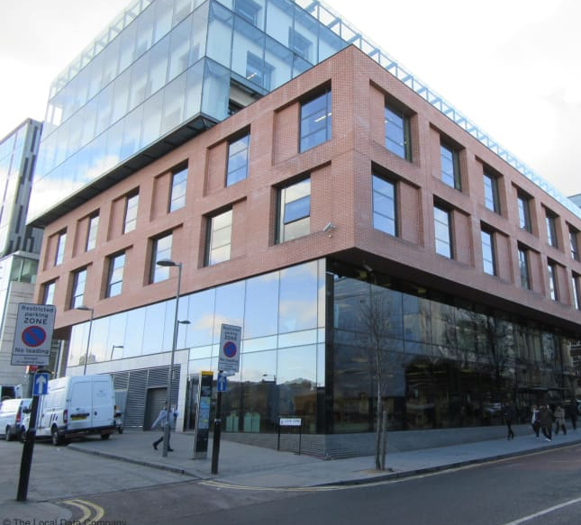
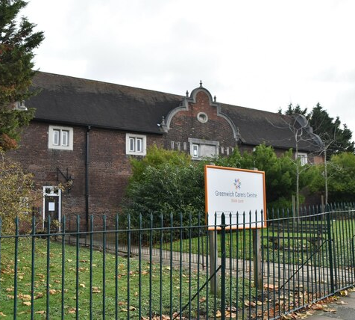
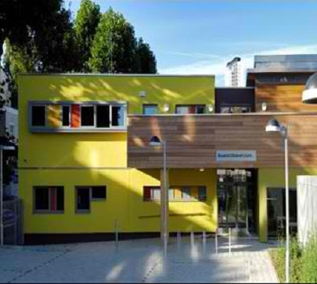
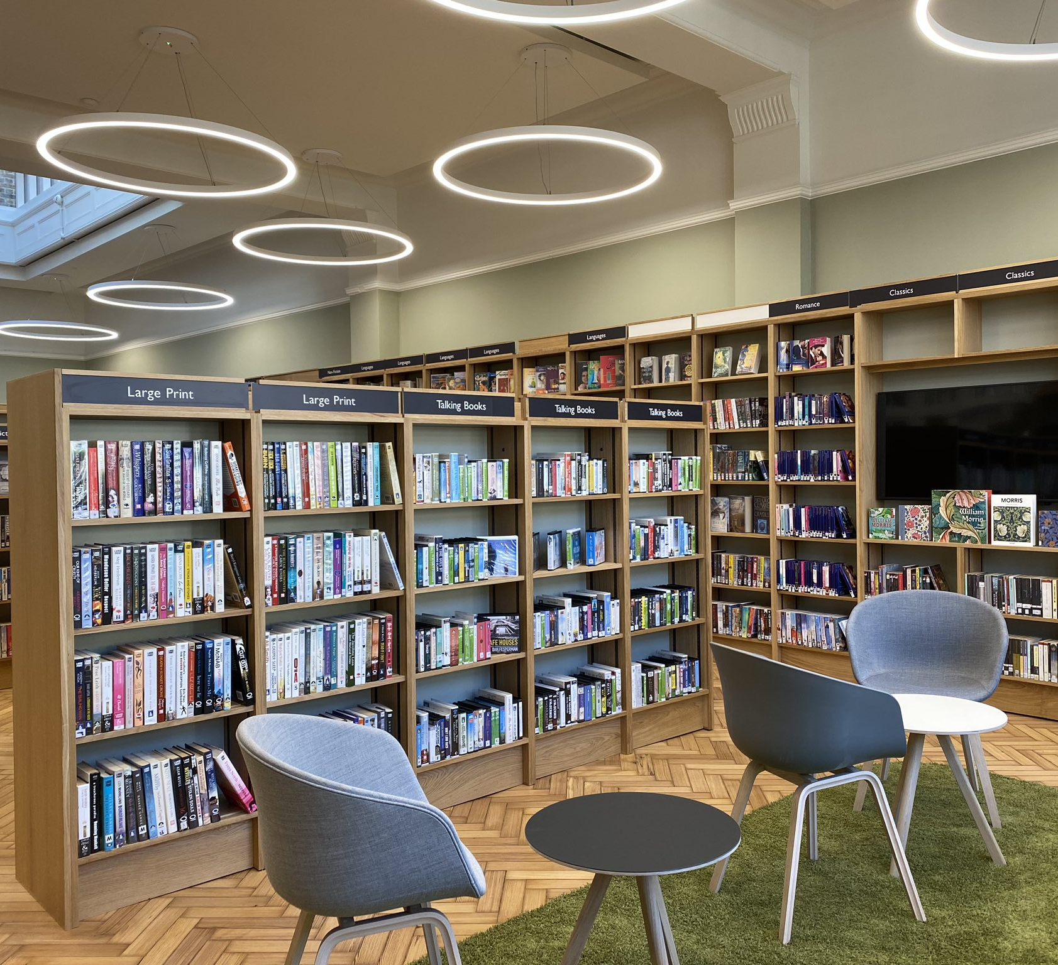
Engaging with residents
Finalised 3-week rapid research
Location: Libraries, Carers Centre, One Stop Advice shop, Children's Centre
Speaking to residents about how they currently navigate information and local services
Over 50 residents spoken to
Positive response to further in-depth interviews
Woolwich Centre Library
Greenwich Carers Centre
Brookhill Children’s Centre
One Stop Advice Event
Notes:
Steve

Slide 17
Key findings from resident rapid research
Directories are not a first port of call for residents – many people are not aware of the GCD
Finding broad information encompasses a mixture of online and offline touch points, of which the GCD could play one step in the wider journey.
Google is a comfortable, safe and familiar starting point for those who at the start of their info-finding journey, others will start further along at a specific known place
Trust comes in all shapes and sizes, through word of mouth or a recommendation, where trust is earned through reliable content.
Social Networks - Meeting people who are in the same situation as them and they trust their suggestions more.
Practical information is important to residents; they want to make sure of the accuracy, the eligibility, & the accessibility before they join the session.
Notes:
Steve
Firstly - Directories are not a first port of call for residents, "if you know it, you might use it, but otherwise you don't know it exists" [RBG staff]
Finding broad information covers a mixture of online and offline touch points, of which the GCD could play one step in the wider journey.
Google is a comfortable, safe and familiar starting place for those who at the start of their info-finding journey, others will start further along at a specific known place. The journey is non-linear
Trust comes in all shapes and sizes, through word of mouth or a recommendation,
Trust is earned through confidence in reliable content.
Social aspects often stand out as a common need across user groups. By this we mean meeting people who are in the same situation as them and they trust their suggestion more.
Practical information is important to residents; ensuring it’s accurate, it includes eligibility information , and also info about accessibility.
I’m now going to hand over to Sharon.
1) Directories are not a first port of call for any residents, rather they are referred/signposted to this, "if you know it, you might use it, but otherwise you don't know it exists" [RBG staff]
2) Finding broad information encompasses a mixture of online and offline touch points, of which the GCD could play one step in the wider journey. Journey is non-linear (and could perhaps be quite messy).
3) Google is a comfortable, safe and familiar starting place for those who at the start of their info-finding journey, others will start further along at a specific know place e.g. Brookhill Children's Centre website (under Home Start website).
4) Trust comes in all shapes and sizes, through word of mouth from somebody who is similar to you or a recommendation, where trust is earned through reliable content, which it currently isn't.
5) Social aspects often stand out as a common needs across user groups. No matter parents or carers, they would like to meet people who are in the same situation like them and they trust their suggestion more.
6) Pragmatic information is important to residents; they want to make sure the accuracy (is it still running?), the eligibility (who is eligible, who can join), the accessibility (how can I park my car and the equipments) before they join the session.

Slide 18
A story we heard from a resident at Brookhill Children’s Centre
Demographic
Meet Lana, she is 34 years old, and has a 18-month son and a 7-year-old daughter.
Goals needs
I want to find out what activities I can do with my baby (under 2 years).
Requirements
She needs classes that fit around her flexible working pattern. She doesn't want to travel too far either.
Trigger to look for information:
She has an 18-month son who due to COVID-19 is very shy and doesn't socialise well with other children.
Steps
Google 'baby classes near me'
Refine my search 'activities for 2 year olds Plumstead'
See Brookhill Children's Centre on results
Ask suggestion from the other parents
Re-googles Brookhill CC and goes straight to website
Book the session on phone
Attend the session
Channels
Google - Search
Google - Home Start
Google Maps
WhatsApp
Google – Home Start
Phone
Children centre
Word of mouth
Paper timetable
Detailed
actions
I will open and use my smartphone to Google
I find RBG Home Start
I see Plumstead Children's Centre
I then click 'Children's Centres' as i want to see more
I google map on my phone, and it's close
I look at timetable for Brookhill.
I wait to pick up child in person at school gate
I click on website and see timetable for Brookhill
I find the phone number to centre
I can see on website says 'booking is required'
I pick up paper timetable in lobby.
Pain
points
Unsure how to book, so I have to check
Google shows things that are far away
Websites do not call out exact age range
Not sure about the location
Not sure if the timetable is up to date
Not sure if the information is up to date
Notes:
Sharon, From the rapid research, we also have an initial understanding of how residents find out support in their daily life. Here is a true story we heard from a resident during our visit at brookhill children’s centre
Demographic
This is Lana, she is 34 years old, and has a 18 month son and a 7 year old daughter. English is her second language.
Goals needs
After Covid regulations are lifted, she wants to find out what activities she can do with her 18-month son that fit around her working pattern and it’s not too far away. So she went to Google, search “baby classes near me” on her smartphone but couldn’t get the result she wants as they are far away and don’t fit her son’s age. So she had to refine the search words, and then found a children centre at Home start, which is a RBG website contains the children centre information , but she had to further check the location on google maps. She finally found brookhill children centre which is nearby but she is not sure the timetable for the activity is up to date. So she wanted to further with friends on whatsapp, waiting at school gate to chat with other parents. Followed the other parents’ recommendation, she wanted to attend the session at Brookhill so she went on google again and went to Brookhill’s website. As she was still not sure about if the information is up to date and how to book the session, she contacted the staff to check. Finally, she successfully attended the session and grabbed the paper timetable in the end to attend the upcoming session.
From this, we know the process to find out the information is often a messier online/offline contextual journey. And GCD would be just one step in a broader longer wider context.

Slide 19
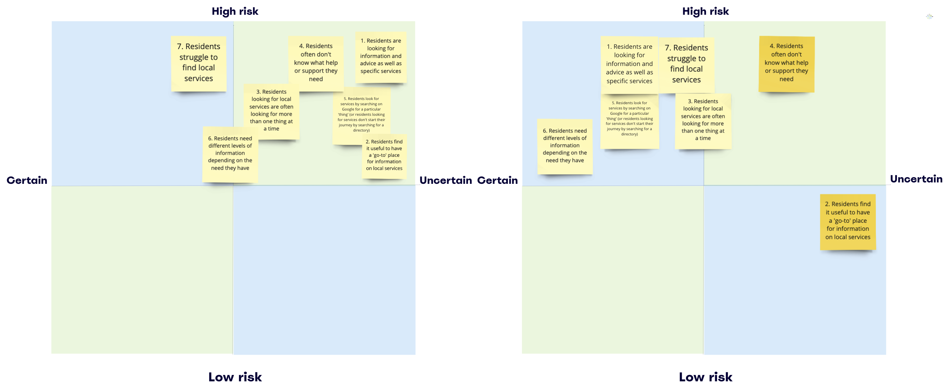
Risky assumptions – before vs. after
Before
After
Notes:
our risky assumptions has shifted after our rapid research with residents.
Now we are more certain on some of our risky assumptions as you can see on the right, we’ve moved around some of post-it to certain.

Slide 20
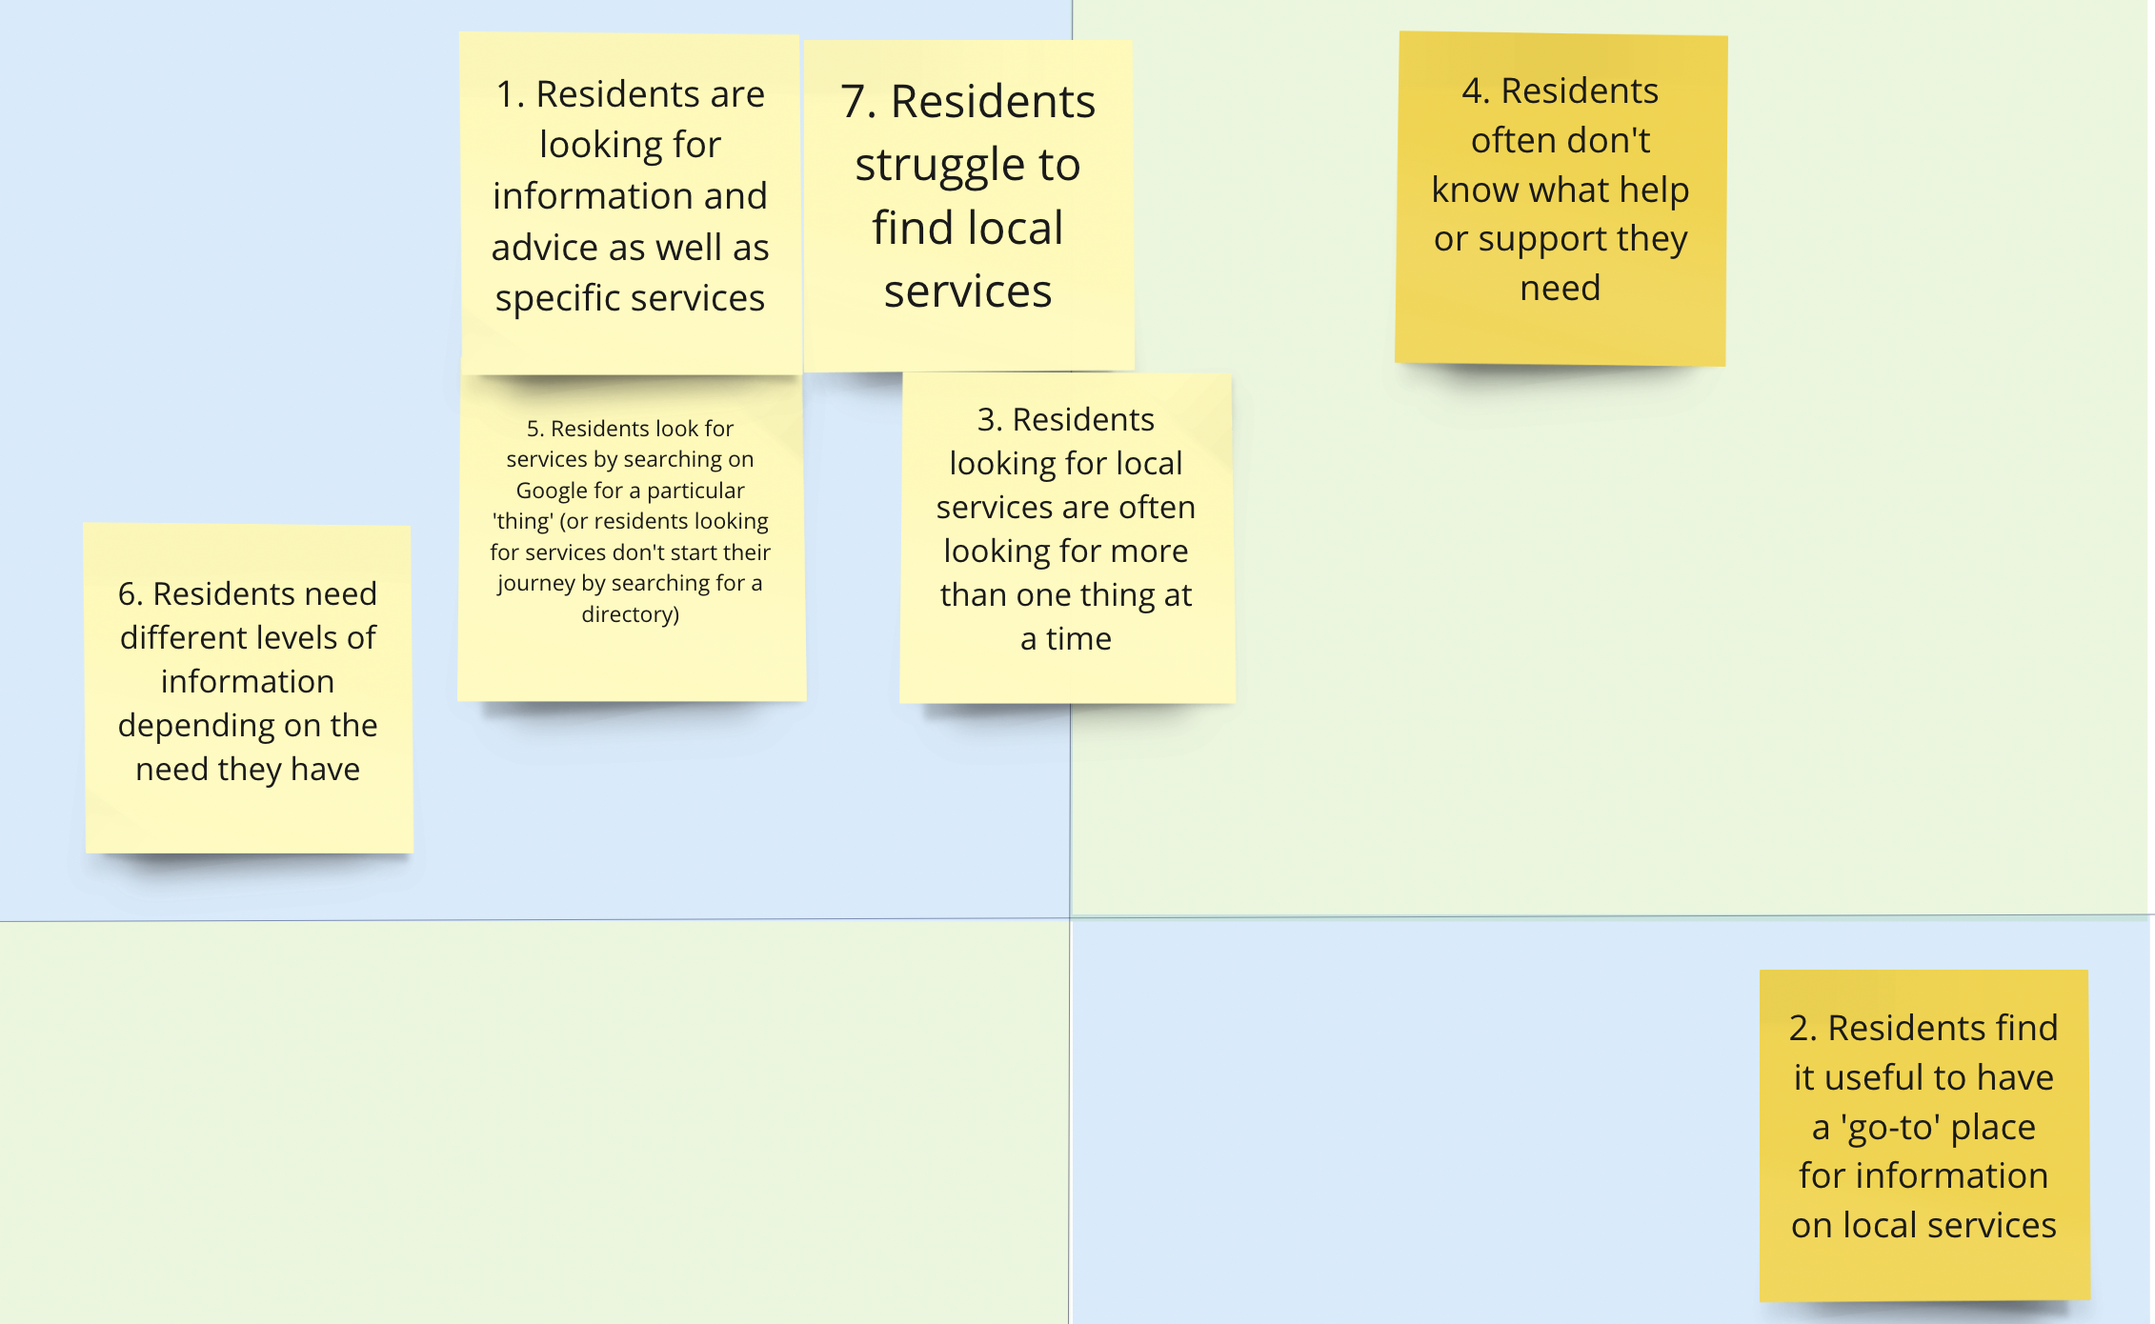
Risky assumptions – next step
High Risk
Known
Unknown
Notes:
Sharon
Some of our assumptions still need further validate, for example, we are still not sure about the assumption 4 on the top right - residents don’t know what help or support they need,
We moved our assumption 2 down on risk as residents might not think or care about this, a problem for us to solve to make sure people can find what they need at the right time.
these will inform our in-depth interview approach with residents so we can further test these assumptions.

Slide 21
Resident focus – where we are now
Rapid research with 50 residents
Set up in-depth interview with residents
In-depth interview with residents
Notes:
As Steve mentioned, we’ve wrapped up our rapid research, and we are currently reaching out to out multiple user groups (parents, young people, adult, carers…) to set up the in-depth interview with residents to have a deeper understanding of their experience and further validate our risky assumptions

Slide 22
In-depth interview approach
What we want to learn ​​
The journey and approaches they take when looking for information, advice and support.
​What are the challenges for resident in their journey
What could help residents to find information/ services in the future.
We'll do this in a 1-hour interview:
Chat to understand residents' need
Exercise to map out their journey
Activity to understand what kind of content is important
Notes:
In the in-depth interview, we want to learn
The end to end offline and online journey the residents go through when looking for information, advice and support
​What are the challenges in their journey
Also explore the future experience and what would be helpful for them
We plan to have an informal chat to understand what kind of information and support do residents need in their day-to-day life, when and how do they find it by conducting an interactive exercise to map out their journey to on post-it. Finally, understand what kind of content is important for residents, this would help us rethink about the information allocation
Then we can translate the findings from interview into prototypes ideas

Slide 23
Local service provider focus

Slide 24
Local service provider focus approach
Engaging with Local Service providers to learn and test how they hold and share data about their services.
Setting up interview sessions with various service providers – starting with initial discussions but increasingly showing and testing prototypes
Working closely with Lizzie – Developer, to help us quickly learn what data Local service providers hold
set up existing platforms to use to test with (we are testing using Outpost and a data standard)

Slide 25
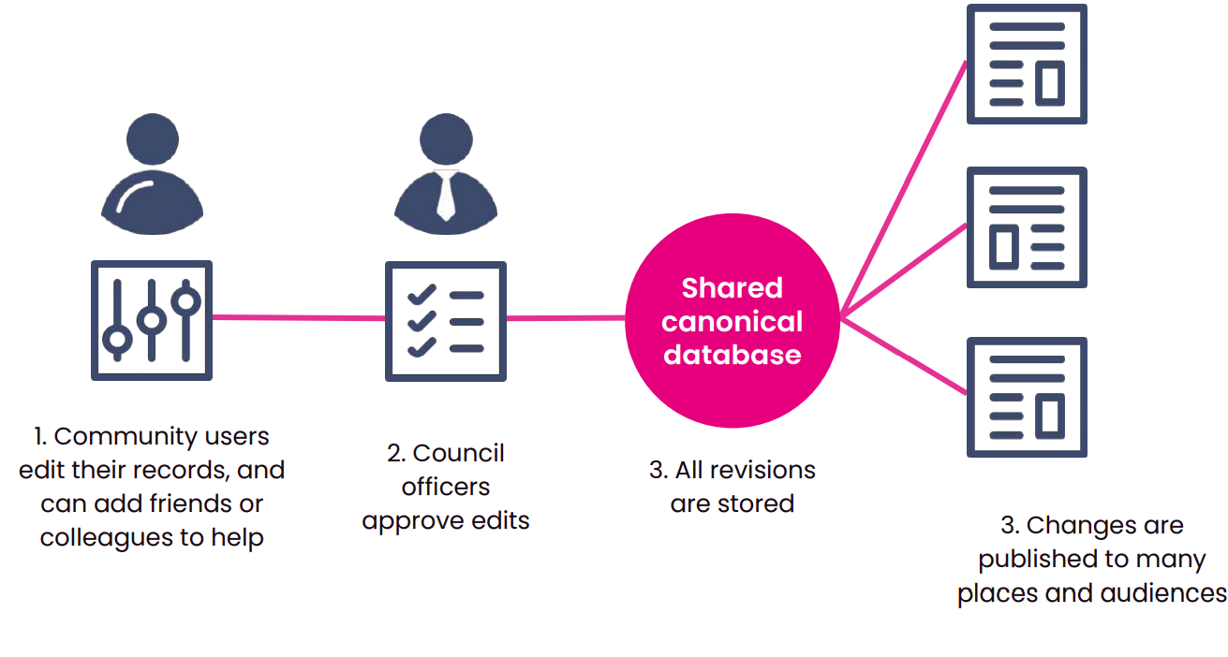
What is Outpost
Outpost is a service listing management system
it holds the data about services
where users (service providers) can add, edit and manage services.
It uses the Open Referral UK data standard
Outpost covers this bit
Community
Directory
Find a childminder tool
….
Notes:
Jenny
Extensible platform that can be used to power anything that needs data about local services
The data can be consumed anywhere, for example a directory built using Scout, other websites.
Works on mobile, slow connections and is WCAG AA compliant
Based on open standards – Open Referral, so it is compatible with other council directories and tools in your org
Open source
It becomes the source of service information so the data can then be used in a variety of ways – eg. Pulled through to a directory.

Slide 26
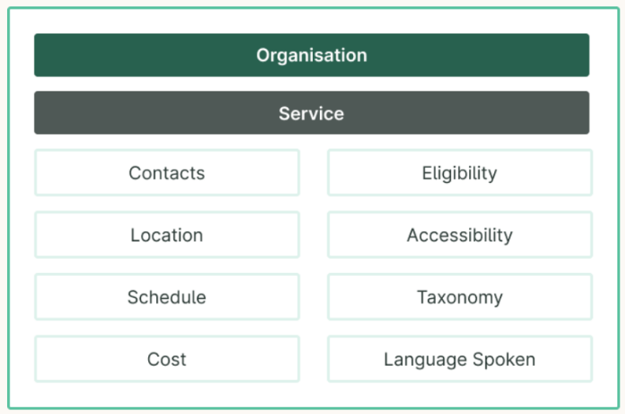
What the data standard looks like
Open Referral UK is a data standard for community services.
A data standard establishes a consistent way of publishing and describing information.
The Open Referral UK standard describes how data should be published for community services. It has several categories of information.
Service will be composed of:
Name
Description
URL (website)
Email
Service schedule will have open and closing times
The data specified to be described would be the fields that a service provider would fill in.
Notes:
Problem it is addressing:
Local government organisations and services collect large amounts of information and data about community services.
Unfortunately, this data is presented in different formats and is collected multiple times in inconsistent ways.
It can be adopted by any service directory, which makes it easier to share information between organisations more easily.

Slide 27
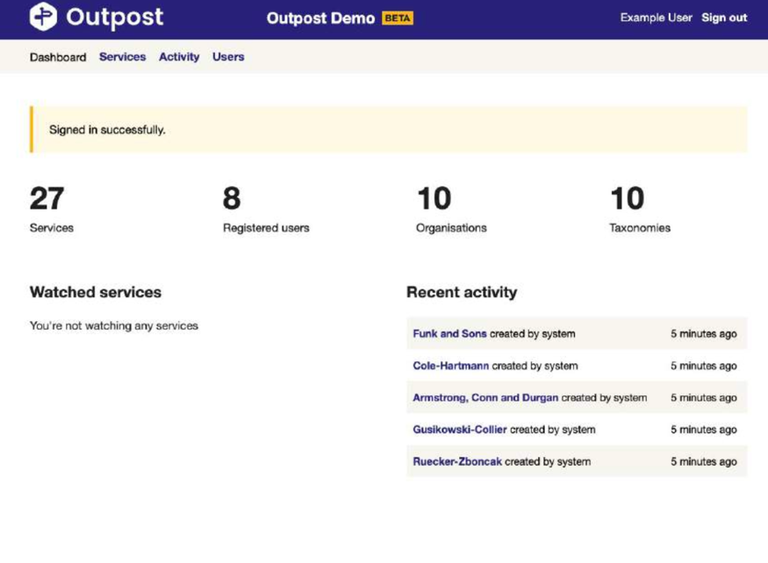
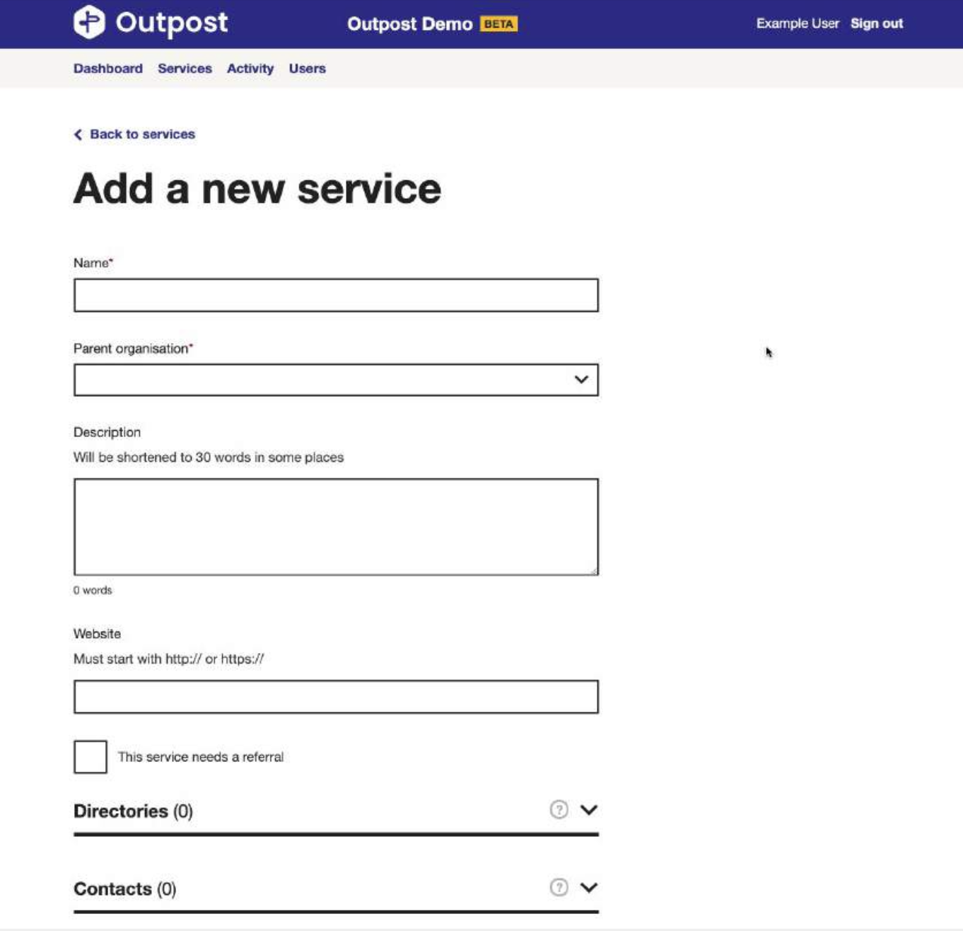
What Outpost looks like
The data specified to be described using the data standard would be the fields that a service provider would fill in.

Slide 28
Why we are testing Outpost
It's quick, cheap and easy to test
Open source
It has been built to be reusable
It uses the Open Referral UK data standard
Has been designed for Local Authority use and with Local authorities
Has been used by Buckinghamshire Council already for two of their services
We are also now working with those that built it - Lizzie
Notes:
Jenny
Extensible platform that can be used to power anything that needs data about local services
The data can be consumed anywhere, for example a directory built using Scout, other websites.
Works on mobile, slow connections and is WCAG AA compliant
Based on open standards – Open Referral, so it is compatible with other council directories and tools in your org
Open source
It becomes the source of service information so the data can then be used in a variety of ways – eg. Pulled through to a directory.
Local government organisations and services collect large amounts of information and data about community services. Unfortunately, this data is presented in different formats and is collected multiple times in inconsistent ways.
It can be adopted by any service directory, which makes it easier to share information between organisations more easily.

Slide 29
Out in the community chatting to people who refer others to local information, support and advice.
Who are we chatting to:
Front-line staff and local service provider
Mixture of current and potential harder to reach GCD users
Referring to a wide range of demographics
Focus of the sessions: Understand how people hold, share and promote and testing some ideas
Notes:
What we are doing:
- contextual learning to test our risky assumptions
- Round 1: testing the data + make iterrations then onto Round 2: more design heavy.
What we have found out so far? / What we have done so far/who we have spoken to?

Slide 30
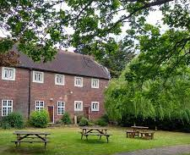
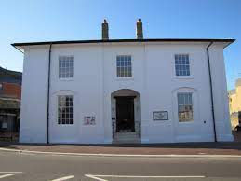
A range of people working directly with residents
Mycenae House, St Mary's Community Centre, The Greenwich Carers Centre, Age UK, South Greenwich Forum.
Local Offer staff, Dementia Hub, Local School Nurses, Social Workers.
Mycenae House
Age UK charity
Greenwich Carers Centre
St Mary's Community Centre, Eltham
Notes:
What we are doing:
- contextual learning to test our risky assumptions
- Round 1: testing the data + make iterrations then onto Round 2: more design heavy.
What we have found out so far? / What we have done so far/who we have spoken to?

Slide 31
Experimentation and work in progress –
team shape
Notes:
Hibak to speak through next steps

Slide 32
Team onion recap
Supporters
Supporters – Cheerleads and champions the project. Helps the core team to assure quality and provides inputs where necessary.
Collaborators – have specialist knowledge and experience to assist the core team. Involved in user research, co-designing and testing of the GCD product.
The Core Team – involved in the day-to day delivery of the GCD. Responsible for planning, designing and developing the GCD product.
Collaborators
Core
Notes:
Beth
We have a framework here to help bring stakeholders and some of the people here today I'm sure into this project. The team will also deliberately engage and co-create with a diverse range of people.
There are so many stakeholders to engage in this work. We did some lighttouch pre-work to understand how the GCD is currently used across different stakeholders at Greenwich.
To ensure we are engaging our internal and external network in the right way at the right time, we are seeing people’s involvement in loosely these three categories.
CORE = Sitting at the core is our empowered product team. They are involved in the day-to day delivery of the work.
COLLABORATORS = Then we have collaborators who are people providing specialist knowledge and who perhaps have strong links to residents and local service provider.
We can't do this work well without knowledge-sharing and learning from the experience of others. An example here could be a frontline worker e.g. social worker, or somebody running a local service e.g. community- run club. They might be involved in user research, co-designing and testing of the GCD product.
SUPPORTERS=Sitting around that, we have supporters, those are senior managers and influencers who cheer lead and champion the work. They help the core team to ensure the quality of the work and provide input where necessary. This can be through S and T's but also through governance boards.

Slide 33
Pivoting our approach to respond to the needs of the team and nature of the work
DISCOVERY
Reducing to a smaller core team to help us work faster as we shift into more alpha activities
Dividing the team into a group of core members and collaborators to ensure we are utilizing everyone’s skillsets, disciplines, capacity and subject matter expertise
Trialing a weekly ‘collaborator’ group session from next week by which the core team will show and discuss work in progress to collaborators for them to:
Critique and challenge
Extend our thinking
Tap us into their networks to help us expand our reach internally and externally
ALPHA
Notes:
Alex

Slide 34
Next steps
Notes:
Hibak to speak through next steps

Slide 35
Over the next 3 weeks, we will…
With residents…
Run our in-depth interviews to better understand their needs and behaviors
Design some activities to find out what content is most important for them
Engage with the Children in Care Council/Care Leavers Forum at their next meet-up
With local service providers…
Finish setting up our test version of Outpost
Run our in-depth interviews and testing sessions
In our team…
Trial our new way of working with our refreshed collaborators group
Notes:
Alex
Mention RBG staff research??
Mention Youth groups/children’s??
Alex?

Slide 36
Questions and feedback
Notes:
Beth

Slide 37
Over to you!
We'd love to know your thoughts and answer any questions you might have.
Comment in the chat or speak up 🙂
What stood out to you?
What questions do you have?
Notes:
We're really keen for this to be a dialogue, so please let us know in the chat as we go, about :
😍 Things you liked
🧐 Things you’d like to hear more about
🤔 Things that surprised you and questions you have

Slide 38
Thank you for coming!
Ways to stay in touch:
Read our weeknotes – these are sent to all Show & Tell attendees every Friday
Come to our future Show & Tell events
Send us an email or a message on Microsoft Teams:
Bethany.Mindham@royalgreenwich.gov.uk
Alex.Sturtivant@royalgreenwich.gov.uk

