Slide 1

Rebuilding Greenwich’s
Community Directory
Show & Tell #2
19/01/2022
Please note this Show & Tell will be recorded.
Notes:
Beth

Slide 2

Before we go any further let’s answer the question:
What is a Show and Tell?
Notes:
Before we get into it, it’s worth saying a bit about what a ‘show and tell’ is for.

Slide 3
A Show & Tell is a regular event where...
You "tell”
Tell us what you think:
Things we may have missed
Offer knowledge we may not have
Support areas we are struggling with
We "show”
Share approach and rationale
Demo ongoing work
Share insights gathered

Slide 4
Why do we do them?
Get feedback from everyone, to shape what we do next
(not just those involved in the day to day work)
Make connections with other work and knowledge
Show progress early and often
Notes:
It’s a way to share learning from a project as you go. Often, change programmes or technology projects will do all the work, and then tell everyone only when the change is about to go live
This is different – it's about sharing the analysis, thinking and learnings continuously.
First one today will be a bit different – setting the scene and introducing the work, with only a little bit about our findings.
you can expect:
Us to show our progress – what have we been doing, and what have we learned?
To have a chance to influence the work. We want to hear what's important to you, and what we’ve missed
To be able to draw links to other projects or initiatives that we might not know about

Slide 5
Today we want to:
Recap what the community directory is and why we’re replacing it
Share our approach to build our understanding of the GCD and the different areas we have focused on
Share the work we have done so far, including our initial hunches about what we think this might mean for the future of the GCD
Explain what we’re doing next
Hear your thoughts, feedback and questions

Slide 6
The team

Slide 7











A blended team from across the Council
Steve Ollier
Principal Performance Officer
Health & Adult Services
Rebecca Layng
Programme Manager
Health & Adult Services
Alexia Fergus
Senior Manager
Health & Adult Services
Hibak Yusuf
Early Help Team Leader
Children Services
Lingjing Yin
Head of Product
Digital and Customer Services
Alex Sturtivant
Product Manager
Digital and Customer Services
Beth Mindham
Delivery Manager
Digital and Customer Services
Alysia-Marie Annett
Senior Content Designer
Digital and Customer Services
Connie Wroe
User Researcher
Digital and Customer Services
Yu Hsuan
Service Designer
Digital and Customer Services
Jenny Thai
Senior Product Designer
Digital and Customer Services

Slide 8
Our ask of you for the next hour…
Be as present as you can
Actively participate but also leave room for others
We have some 'prompt questions' throughout, engage with them as you wish to
This is our second Show & Tell at Greenwich - we want to set an encouraging and open space where we as the team and you as the audience feel brave enough to say ‘I don’t know’ if something isn’t clear or we don’t have the answer yet.

Slide 9
Quick recap
What is the Community Directory and why are we re-designing it?

Slide 10
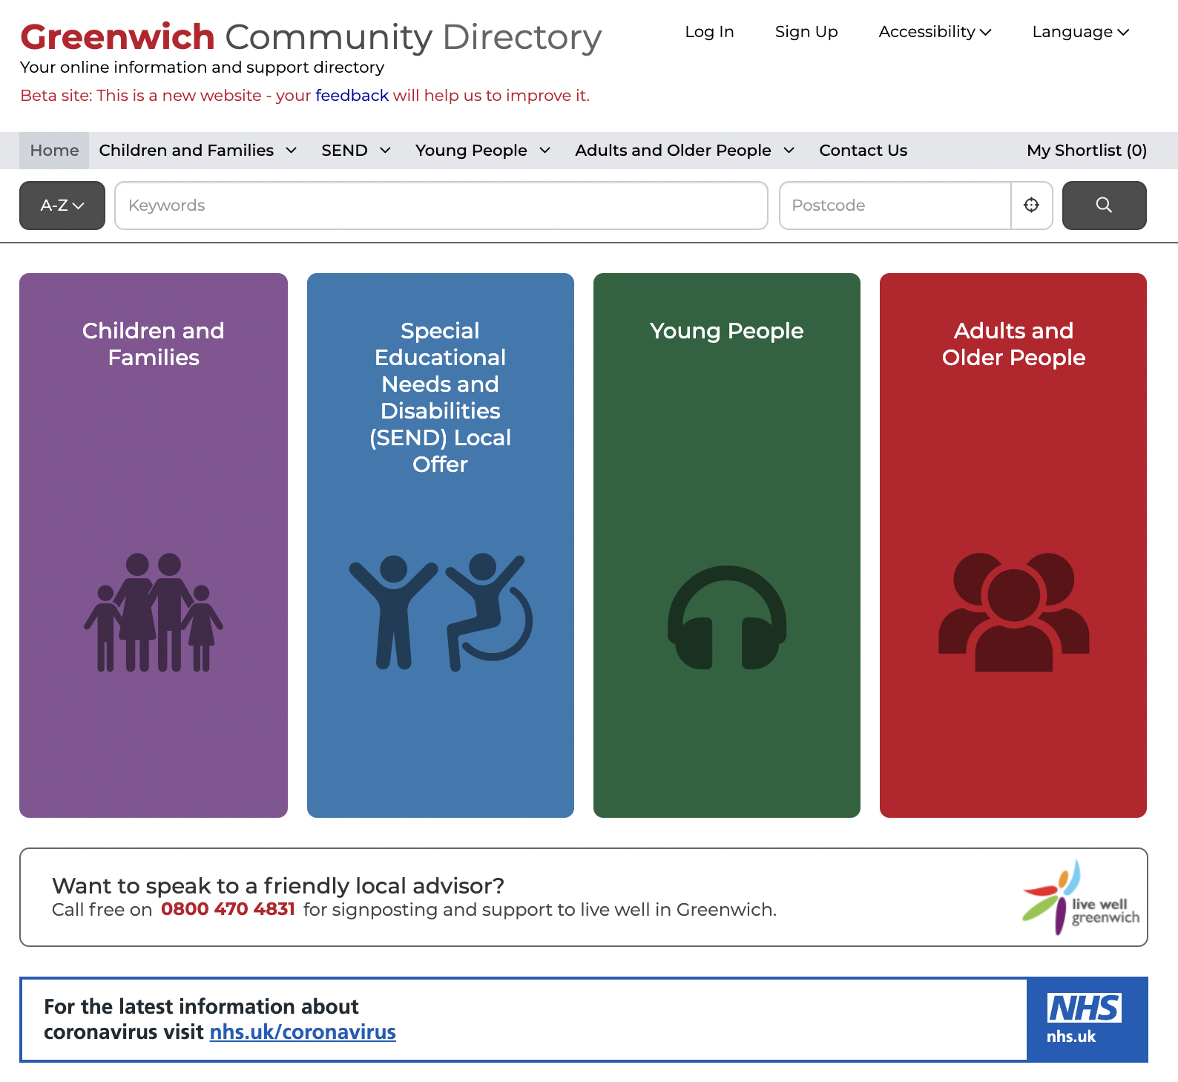
What is the Greenwich Community Directory?
A directory of health, social care and community services in Greenwich, launched in Spring 2015 that:
signposts people of all ages to support
focuses on the voluntary sector
is a key part of prevention - early intervention
is used by both public and professionals
has over 2,600 live listings
had over 8,000 sessions per month (2020)
Live Well Greenwich – Telephone support from Charlton Athletic Community Trust 2017.
It merged with the Families Information Services and Local Offer in 2019.
Notes:
The Greenwich Community Directory is a directory of health, social care and community services in Greenwich:
Initially it was a response to the Care Act requiring LA to sign post residents to services available across the community in particular those provided by the voluntary sector. It gave residents access to info on social care, health and wellbeing.
The voluntary sector play a key role in prevention and early intervention (for example supporting people with Dementia).
The Directory is also used by professionals: RBG staff, NHS staff, GPs to support their work – through Social Prescribing. For example Community Centres are encouraged to list activities which can assist with social isolation – most recently the Carers Centre page has been updated with December's activities.
With over 2600 live listings on the directory there is a rich mix of advice and support services.
GCD is a crucial digital product to allow communities find local service information. It connects to the core services council offers too.
Since the launch of the Directory there has been a significant increase in its usage from just over 1000 sessions per month in 2016 to over 8000 by 2020. Increasingly it is recognised by the voluntary sector and local organisations as a good place to list services, activities and events.
In 2019 the Directory was expanded by merging with the Families Service Directory and SEND Local Offer offering listings across all age groups and we'll hear more about that from Hibak in a few minutes.
The Directory includes a telephone support service provided by Live Well Greenwich – delivered by CACT. This helps members of the community who are perhaps less confident with computers/IT.

Slide 11
Why are we redesigning it now?
Potential Impact | Level of Improvement | Strategic and political Importance | Future proofing the council
Financial Impact: By tackling this, we will save £33,000 software cost per year. There will be indirect savings of staff time spent on navigating information for residents. The platform underpins the GCD ‘Open Object’ is up for renewal in Sep 2022 Depth of Impact: This will significantly improve the experience for residents, particularly those trying to meet their own needs or those of someone they care for to search for information, advice and helpful services at point of need or being prompted by professionals or their networks. Residents with more complex needs might work with ‘Referers’ - who use information services to support people. It will also make the staff’s life easier, particularly those who currently publishing, maintaining and promoting their service information. | For residents By tackling this, we anticipate a significant improvement of our information service. It will reduce duplication of local service information and advice published online hence reducing confusion for users and workload for organisations to keep those information up to date. For staff and organizations updating information We also anticipate achieve efficiencies and make keeping large amount of devolved content up to date more manageable by using modern technology and better content practice. This will also help strengthen partnership with voluntary/third sector - an up to date, well-supported platform to promote their services/offer. | Digital Strategy As part of the digital strategy, it is our ambition to build new resident services which are online by default, with extra help for those who need it. Enabling health and social care to realise their service ambition Tackling on this will gives us the opportunity to review service user’s end-to-end journey and how different RBG digital products can be best optimised to meet their needs. This will strength partnership working between digital and services, creating momentum of transformation in health and social care services. Good story This will create an inspirational narrative for the council. | Re-usable products This will kick us off building reusable in-house product to solve common problems. Cheaper and more sustainable to maintain We will be building on existing products, standards and insights and actively collaborating with other councils. This will ensure we build the right thing that is more sustainable to maintain and respond to uncertainty,
Notes:
Why are we redesigning it:
Ongoing annual renewal costs plus costs to redesign by Idox. Annual maintenance charge £33K.
The platform dates back to 2014 – a redesign is an opportunity to future proof the directory
Improve the user journey – finding the right info at the right time for residents – carers / referrers/ parents/ staff
A new digital tool which is designed to make better use of community services by aligning them with the needs of service users.
Ensuring the content is as update and accessible as possible
Improve the scope for providers to add and update listings and content
A key part of the recently published Corporate Digital Strategy 2020-24 to continuously develop our services and products. - where we can better control them to meet user need.

Slide 12
Our mission
To design a reusable community directory product that:
makes local information, advice and services more accessible, intuitive and easy to navigate for residents
creates a more sustainable and devolved way to publish and update content for all organisations and service providers involved

Slide 13


£350,000 central gov funding to boost our product development capability
Build on existing products, standards and insights
that have already proven to meet user needs and been embedded in existing service context. We will be learning from Outpost and Scout, Open Referral data standard, Local Government Drupal, Essex CC’s Local Offer Discovery, Buckinghamshire’s Family information service.
Build an open-source, API-driven product
to ensure the product is doing one thing very well and offering greater flexibility for a wide range of local governments with different product ecosystems and digital maturity.
Co-invest in a product team
to support the ongoing design, development and maintenance of this product to ensure it’s meeting user needs, solving common problems and is secure to use.
Help other organisations on their adoption journey
through deliberate design and engineering choices, easy-to-navigate documentations of insights, design system and code library, and regular events/ blogging to show our work and answer questions.
Notes:
We have successfully secured £350,000 from the Department of Levelling Up, Housing and Community (Previously MHCLG).This funding will cover the cost of designing and building a new product which can be reused by other Councils.

Slide 14
Our project approach

Slide 15
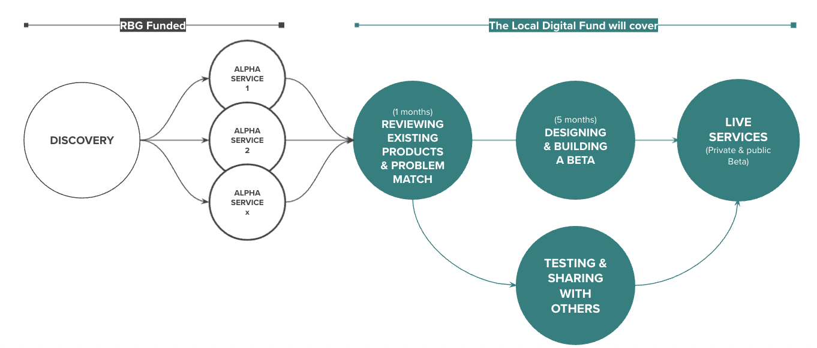

Our delivery plan
Funded by the DLUHC Local Digital Fund
We’re here
DISCOVERY
ALPHA
BETA
Understand the context and problems
Test different solutions
to the problems
Build, refine and improve
the service
Notes:
Alex

Slide 16
We’ve started with 6 weeks of broad research
We’ll be ready to move onto the next stage of our Discovery when:
We have a list of all the services that have a touchpoint in the GCD
We understand what content on the GCD is most and least looked for
We’ve identified the different current main user groups of the GCD
We’ve identified the different ‘potential’ user groups of the GCD
We’ve documented the technical make-up of the existing GCD
We’ve met with other local authorities to learn from their experience of developing directories
We understand the legal and technical constraints of the project
We understand what Scout, Outpost, LocalGov Drupal and Open Referral UK are
We’ve prioritised the services for further exploration
We’ve written our objectives for what to do next
Notes:
Alex

Slide 17
We’ve started with 6 weeks of broad research
Our current ‘workstreams’
Users
Technology
Constraints
Content & Services
Learning from others
Notes:
Alex

Slide 18
Users

Slide 19
What we want to learn
Objectives
1. We understand who the different user groups who currently use the GCD are
2. We understand who the potential user groups who could benefit from using the GCD (but currently don't) are
How we're doing this
Desk research around triggers to finding local information
We've interviewed over 25 staff members
Open Objects and Google Analytics (Children's and Local Offer and Adults)
Notes:
Objectives
1. We understand who the different user groups who currently use the GCD are
2. We understand who the potential user groups who could benefit from using the GCD (but currently don't) are
How we're doing this
Desk research around triggers to finding local information e.g. life events, and also who is involved in a community directory ecosystem.
We've chatted to over 25 staff members to understand who is using the GCD as part of their daily work (whether you're using this as a front-line worker, a service provider e.g., CVS, service commissioners, or whether you're working on the back-end as a listing editor).
We've analysed Open Objects and Google Analytics (Children's and Local Offer side) to understand who is currently using the GCD and identified the most active RBG staff members and local service providers.

Slide 20
What we've found out
Key learnings from this broader phase
64% female and 25 – 34 year-old (Children's and Local Offer)
Many RBG staff/front-line workers have their own personal mini-directories
Different types of information are uploaded to the GCD e.g. events, public health advice, local information which potentially creates duplication across different RBG websites / resources.
Notes:
Key learnings from this broader phase:
64% female and 25 – 34 year-old (Children's and Local Offer)
Many RBG staff have their own personal mini-directories that they keep up to date and use to refer to residents and do not take full advantage the benefits the GCD could potentially bring.
Many RBG staff members / front line workers are using the GCD for different types of information e.g. events, public health advice, local information which potentially muddles the proposition of the GCD.

Slide 21
What we want to learn next
What are our hunches?
RBG staff need a true reason to use the new GCD in their daily work, to help refer people to support services and local information --> we need a promotional strategy here.
Service commissioners at RBG could perhaps play a closer role in ensuring their service areas are up to date.
The biggest difference in user's behaviour is not whether you're looking for yourself or referring somebody else, but rather if you're looking for something specific (closed) vs. looking to be inspired (open).
What do we want to find out next?
We have very little data on which residents spontaneously come across the GCD, it seems many are referred through RBG staff or local service providers, something we will be exploring further.
Deep-dive into specific service area where we will be understanding user needs and pain points (residents, staff, local service providers, front line workers)

Slide 22
Content & services

Slide 23
What we want to learn
Objectives
1. We understand the services that currently have a touchpoint in the directory
2. We understand what content is the most and least looked for
How we're doing this
Content audit
Looking at Google Analytics page views and user behaviour
Analysing search terms and most viewed records from Open Objects
Notes:
Alysia

Slide 24
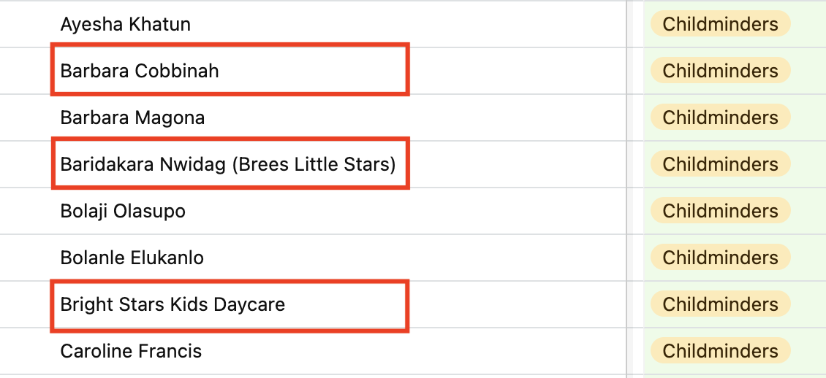
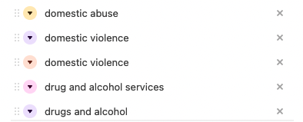
What we've found out
Key learnings from the audit
Service listing title structure is inconsistent
Taxonomy and groupings are similar and listings often overlap
Key learnings from Google Analytics
and Open Objects
Users get lost when navigating on GCD
Users navigate content based on the support they need rather than by content types
Notes:
Alysia

Slide 25
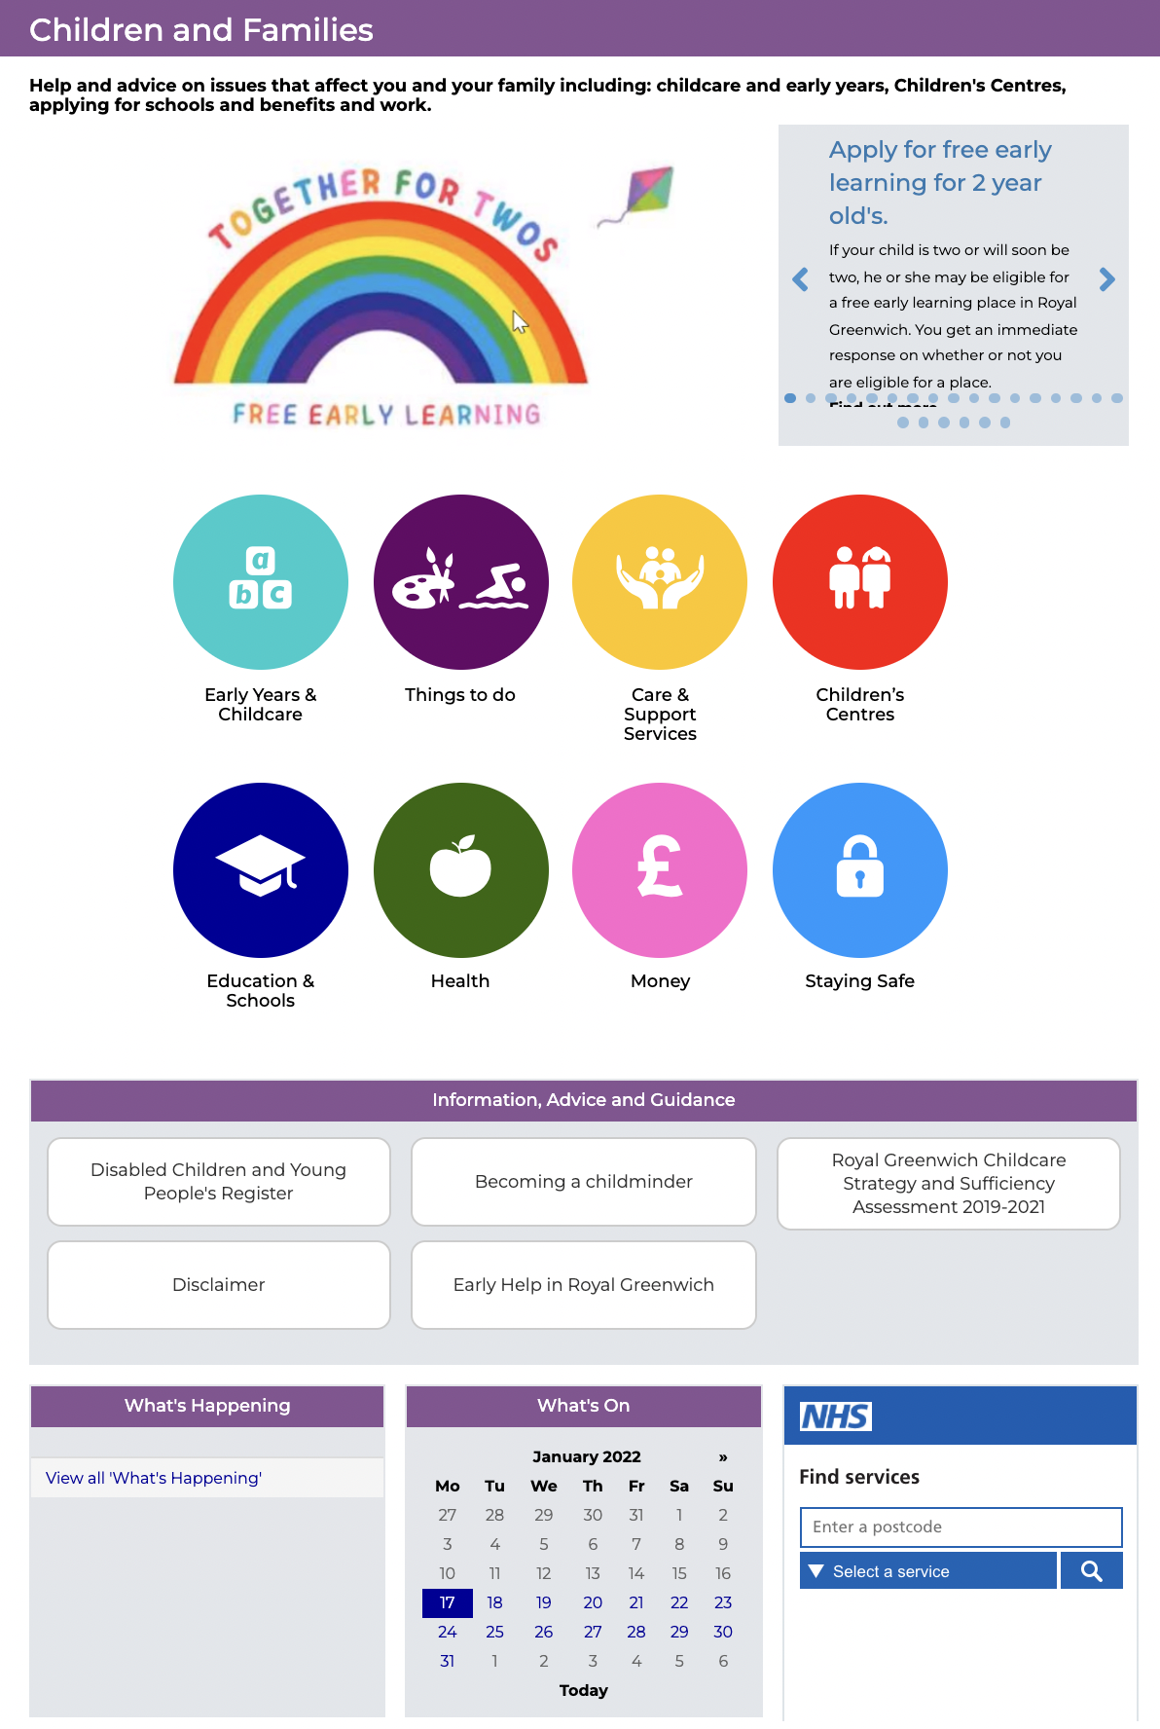
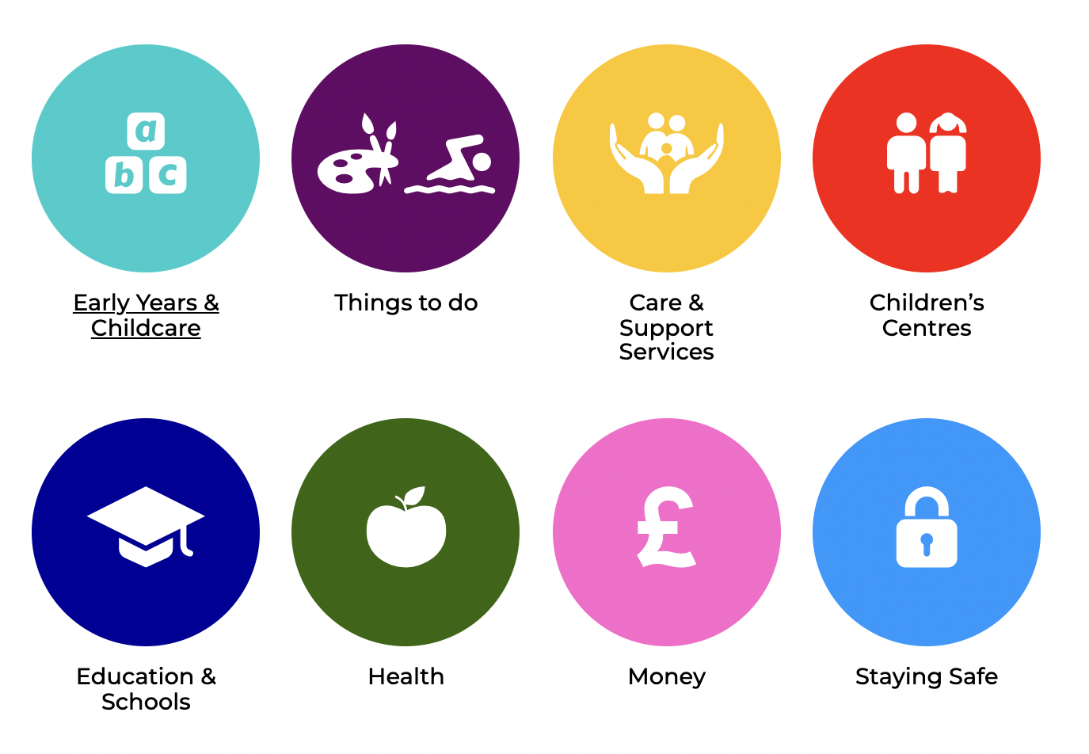
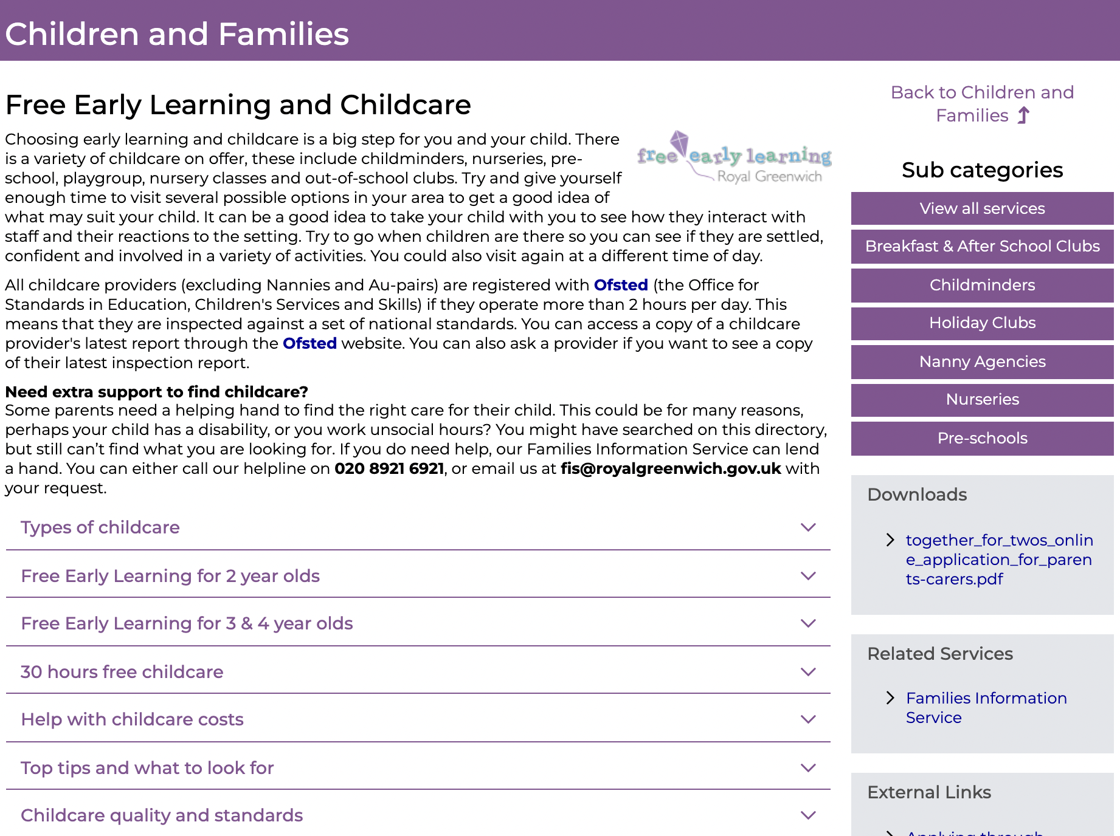
User flow
Starting from the main categories while skipping the information and guidance section
Going to “Sub categories”
Notes:
We looked into the google analytics to identify the user flow, which is how user navigate content on community directory
Take children and families page for example, users tend to start from the main categories while skipping the information and guidance section.
After they click on the main category, for instance, early years & childcare, they will directly go to the sub category on the right hand side to look for the services they need

Slide 26
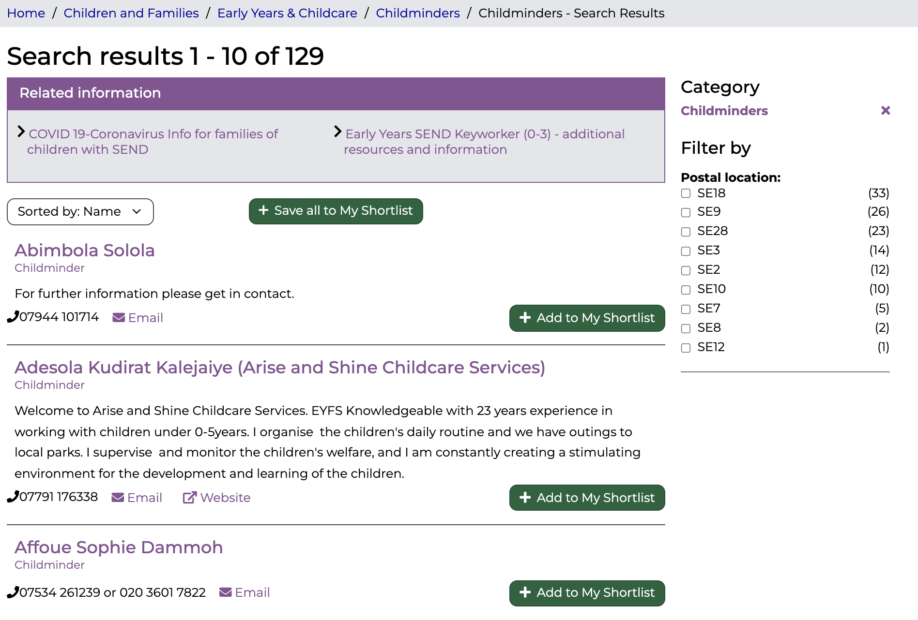
User flow (continued)
No other categories
Users get lost
High drop-offs rate
Notes:
However, users can’t see the other categories after click on one, which drives them to the previous page if they can’t find the information they need. Based on google analytics, lots of users get lost during this process, leading to high drop-offs rate.

Slide 27
Most viewed content on GCD
Compared the data from page views Google Analytics, search terms, and most viewed records on Open Object
Children and Families | Local Offer | Adults and Older People
Early Year and Childcare (Childminders, nurseries) Things to do (short breaks, activities) Care & Support Services (parenting) | Education & Schools (Education, Health and Care Plans, Support Team for Education in Primary and Secondary School) Early Years & Childcare (Early Years Inclusion Team) Care & Support Services (ASD Support Services) | Care and Support Services (Housing) Health (mental health, dementia) Community Groups and social activities (migrant groups) Training and Employment (Occupational therapy)
Notes:
Apart from looking into the user flow, we also compared the data of page views on Google Analytics, search terms, and most viewed records on Open Object to understand what kind of the services are most looked for on community directory.
From children and families channel, early years and childcare, especially childminders and nurseries, are the most viewed content. On local offer channel, education & school, especially the information around Education, Health and Care Plans is the most looked for. On adults and older people side, the most viewed content is care and support services, like housing.
This gives us an initial thought around the services and scenario we want to further look into
The interesting finding here is that from the council departments side, we differentiate contents as service, events and information, and we set up different sections on the website so it’s easier for users to navigate. However. From the users point of view, they don’t see the content as different types. They only want to know what can support them, no matter it's service, event, information. It’s definitely something we want to bare in mind when developing the website structure and category in the future.

Slide 28
What we want to learn next
What are our hunches?
There are category overlaps as more services being added over time
Listings are categorised from a service perspective rather than being user focused
Not an overarching person to manage and keep content consistent
What do we want to find out next
Understand what categories are services in themselves
Look into the ecosystem Greenwich Community Directory, the relationships between actors
Zoom into the service areas that are most looked for, mapping the end-to-end journey from resident’s point of view
Notes:
In summary, our hunches are
as listings for the local offer and children's services were added after adult social care services, there are category overlaps.
The content are listed from a service types perspective, but it’s different from how residents perceive and find content on GCD
There is no overarching person to manage the content across Council, making it hard to be consistent among all listings
What do we want to find out next
Understand what categories are services in themselves
Look into the ecosystem, the relationships between the actors, ex, referrers, residents, frontline workers, to better understand the role of GCD in people’s life
Zoom into the service areas that are most looked for based on data, mapping the end-to-end journey from resident’s pov, and how they get information on GCD

Slide 29

Prompt questions
Has anything surprised you?
What would you like to know more about?

Slide 30
Technology
Notes:
Jenny

Slide 31
What we want to learn
Objectives
We understand what Scout, Outpost, LocalGov Drupal and Open Referral UK are
We’ve documented the technical make-up of the existing GCD
How we're doing this
Desk research about each
Meeting with the creators of these to learn more through demos and discussion

Slide 32



Technology we looked at
Outpost is a service listing management system – where users can add, edit and manage services. The data can then be used in a variety of ways – eg. Pulled through to a directory. It uses the Open Referral UK data standard.
LocalGov Drupal is an open-source (free) web content management system configured to the meet the requirements of a council websites. There is a community of developers, content designers and leaders for local councils across the UK – a publishing platform created by councils, for councils.
Scout
Scout is an option for a frontend experience of a service directory – so the outward facing directory where you can search, see a list of service results, see a service listing.
Open Referral UK is a data standard for community services.
A data standard establishes a consistent way of publishing and describing information. It can be adopted by any service directory, which makes it possible to share information between organisations more easily

Slide 33

Technology we looked at
Placecube offer a platform called Open Place Directory. It is a platform that facilitates crowdsourcing & quality assurance of ‘Open Referral UK’ data standards for local services.

Slide 34
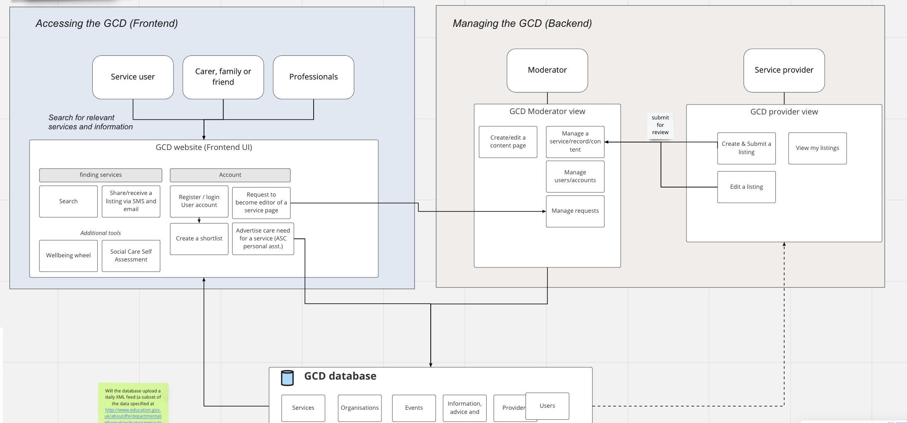
Current technical setup
We are capturing what the current technical setup is and documenting it in a technical/system architecture map. This helps us understand how things currently work and we should keep in mind for the future.

Slide 35
What are our hunches?
There are a lot of technology options that we can reuse which allows us to avoid starting from scratch.
There is an advantage to looking at building the directory into smaller components/modules that are connected rather than one larger solution that does everything.
The types of tech we are looking at will help us make our project open and more easily reusable

Slide 36
Constraints

Slide 37
What we want to learn
Objectives
1. We understand the legal and technical constraints of the project
2. We understand how the GCD aligns with RBG Strategies
How we're doing this
Breaking this down across the following:
Children and Families / Young People
SEND Local Offer
Adults and Older People

Slide 38
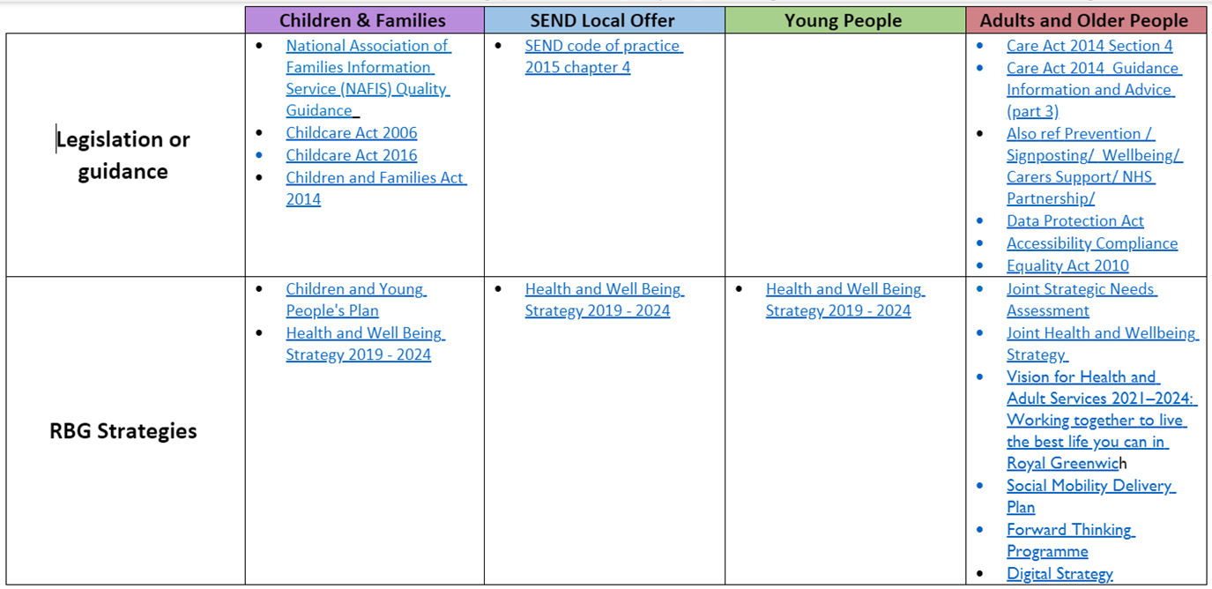
What we've found out

Slide 39
What we've found out
Children and Families – Childcare Act
  Must establish a service providing info, advice and assistance
SEND – Code of practice
  Must publish a Local Offer which sets out in one place information about the provision for children and young people who have SEN or are disabled.
  Adults and Older People
  Under the Care Act 2014 the LA must establish and maintain a service providing people in its area with info and advice relating to care and support for adults and support for carers.
  Compliance
  Data Protection Act 2018
  Accessibility Regulations 2018
  Equality Act 2010
  Greenwich strategies
  Joint Health and Well Being Strategy
  Vision for Health and Adults Services

Slide 40
Prompt questions
Is anything unclear so far?
Would you like us to explain anything again or in more detail?

Slide 41
Learning from other Local Authorities

Slide 42
What we want to learn
Objective
We’ve met with other local authorities to learn from their experience of developing directories
How we're doing this
Meeting with local authorities across the UK – learning through demos and in-depth discussions
Exploring how best to continue to have conversations with the sector: we have invited everyone we have spoken to, to a LGDrupal led Directories Show & Tell event which we are presenting at. Around 33 other Councils are invited so far!

Slide 43




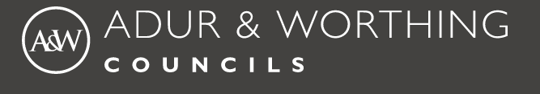

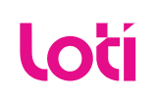


Who we have engaged with so far
Notes:
Since our last Show & Tell we have been busy learning from the sector

Slide 44
What we’ve found out
The public sector has a lot of collective knowledge about directories and there is appetite/enthusiasm towards the creation of something reusable.
There are many Councils in the UK developing and improving their directories – all of which are at different levels of maturity.
The technical make up of directories across the UK varies but so far, some common approaches have been taken:
  Off the shelf ‘SAAS’ products
  In house-built directories
  Open-source directories
Notes:
The sector has been forthcoming in sharing their journeys and learnings.

Slide 45
What’s coming up next?

Slide 46

Taking time to pause, share and reflect, so we can decide where to begin our focused Discovery
Notes:
Alex

Slide 47
Questions and feedback

Slide 48
Over to you!
We'd love to know your thoughts and answer any questions you might have.
Comment in the chat or speak up 🙂
What stood out to you?
What questions do you have?
Notes:
We're really keen for this to be a dialogue, so please let us know in the chat as we go, about :
😍 Things you liked
🧐 Things you’d like to hear more about
🤔 Things that surprised you and questions you have

Slide 49
Thank you for coming
Ways to stay in touch:
1. Read our weeknotes – these are posted in the Digital MS Teams 'Weekly round-ups and de-briefs' Channel and are sent to all Show & Tell attendees every Friday.
2. Come to our future Show & Tell events.
3. Send us an email or MS Teams chat: Bethany.Mindham@royalgreenwich.gov.uk & Alex.Sturtivant@royalgreenwich.gov.uk

