Slide 1
Rebuilding Greenwich’s
Community Directory
Show & Tell #1
02/12/2021
Please note this Show&Tell will be recorded.

Slide 2
Before we go any further let’s answer the question:
What is a Show and Tell?
Notes:
Before we get into it, it’s worth saying a bit about what a ‘show and tell’ is for.

Slide 3
A Show & Tell is a regular event where...
You "tell”
Tell us what you think!:
Things we may have missed
Offer knowledge we may not have
Support areas we are struggling with
We "show”
Share approach and rationale
Demo ongoing work
Share insights gathered

Slide 4
Why do we do them?
Get feedback from everyone, to shape what we do next
(not just those involved in the day to day work)
Make connections with other work and knowledge
Show progress early and often
Notes:
It’s a way to share learning from a project as you go. Often, change programmes or technology projects will do all the work, and then tell everyone only when the change is about to go live
This is different – it's about sharing the analysis, thinking and learnings continuously.
First one today will be a bit different – setting the scene and introducing the work, with only a little bit about our findings.
you can expect:
Us to show our progress – what have we been doing, and what have we learned?
To have a chance to influence the work. We want to hear what's important to you, and what we’ve missed
To be able to draw links to other projects or initiatives that we might not know about

Slide 5
What we are going to cover today, in our first ever Show & Tell...
Team introduction
Project context – What is the Greenwich Community Directory and why is it being re-designed?
Our approach and stages of the project
How we plan to involve others
Governance
Questions, feedback and next steps
Notes:
Beth slides 1-4

Slide 6
Our ask of you for the next hour…
Be as present as you can
Actively participate but also leave room for others
We have some 'prompt questions' throughout, engage with them as you wish to
This is our first Show & Tell at Greenwich - we want to set an encouraging and open space where we as the team and you as the audience feel brave enough to say ‘I don’t know’ if something isn’t clear or we don’t have the answer yet.
Notes:
Be as present as you can - it's tempting to check emails and do other things but if you could avoid looking at other devices or doing admin tasks it would be much appreciated.
Actively participate but also leave room for others - we will produce better outcomes by hearing a diversity of perspectives.
We have some ‘prompt questions’ at the end of some of the sections in our Show & Tell today, these aim to get you thinking and reflecting about what we are saying. Please use the chat to respond and interact as we go. We will also have time for questions and discussion at the end.
This is our first Show & Tell at Greenwich - the team has varying levels of experience in doing Show & Tells, working at Greenwich and working in/with Digital services. We want to set an encouraging and open space where we as the team and you as the audience feel brave enough to say ‘I don’t know’ if something isn’t clear or we don’t have the answer yet.

Slide 7
The team
Notes:
Before we get into it, it’s worth saying a bit about what a ‘show and tell’ is for.

Slide 8
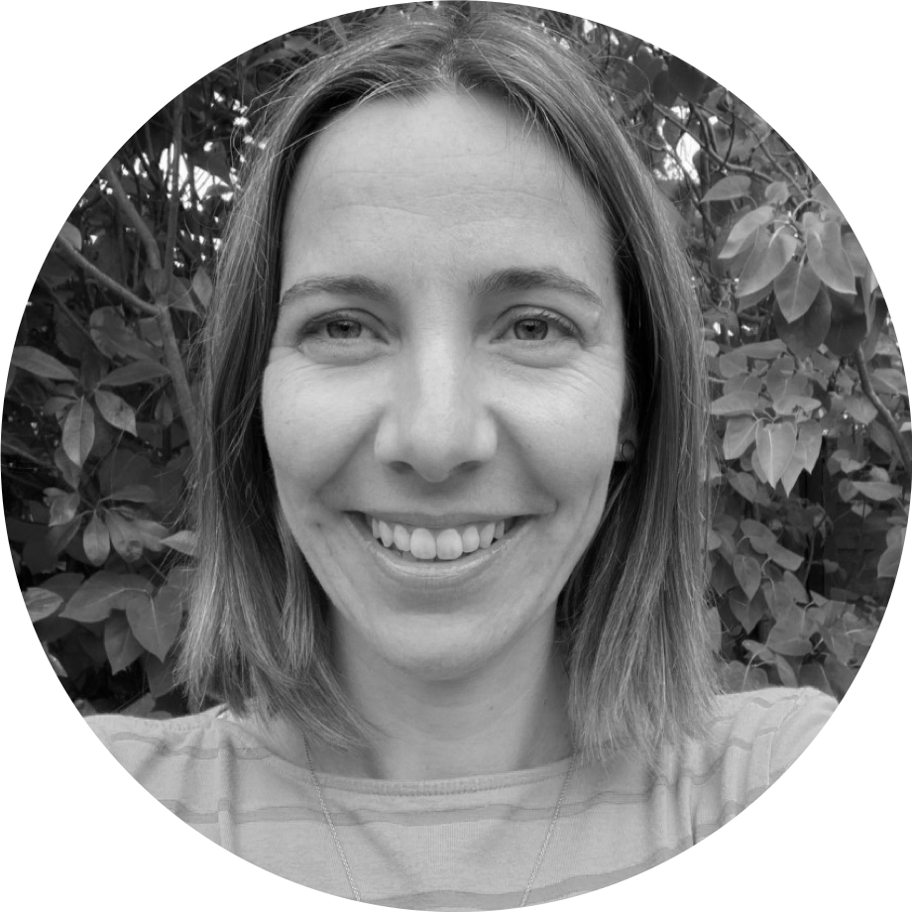
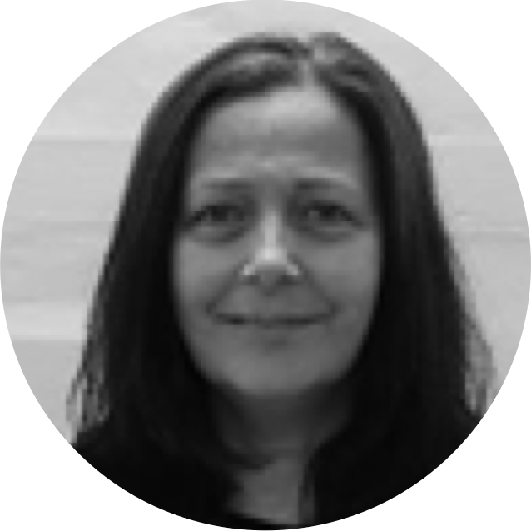
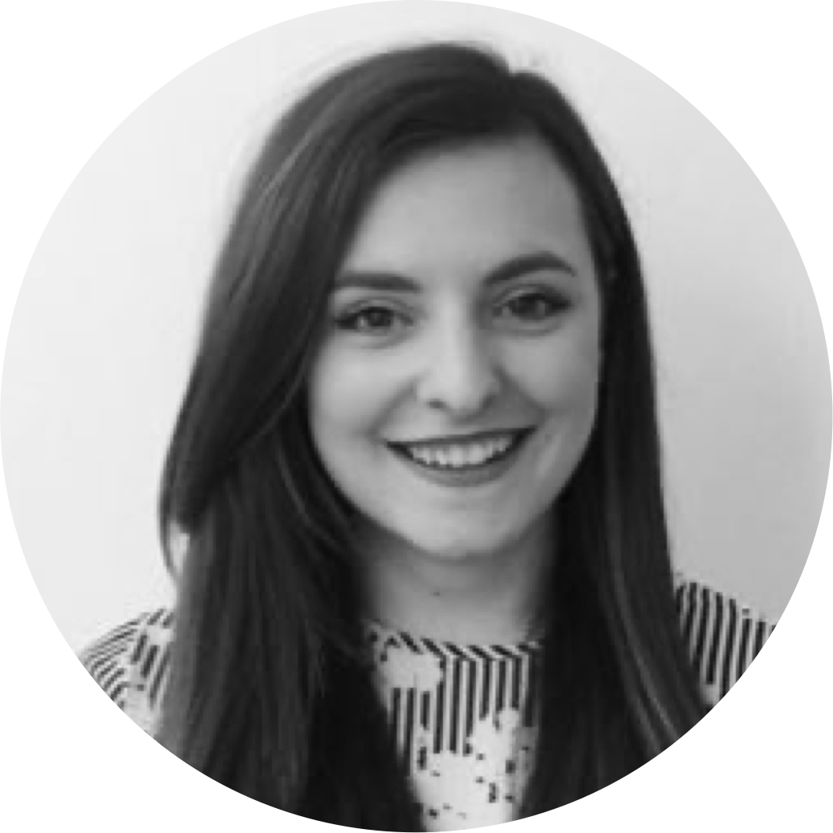
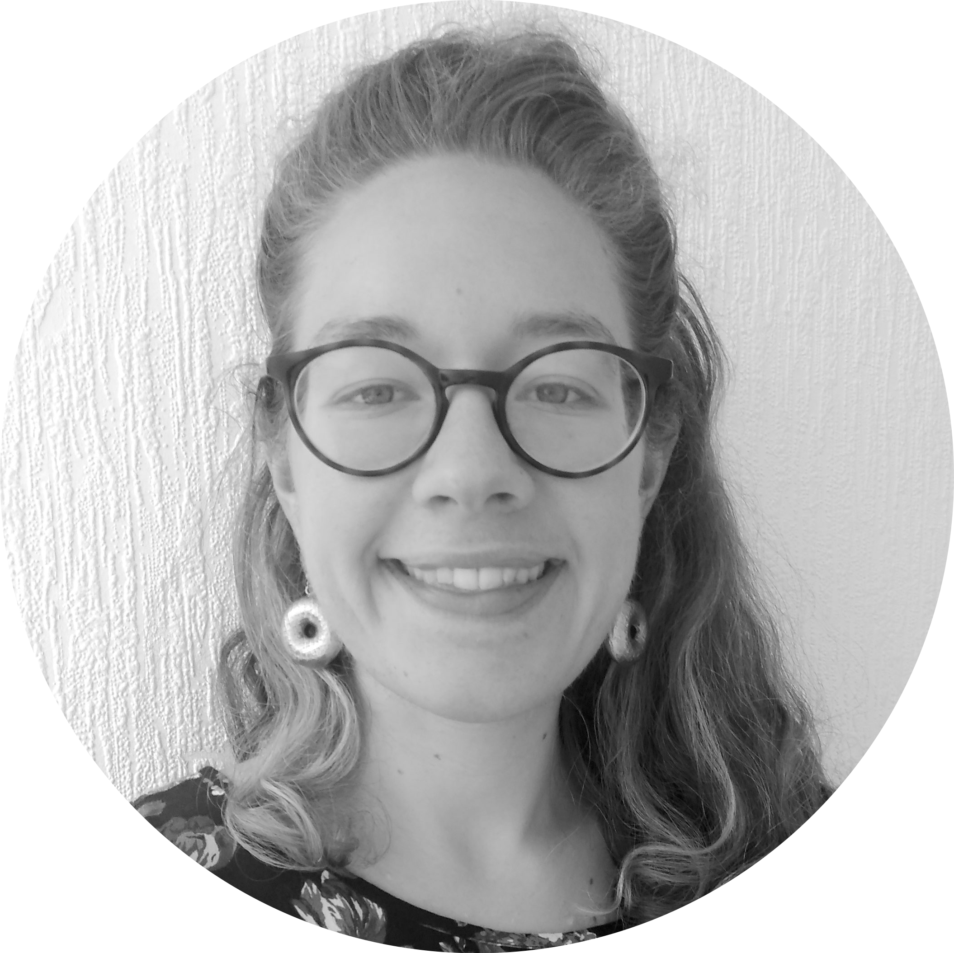
A blended team from across the Council
Steve Ollier
Principal Performance Officer Health & Adult Services
Rebecca Layng
Programme Manager
Health & Adult Services
Alexia Fergus
Senior Manager
Health & Adult Services
Nicola Hunt
Early Years Inclusion Coordinator
Children Services
Hibak Yusuf
Early Help Team Leader
Children Services
Alex Sturtivant
Product Manager
Digital and Customer Services
Beth Mindham
Delivery Manager
Digital and Customer Services
Alysia-Marie Annett
Senior Content Designer
Digital and Customer Services
Connie Wroe
User Researcher
Digital and Customer Services
Yu Hsuan
Service Designer
Digital and Customer Services
Jenny Thai
Senior Product Designer
Digital and Customer Services
Notes:
Presenter: ????
As the GCD has grown - since 2016 there's now a lot of people involved with a wide range of stakeholders. A Core Team has been established involved in the day to day delivery of the GCD. The team is responsible for planning, designing and developing the GCD product. It's a blend of people from ICT, HAS and DCS.

Slide 9
Context
What is the Community Directory and why are we re-designing it?
Notes:
Before we get into it, it’s worth saying a bit about what a ‘show and tell’ is for.

Slide 10
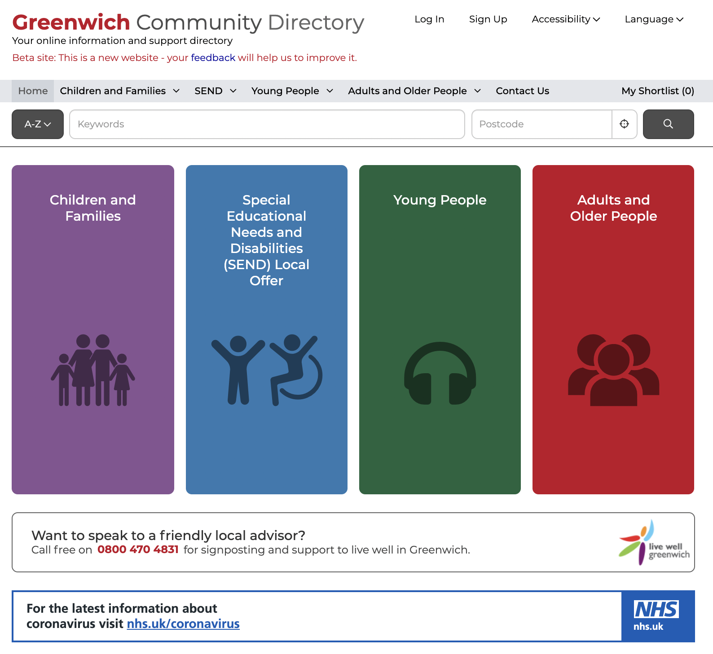
What is Greenwich Community Directory?
A directory of health, social care and community services in Greenwich, launched in Spring 2015 that:
signposts people of all ages to support
focuses on the voluntary sector
is a key part of prevention - early intervention
is used by both public and professionals
has over 2,600 live listings
had over 8,000 sessions per month (2020)
Live Well Greenwich – Telephone support from Charlton Athletic Community Trust 2017.
It merged with the Families Information Services and Local Offer in 2019.
Notes:
Steve:
The Greenwich Community Directory is a directory of health, social care and community services in Greenwich:
Initially it was a response to the Care Act requiring LA to sign post residents to services available across the community in particular those provided by the voluntary sector. It gave residents access to info on social care, health and wellbeing.
The voluntary sector play a key role in prevention and early intervention (for example supporting people with Dementia).
The Directory is also used by professionals: RBG staff, NHS staff, GPs to support their work – through Social Prescribing. For example Community Centres are encouraged to list activities which can assist with social isolation – most recently the Carers Centre page has been updated with December's activities.
With over 2600 live listings on the directory there is a rich mix of advice and support services.
GCD is a crucial digital product to allow communities find local service information. It connects to the core services council offers too.
Since the launch of the Directory there has been a significant increase in its usage from just over 1000 sessions per month in 2016 to over 4000 by 2020. Increasingly it is recognised by the voluntary sector and local organisations as a good place to list services, activities and events.
In 2019 the Directory was expanded by merging with the Families Service Directory and SEND Local Offer offering listings across all age groups and we'll hear more about that from Hibak in a few minutes.
The Directory includes a telephone support service provided by Live Well Greenwich – delivered by CACT. This helps members of the community who are perhaps less confident with computers/IT.

Slide 11
Example from Children’s
Both parents work full time, they need to find suitable childcare.
Families Information Service
The family contact the Families Information Service helpline to find out more about childcare and activities.
They are advised over the phone and directed to the Greenwich Community Directory
Family with two children under 5 recently moved to Royal Borough of Greenwich.
Notes:
Family with two children under 5 recently moved to Royal Borough of Greenwich.
Both parents work full time, they need to find suitable childcare as soon as possible.
The family contact the Families Information Service helpline to find out more about childcare and activities.
They are advised over the phone and directed to the Greenwich Community Directory to explore further.

Slide 12
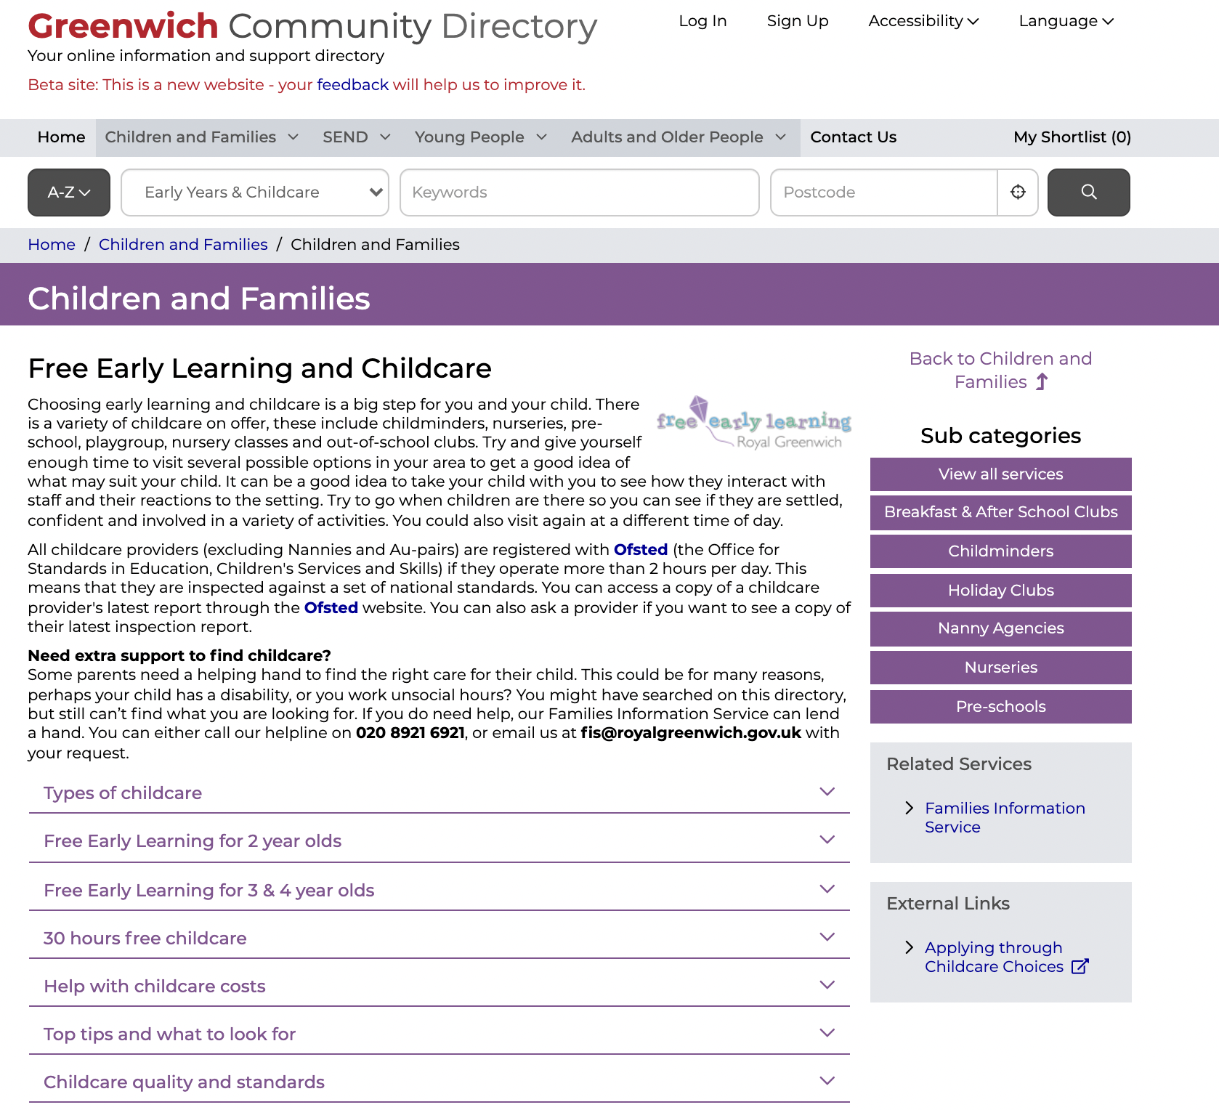
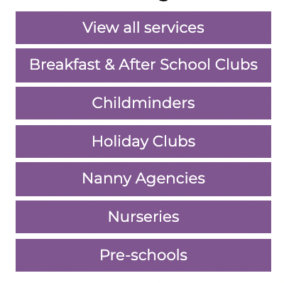
Example from Children’s
Find out more about nurseries, preschools, after school clubs and holiday playschemes.
Notes:
The Early Years and Childcare Section of the Greenwich Community Directory contains information on types of childcare providers, free early learning and help with childcare costs.
Not only can the family search for local childminders but they can find out more about nurseries, preschools, after school clubs and holiday playschemes.

Slide 13
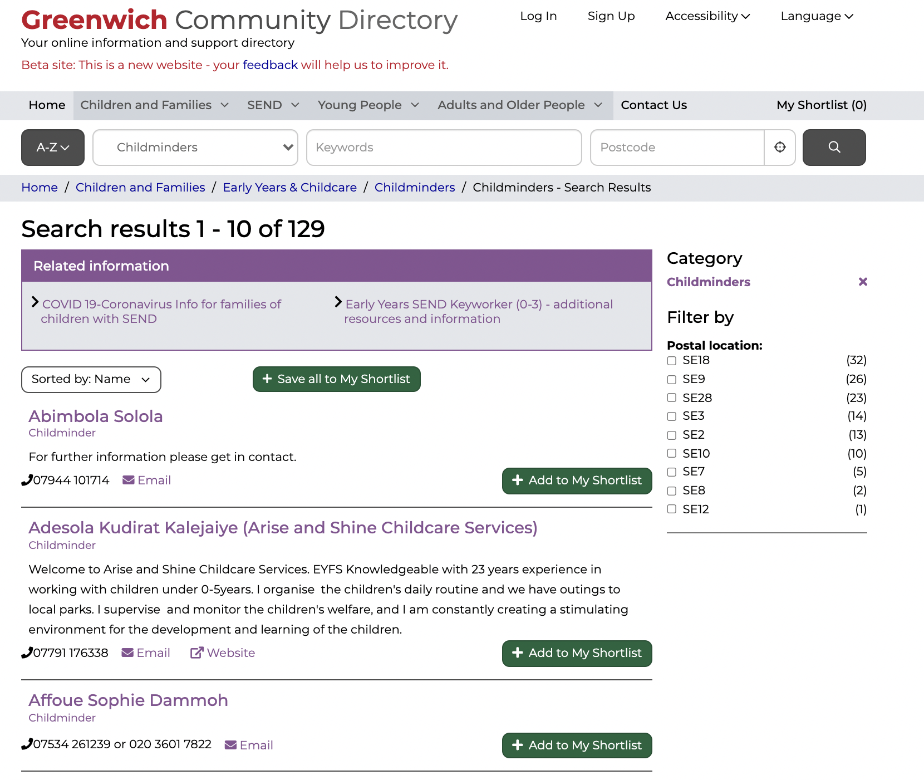
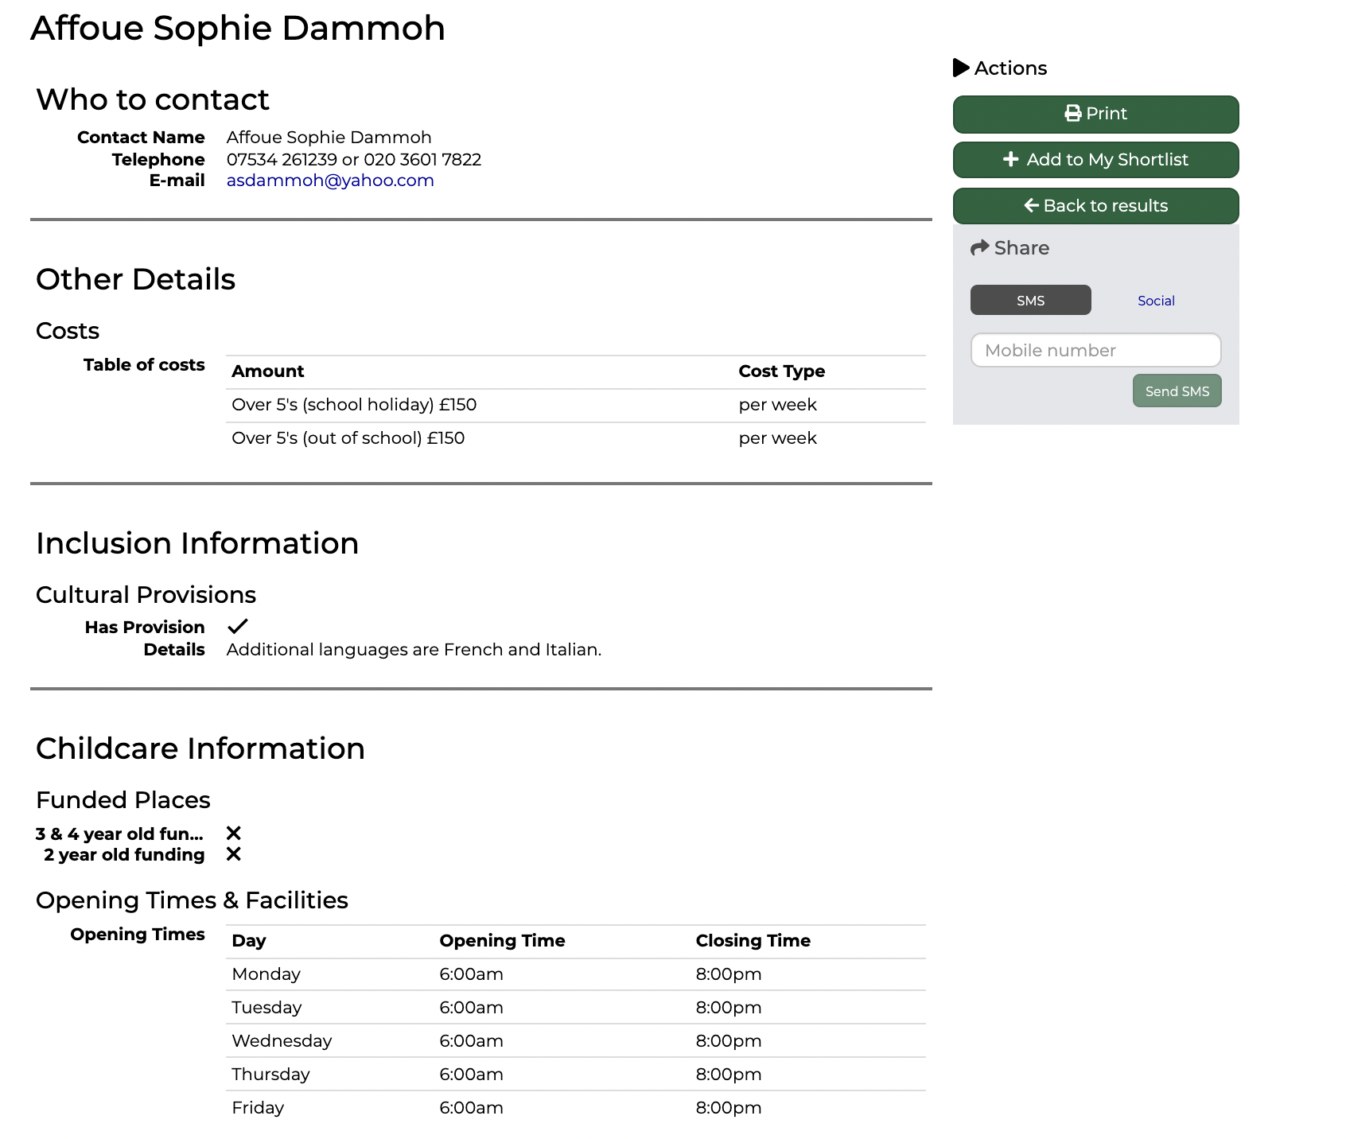
Example from Children’s
The directory allows the family to filter the childminders by postcode, which refines their list even further.
Notes:
The directory allows the family to filter the childminders by postcode, which refines their list even further.
The family found information on opening hours, costs and direct contact details very useful and central to them making an informed choice.

Slide 14
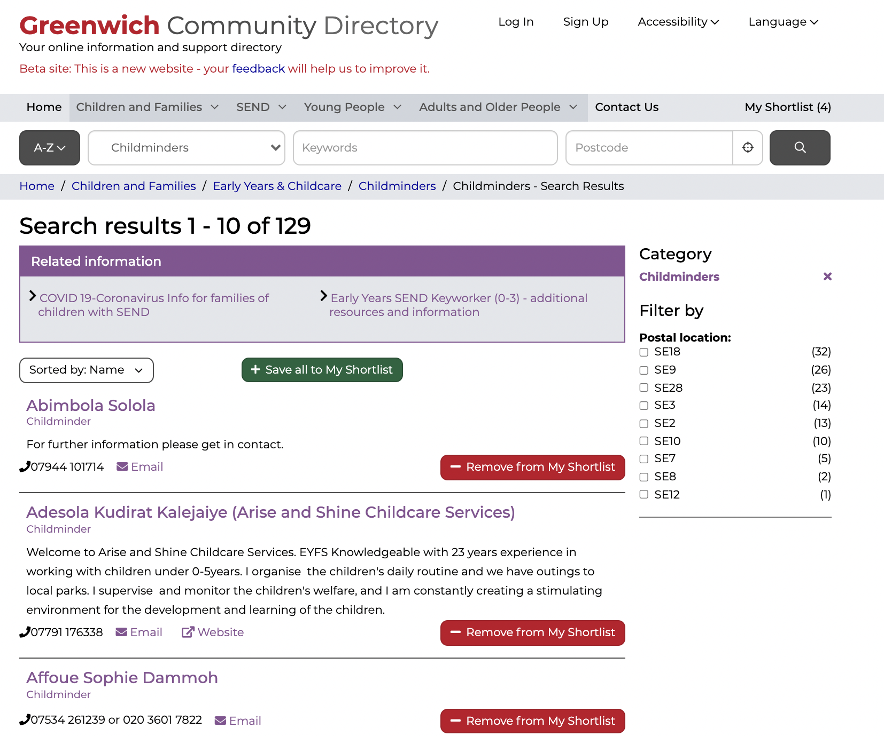
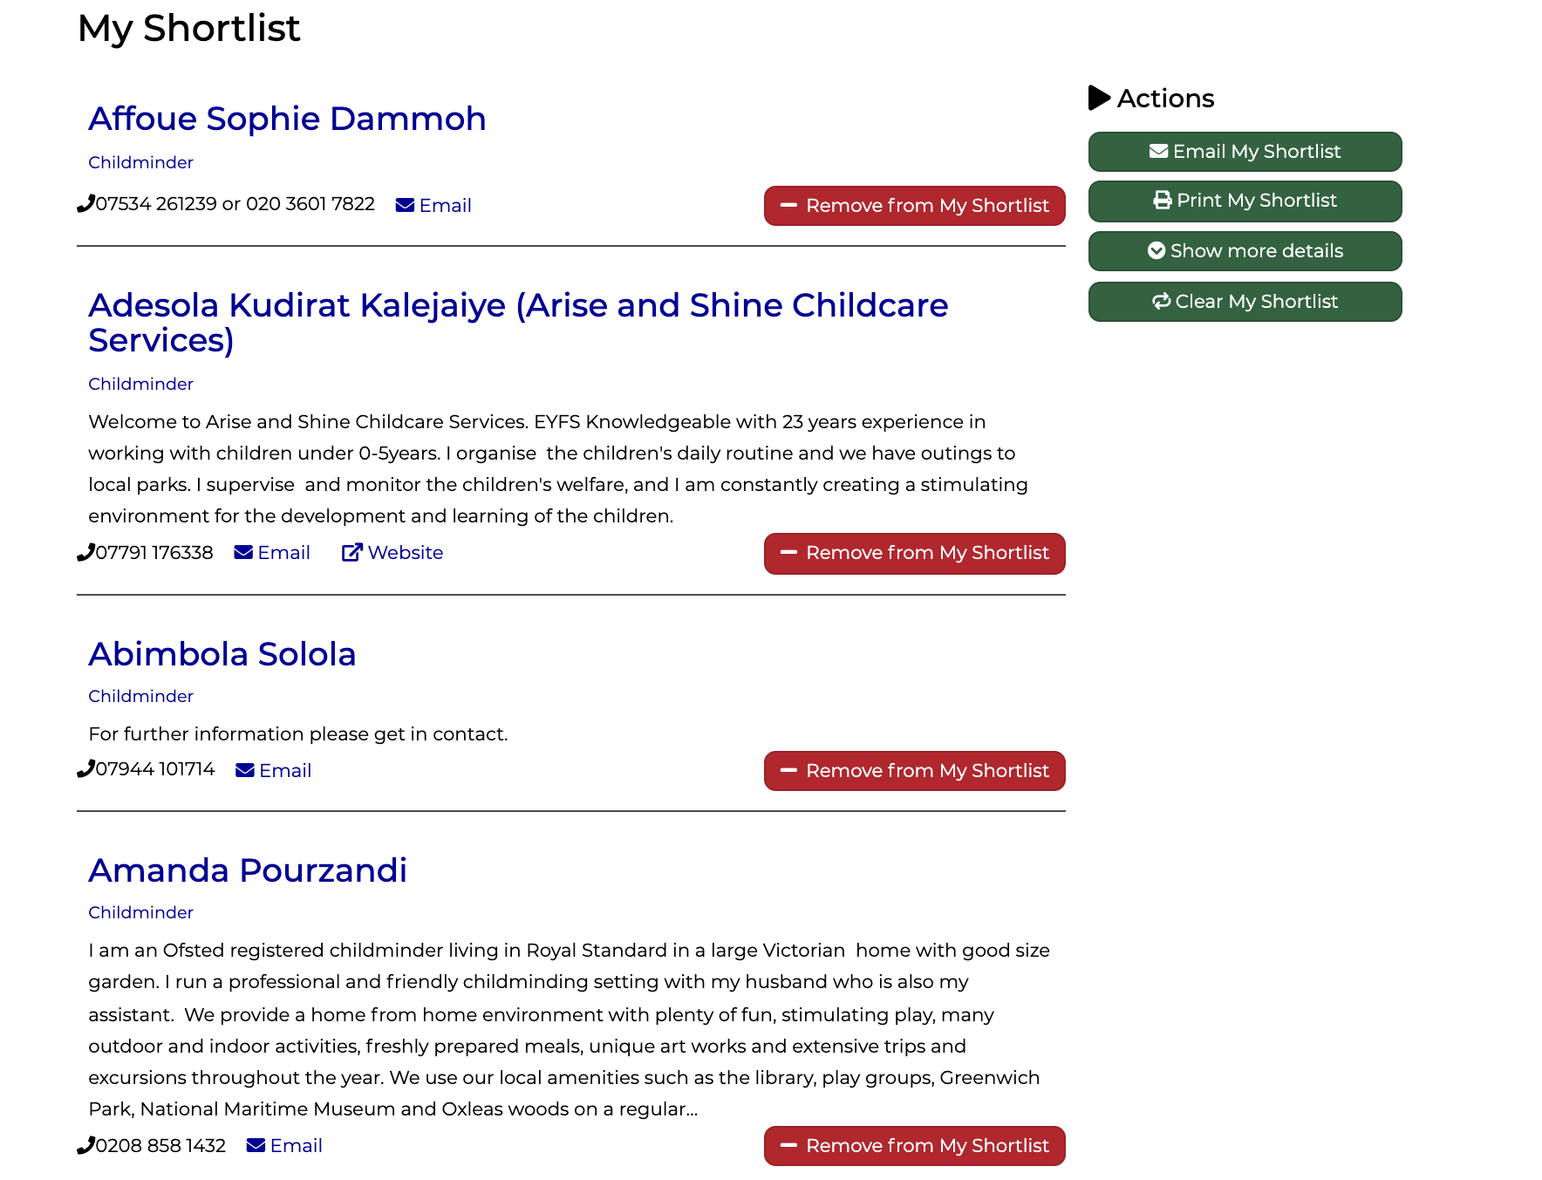
Example from Children’s
Notes:
After contacting a few childminders on their shortlist they decided on a childminder that worked for their family.
In addition to sourcing a childminder they used the directory to find their local children’s centre and children’s activities on offer.
-------
Family with two children under 5 recently moved to Royal Borough of Greenwich.
Both parents work full time, they need to find suitable childcare as soon as possible.
The family contact the Families Information Service helpline to find out more about childcare and activities.
They are advised over the phone and directed to the Greenwich Community Directory to explore further.
The Early Years and Childcare Section of the Greenwich Community Directory contains information on types of childcare providers, free early learning and help with childcare costs.
Not only can the family search for local childminders but they can find out more about nurseries, preschools, after school clubs and holiday playschemes.
The directory allows the family to filter the childminders by postcode, which refines their list even further.
The family found information on opening hours, costs and direct contact details very useful and central to them making an informed choice.
After contacting a few childminders on their shortlist they decided on a childminder that worked for their family.
In addition to sourcing a childminder they used the directory to find their local children’s centre and children’s activities on offer.

Slide 15
Why are we redesigning it now?
Potential Impact | Level of Improvement | Strategic and political Importance | Future proofing the council
Financial Impact: By tackling this, we will save £33,000 software cost per year. There will be indirect savings of staff time spent on navigating information for residents. The platform underpins the GCD ‘Open Object’ is up for renewal in Sep 2022 Depth of Impact: This will significantly improve the experience for residents, particularly those trying to meet their own needs or those of someone they care for to search for information, advice and helpful services at point of need or being prompted by professionals or their networks. Residents with more complex needs might work with ‘Referers’ - who use information services to support people. It will also make the staff’s life easier, particularly those who currently publishing, maintaining and promoting their service information. | For residents By tackling this, we anticipate a significant improvement of our information service. It will reduce duplication of local service information and advice published online hence reducing confusion for users and workload for organisations to keep those information up to date. For staff and organizations updating information We also anticipate achieve efficiencies and make keeping large amount of devolved content up to date more manageable by using modern technology and better content practice. This will also help strengthen partnership with voluntary/third sector - an up to date, well-supported platform to promote their services/offer. | Digital Strategy As part of the digital strategy, it is our ambition to build new resident services which are online by default, with extra help for those who need it. Enabling health and social care to realise their service ambition Tackling on this will gives us the opportunity to review service user’s end-to-end journey and how different RBG digital products can be best optimised to meet their needs. This will strength partnership working between digital and services, creating momentum of transformation in health and social care services. Good story This will create an inspirational narrative for the council. | Re-usable products This will kick us off building reusable in-house product to solve common problems. Cheaper and more sustainable to maintain We will be building on existing products, standards and insights and actively collaborating with other councils. This will ensure we build the right thing that is more sustainable to maintain and respond to uncertainty,
Notes:
Steve
Why are we redesigning it:
Ongoing annual renewal costs plus costs to redesign by Idox. Annual maintenance charge £33K.
The platform dates back to 2014 – a redesign is an opportunity to future proof the directory
Improve the user journey – finding the right info at the right time for residents – carers / referrers/ parents/ staff
A new digital tool which is designed to make better use of community services by aligning them with the needs of service users.
Ensuring the content is as update and accessible as possible
Improve the scope for providers to add and update listings and content
A key part of the recently published Corporate Digital Strategy 2020-24 to continuously develop our services and products. - where we can better control them to meet user need.

Slide 16
The problems we could solve
Navigating local information and services can be overwhelming and confusing for residents particularly those who have special needs
The current GCD content management model is not fit-for-purpose to manage large volume of local service information
Lack of a consistent way to categorise, link content and communicate different types of content
Opportunity:
There is a need to help make local information, advice and services more accessible, intuitive and easy to navigate based on residents’ contextual needs.
As a council, we need to clarify GCD’s mission/ purpose. This will give people a reason to use it and deliver real value to people’s life.
Opportunity:
There is a need for a more modern, sustainable and devolved content publishing model to work between local authorities, community organisations and local service providers. This will improve engagement and ensure stakeholders feel a sense of ownership over their content.
Opportunity:
There is a need to reduce these inefficiencies by formulating a consistent format to organise information that is easy for residents, staff and local service providers to adopt the product.
Notes:
Steve – 8, 9, 10.
From speaking to people, it highlighted the 3 major problems we could solve.
Problem 1: Navigating local information and services can be overwhelming and confusing for residents especially for those with special needs.
(Better sign posting = better outcomes).
For families with care responsibilities, or people living with care or special needs, it’s often hard to understand where to start and find the most suitable service to meet their needs. From speaking to colleagues we know the GCD has overlapping information with other digital products, such as Greenwich.gov.uk, Livewell, Family Information Service (FIS), Community Hub etc, This creates confusion amongst staff members and residents when navigating local services and information in Greenwich. As a result of this, the GCD is not as well used as it perhaps could be.
Problem 2: The current GCD is built on a centralised content management system but there is not one central team or person who owns/monitors content. Lots of teams have edit access, each with different publishing and functionality needs and goals. Having lots of editors makes it hard to get an oversight of what content already exists, and where, leading to duplication. It also makes it hard for RBG staff and external organisations to publish and monitor their content.
Problem 3: There is a lack of a consistent way around how the information around local services is structured, which introduces significant inefficiencies for local authority staff wishing to publish and manage information on local service provision, and for community providers wishing to reach out to residents, for link worker to refer people to suitable services, and for residents to find the information they need.

Slide 17
Our mission
To design a community directory product that:
makes local information, advice and services more accessible, intuitive and easy to navigate for residents
creates a more sustainable and devolved way to publish and update content for all organisations and service providers involved
Notes:
Alysia slides 9- 11 Lingjing
Based on the problems Steve mentioned earlier. We drafted a mission statement to guide our work. We want to design a CD product that does two things.
1. Making this an exemplar for future localgov-built, owned and iterated cloud services.
2. Creating a suite of products and platforms which can be easily consumed in a SaaS-like way, with each contributing local authority assisting in maintenance, iteration and guidance.

Slide 18
£350,000 central gov funding to boost our product development capability
Build on existing products, standards and insights
that have already proven to meet user needs and been embedded in existing service context. We will be learning from Outpost and Scout, Open Referral data standard, Local Government Drupal, Essex CC’s Local Offer Discovery, Buckinghamshire’s Family information service.
Build an open-source, API-driven product
to ensure the product is doing one thing very well and offering greater flexibility for a wide range of local governments with different product ecosystems and digital maturity.
Co-invest in a product team
to support the ongoing design, development and maintenance of this product to ensure it’s meeting user needs, solving common problems and is secure to use.
Help other organisations on their adoption journey
through deliberate design and engineering choices, easy-to-navigate documentations of insights, design system and code library, and regular events/ blogging to show our work and answer questions.
Notes:
We have successfully secured £350,000 from the Department of Levelling Up, Housing and Community (Previously MHCLG).This funding will cover the cost of designing and building a new product which can be reused by other Councils.

Slide 19
Prompt question
Does the Greenwich Community Directory relate to you?
Have you worked on a similar project before?

Slide 20
Our approach
(and the stages of this project)

Slide 21
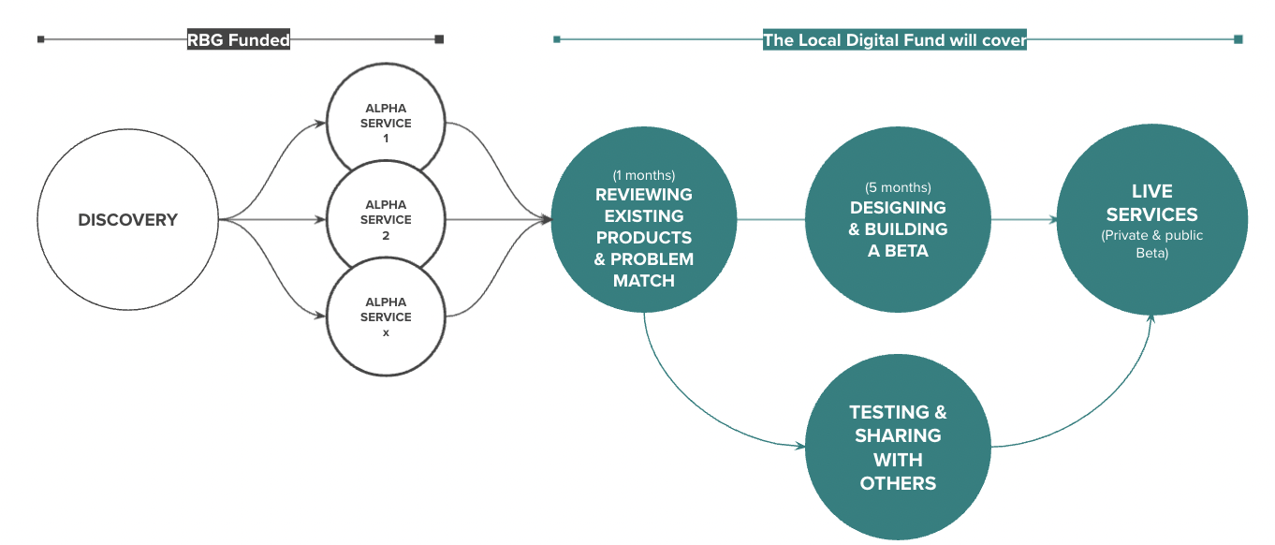
Our delivery plan
Understand the context and problems
Test different solutions
to the problems
Build, refine and improve
the service
Notes:
Sharon
(Hi I’m a service designer in the project)
We are following the product lifecycle Government Digital Service recommended.
As you can see from left hand side of the diagram, the life cyle starts from discovery phase to understand the problems and the context. The discovery phase will be followed by the alpha phase to rapidly testing ideas so that we are clear about what we need to build. Then we will go to beta phase, which is the green circles on the right part of slide, to build the product, refine and improve the service
Alongside the building work, we will work with other authorities and platform teams to make sure that what we build is a product which others can easily reuse.
Since GCD is already in our digital year 1 roadmap, we will fund the initial discovery. The £350k funding we've won from the Department for levelling up, housing and communities , will cover the cost of designing and building a beta product.
-----
Since GCD is already in our digital year 1 roadmap, we will fund the initial discovery to understand what is our needs, then followed on by an alpha phase to rapidly testing ideas so that we are clear about what we need to build. Then we will go to beta phase, which is to build, refine and improve the service
Alongside the build work, we will work with other authorities and platform teams to make sure that what we build is a product which others can easily reuse.

Slide 22
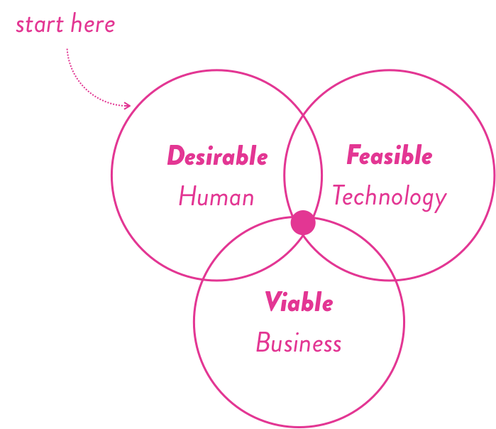
Starting with discovery
This is a time when we explore the needs, problem space and possibilities before creating or changing anything.
It is about building a shared understanding of user’s actual needs, service ambition, statutory and delivery constraints.
This will lead us to define the product proposition of the GCD (what it will do, why and how)
Notes:
Sharon
To get us started, we are starting with a discovery to explore the needs, problem space and technology possibilities before developing the Greenwich community directory in the future
The discovery phase is about building a shared understanding of user’s actual needs, their job to be done, the possibilities and limitations of technology, and delivery constraints, which will lead us to define the clear product proposition of the Greenwich community directory .

Slide 23
How we plan to approach our discovery
Notes:
Alex

Slide 24
What information is currently on the community directory?
Who are the different people that use it?
What is the technology behind it?
What constraints exist?
We’ll start our discovery with a short phase of broad research
Notes:
Alex
To get us started, we are starting with a discovery to explore the needs, problem space and technology possibilities before developing the future proposition of Greenwich community directory .
The discovery phase is about building a shared understanding of user’s actual needs, their job to be done, the possibilities and limitations and technology, and delivery constraints, which will lead us to define the product proposition of the Greenwich community directory .

Slide 25
Then we’ll do in-depth research with a specific service area
1
What are the needs, pain points and desires of the users that interact with this service?
How might the community directory address these opportunities?
How can we rapidly test our assumptions?
DISCOVERY
2
ALPHA
3
Notes:
Alex

Slide 26
How we will involve others

Slide 27
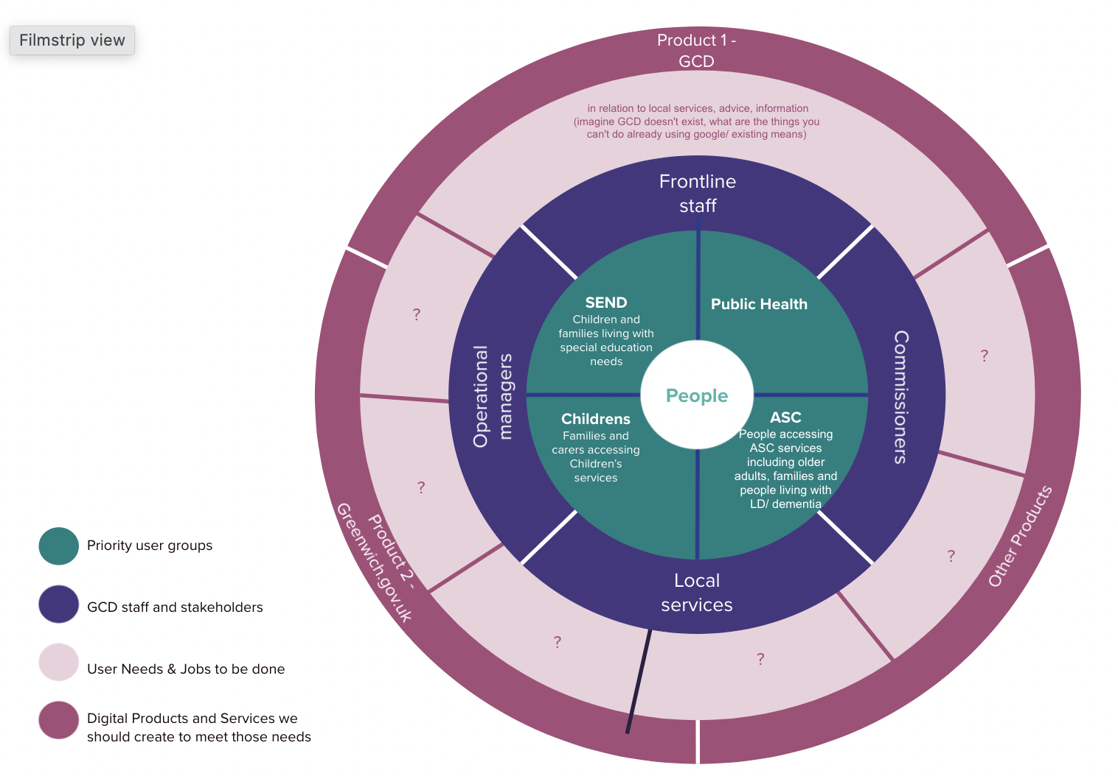
Taking a people-centred, holistic and co-creative approach
Notes:
Beckie – slide 19
Thanks Alex. My name's Beckie and I'm a Programme Manager for Public Health in Health and Adults services.
Following on from what Alex was saying, we will be taking a people-centred, holistic and co-creative approach. Obviously vital to put people at the centre as ultimately they're who this is for, but equally the GCD is and will be used by staff and services across the borough, so we need to involve key people throughout the process.
This diagram shows the different service areas and the different people that are involved with the GCD.
As Alex was saying, we will be starting off broad in the discovery phase, and then honing in on one or two areas at a time, for example Public Health or Children's Services, to test our ideas.
Diagram shows the order we'll be talking to people – starting off in the green area, with the priority users of the GCD, eg. SEND, Public Health, Children's Services and Adults and Social Care.
The purple circle shows our next stage, so staff and stakeholders who use the GCD, e.g. local services, commissioners, frontline staff and operational managers.
We then move onto what the user needs are and the jobs that need to be done in relation to this, and finally the dark pink circle shows the digital products and services we should create to meet those needs.
I'll now pass over to Connie who's going to talk in a bit more detail about the stakeholder engagement side of things.

Slide 28
We want to co-create with a diverse range of stakeholders
Supporters
Supporters – Cheerleads and champions the project. Helps the core team to assure quality and provides inputs where necessary.
Collaborators – have specialist knowledge and experience to assist the core team. Involved in user research, co-designing and testing of the GCD product.
The Core Team – involved in the day to day delivery of the GCD. Responsible for planning, designing and developing the GCD product.
Collaborators
Core
Notes:
Connie – slide 20
We have a framework here to help bring stakeholders and some of the people here today I'm sure into this project. The team will also deliberately engage and co-create with a diverse range of people.
There are so many stakeholders to engage in this work. We did some lighttouch pre-work to understand how the GCD is currently used across different stakeholders at Greenwich.
To ensure we are engaging our internal and external network in the right way at the right time, we are seeing people’s involvement in loosely these three categories.
CORE = Sitting at the core is our empowered product team. They are involved in the day-to day delivery of the work.
COLLABORATORS = Then we have collaborators who are people providing specialist knowledge and who perhaps have strong links to residents and local service provider.
We can't do this work well without knowledge-sharing and learning from the experience of others. An example here could be a frontline worker e.g. social worker, or somebody running a local service e.g. community- run club. They might be involved in user research, co-designing and testing of the GCD product.
SUPPORTERS=Sitting around that, we have supporters, those are senior managers and influencers who cheer lead and champion the work. They help the core team to ensure the quality of the work and provide input where necessary. This can be through S and T's but also through governance boards.

Slide 29
Prompt questions
Do you see yourself as a supporter, collaborator or in the core team? Post in the chat now
What would you like to see us explore as part of our Discovery?

Slide 30
Governance approach

Slide 31
Governance & work in the open
1. Self-governance by an
empowered Product Team
The GCD core product team is a blended multi-disciplinary team made up of members from Digital, Adults, Children’s and Public Health. The core team will steer the product direction using the evidence from their research and co-production with residents, staff members and partners.
What this will look like in practice:
Agile ways of working
Regular blog posts/ weeknotes
Show and Tell
2. Strategic input from senior management
It is also important the core team seek timely feedback and support from senior management across the council.
The core team will ensure senior management are kept informed on project updates and progress; providing the space for discussion and strategic input where necessary.
What this will look like in practice:
Digital Board
Health and Adult’s Portfolio Board
Notes:
Slide 21 – Jenny; questions and feedback.
In terms of governance. We want to give autonomy to the core team to ensure they are empowered to steer the product direction using the evidence from research and co-production with residents. The team will adopt agile ways of working to prioritising work, measuring outcomes and iterating ways of working. They will work in the open by publishing regular blog posts/ week notes. They will make themselves available for any questions, feedback and/or input through regular Show & Tell events. They will also organize specific workshop to co-create ideas with service teams and partner organizations.
It is also important the core team seek timely feedback and support from senior management across the council. They will do that by actively engage and keeping senior management informed about the project progress, providing space for discussion using forums like digital board, health and adults portfolio board.

Slide 32
Questions and feedback

Slide 33
Over to you!
We'd love to know your thoughts and answer any questions you might have.
Comment in the chat or speak up 🙂
What stood out to you?
What surprised you?
What questions do you have?
Notes:
We're really keen for this to be a dialogue, so please let us know in the chat as we go, about :
😍 Things you liked
🧐 Things you’d like to hear more about
🤔 Things that surprised you and questions you have

Slide 34
Next steps

Slide 35
Between now and Christmas we will:
Conduct upfront broad research, including speaking with external organisations such as other Local Authorities - over the past week we have spoken to Essex Council and Dorset Council but there are others we plan to speak with.
Develop our Discovery Plan and create a Roadmap with some provisional timelines.
Finalise our approach to Communications.
Have a team synthesis day to share our learnings and knowledge.

Slide 36
How to stay in touch
Read our 'Weeknotes' which in the Digital MS Teams 'Weekly round-ups and de-briefs' Channel. We are also going to start sending these out via email.
Come along to future Show&Tells, our next one will be in a few weeks' time or early in the New Year (tbc).
Send us an email or MS Teams chat. For now, it's best to contact Alex.Sturtivant@royalgreenwich.gov.uk or Bethany.Mindham@royalgreenwich.gov.uk

Slide 37
Thank you for coming along.

