Slide 1
Rebuilding Greenwich’s
Community Directory
Show & Tell #7
21/06/2022
Please note this Show & Tell will be recorded
Notes:
Beth slides 1-8

Slide 2
What is a Show & Tell?
A regular event where we...
Get feedback from everyone, to shape what we do next
(not just those involved in the day to day work)
Make connections with other work and knowledge
Show progress early and often
Notes:
It’s a way to share learning from a project as you go. Often, change programmes or technology projects will do all the work, and then tell everyone only when the change is about to go live
This is different – it's about sharing the analysis, thinking and learnings continuously.
First one today will be a bit different – setting the scene and introducing the work, with only a little bit about our findings.
you can expect:
Us to show our progress – what have we been doing, and what have we learned?
To have a chance to influence the work. We want to hear what's important to you, and what we’ve missed
To be able to draw links to other projects or initiatives that we might not know about

Slide 3
Today’s Show & Tell
We will cover:
How we’ve progressed with the work since our last S&T
Some ideas and experiments we’ve been testing out
So that you:
Have a sense of the direction we're going in
See some of our work in progress and have an opportunity to us what you think!

Slide 4
What we're not covering today
Detailed context behind our work
An in-depth update or explanation of everything we’ve done since our last Show & Tell
If you want to learn more about the context of this work you can read weeknotes 1-7 covering the early stages of the project, watch the team present in their first Show &Tell event or look at the slides here.

Slide 5
Our team + mission

Slide 6
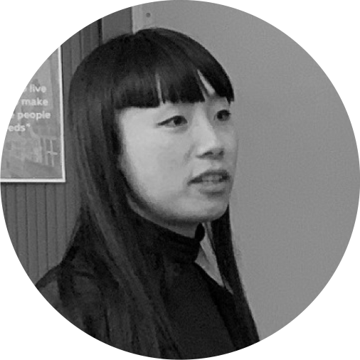
A blended team from across the council
Steve Ollier
Principal Performance Officer Health & Adult Services
Rebecca Layng
Programme Manager
Health & Adult Services
Alexia Fergus
Senior Manager
Health & Adult Services
Hibak Yusuf
Early Help Team Leader
Children Services
Lizzie Cullen Davison
Software Developer
TPX Impact
Lingjing Yin
Head of Product
Digital and Customer Services
Alex Sturtivant
Product Manager
Digital and Customer Services
Beth Mindham
Delivery Manager
Digital and Customer Services
Alysia-Marie Annett
Senior Content Designer
Digital and Customer Services
Connie Wroe
User Researcher
Digital and Customer Services
Yu Hsuan
Service Designer
Digital and Customer Services
Jenny Thai
Senior Product Designer
Digital and Customer Services

Slide 7
Our mission
To design a reusable community directory product that:
makes local information, advice and services more accessible, intuitive and easy to navigate for residents
creates a more sustainable and devolved way to publish and update content for all organisations and service providers involved

Slide 8
Testing out solutions to problems we learned about in Discovery
Notes:
Today we're going to be showing you the work we're doing to test out solutions to the biggest problems we learned about in Discovery.

Slide 9
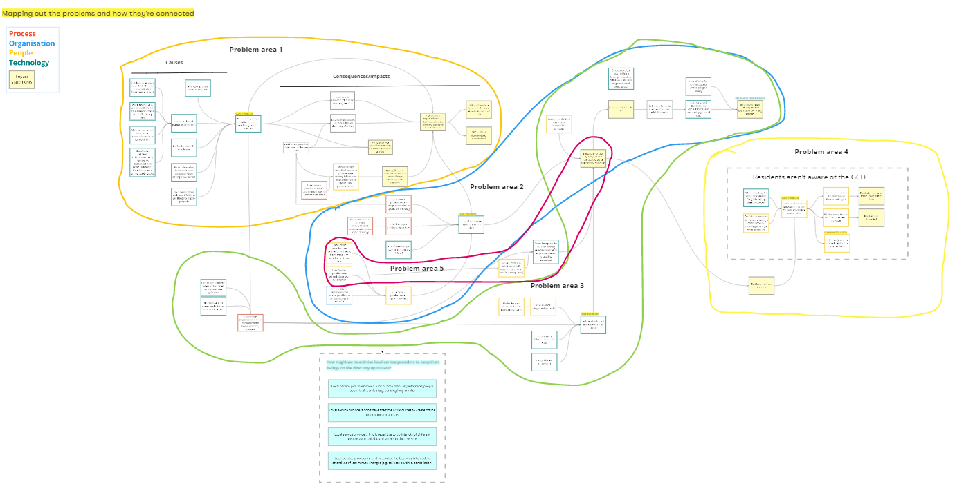
At our last Show & Tell we looked at our problem map
Causes
Problem
Consequences
Notes:
If you attended our last Show & Tell, you might remember we took you through this map of problems that we created. We created this to understand all the different pain points and problems and how they relate to one another.

Slide 10
We created 5 problem statements
It’s not quick, easy or intuitive to add listings to the GCD
A lot of content on the GCD is out of date
Information on the GCD is hard to navigate
For residents, it’s not clear where to go to find local information, advice and services
Some listings on the GCD are missing contact information
Notes:
From this we were able to simplify what we learned into 5 problem statements, which are on this slide, and we asked you to vote on these to help us figure out the priority of where we should be looking.

Slide 11
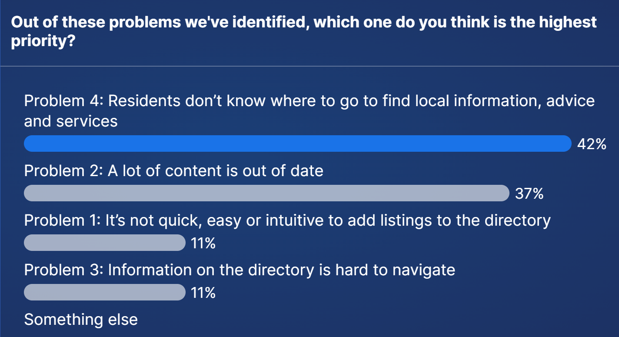
We asked you tell us which problem we should look at first
Problem 4
Problem 2
Problem 1
Problem 3
Notes:
These were the results.
After the show and tell we started thinking about how we could actually start testing out solutions to the problems. But when we thought about problem 4, the one with the most votes, we realised that it's hard to solve this problem before we've actually come up with a new directory product. If we want residents to know where to go to find local information, advice and services, we need to build the thing for them to use first.
So we decided in our team to de-prioritise that for now, and instead think about that as more of an overarching problem to keep thinking about.
That lead us onto the next most voted for problem of a lot of content being out of date. This is a big problem for us because it reduces the trust people have in the directory, and less people are using it. So we agreed it would be good to put some focus there and start testing different solution ideas.
We also wanted to work on another problem too, so we looked at our other 2 options.
We've already started testing a new directory tool for staff and service providers called Outpost. From what we've seen so far, Outpost makes it much quicker and easier to add listings to the directory. We didn't feel like we needed to spend much more time on that. So we deprioritised that problem.
Instead, we wanted to focus on the problem we knew less about which was that information on the GCD is hard to navigate. We decided to look at that alongside problem 2.
I'll hand over to Sharon to talk about how we've been looking at these problems.

Slide 12
Experimenting with new ideas and testing them with users
Notes:
Alex?

Slide 13
Alpha – Looking at problem 2 & 3 as riskiest
A lot of content is out of date which means the GCD isn't trusted as a source of information
▶︎ How might we keep content up to date and increase trust with users?
Information on the GCD is hard to navigate
▶︎ How might we make information easier to navigate on the directory?
Notes:
In the current stage we are experimenting the 2 key problems

Slide 14
Problem 2: test with service provider
How might we keep content up to date and increase trust with users?
▶︎ Idea 1: Make service listings easily shareable on other channels
Experiment 1
Incentivise local service providers by making it easy to share listings to different channels (online social media, websites and offline, e.g. printed).
Hypothesis
We believe that making it easy to share listings on different online and offline channels for local service providers will incentivise them to use GCD.
We think this is true because local service providers told us that preparing offline printed materials and sharing service across online platforms to reach audience take them lots of time, and they often don't have the capacity to do it
Notes:
For the problem 2, How might we keep content up to date and increase trust with users?
We know that to keep the content up to date on GCD, we have to first encourage service providers to use GCD ,
We are thinking to Incentivise local service providers by making it easy to share listings to different channels (online social media, websites and offline, e.g. printed).
Hypothesis
We believe that making it easy to share listings on different online and offline channels for local service providers will incentivise them to use GCD.
We think this is true because local service providers told us that they see printed materials as valuable way to reach out to residents and they often share contents across online platforms to reach users, however, it takes them lots of time to do so, and they don't have the time or resources to do it,

Slide 15
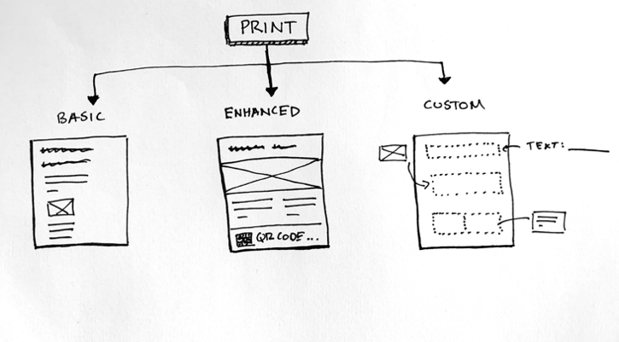
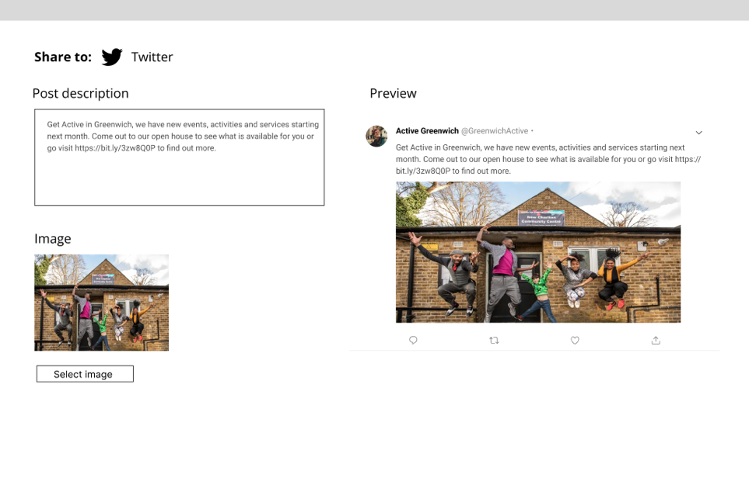
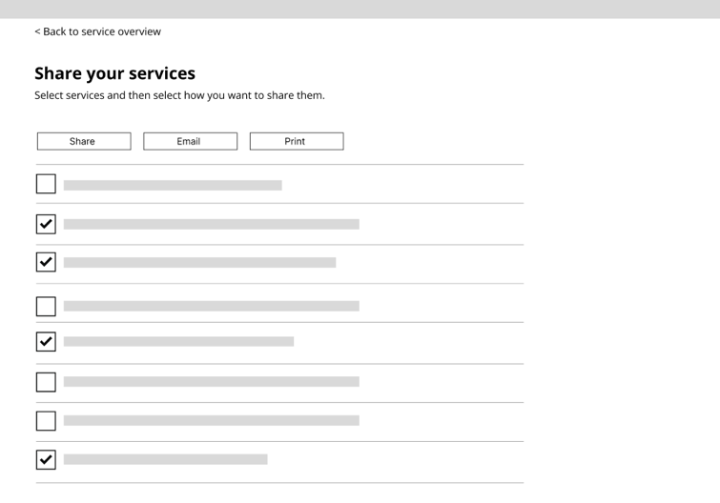
Experiment 1 – Make service listings easily shareable
Notes:
We designed some low fidelity prototypes to show service providers the quick flow to share the service across different platforms on the backend.
In the ideal scenario, after they upload the content on GCD backend, as you can see on the top right image, they can use the template to print out the leaflets right away. They can choose to use basic or advanced template, or customise their leaflets. Or by clicking on share on social, they can adjust the content and preview the post that would be shared to different social media platforms, in this example, twitter, through one click.
Finally we provide the function for them to share multiple services if they need.
We hope by adding functions, we can reduce the time they spend on sharing and promoting services across different platforms, and encourage service providers to go on GCD and maintain their content actively.

Slide 16
Problem 2: test with service provider
How might we keep content up to date and increase trust with users?
▶︎ Idea 2: Nudge service providers to keep content up to date
Experiment 2 2
Use social norms as different nudges to encourage service providers to update their listings
Hypothesis
We believe that social norms will help local service providers update their listings.
We think this is true because external influences will have an impact on people’s motivation to update a listing and local service providers will be more likely to update their listing if the suggestion comes from the community pressure rather than the council.

Slide 17
Experiment 2 – Nudge service providers to update content
1
2
Notes:
So we try to bring the users in the context to show the service providers how many people have viewed your services on GCD, as you can see the picture on the left, we are trying to use the positive nudge, pointing out their service is getting hit, instead of sending a warning text. And show how many residents have clicked on their service on GCD.
On another idea, (right hand side) , we specify why it’s important to keep the listings updated

Slide 18
Experiment 2 – Nudge service providers to update content
3
4
Notes:
We also created a scenario for the residents in the community to suggest an edit if they find the information is incorrect, and show the service providers the suggestion, as you can see the on the left handside
We also experimented the language to talk to service providers to make it more interactive and engaging.

Slide 19
Our learnings from the testing with service providers
If service providers know a platform could help them reach their audience, they care about the content and even will set up a team to maintain the content on the platform
The data in the nudge by itself is not compelling enough. We need to change their perception on the GCD - it's a platform their audience are using
Making the process easier and simpler to share their service and nudging them to update contents are later solutions.
Notes:
After testing with service providers,
We realise tweaking functions and making the process easier to help service providers promote their services via GCD is not enough to encourage them to use GCD more, SPs are currently have their ways to share contents across platforms for example, they use things like Canva, a online platform to design their leaflets, they even have set up their own team to maintain the social media and update contents across different platforms.
We also found that all the nudges to remind service providers to update contents would work, but if they don’t see the value of using GCD, they will not maintain the content actively, and we can’t solve the problem of keeping the content updated.
From this, we learned that the real incentive relies on the frontend – not only showing service providers that residents are using GCD. But find ways to change their perception on the GCD that - it's a platform their audience are using, which enables them to reach out their target audience and they will put effort into keeping content updated on GCD.
These are valuable learnings, and show why testing is important to learn something we didn’t expect and help us focus on the key problems.

Slide 20
Prompt questions…tell us what you think
What do you think about these experiments?
What do you want to know more about?
Are there any questions so far?
Notes:
Now we would like to pause here and we are curious to know what do you think

Slide 21
Problem 3 prototypes
How might we make information easier to navigate on the directory?
▶︎ Idea 1: Curated content will help residents find information and services that are relevant to them
Hypothesis
We believe that curating content and services by life events or needs will help residents find information and services most relevant to them on their own.
We think this is true because life events are often the trigger points for residents to look for things. There is also lots of information and services and it is hard for residents to know where to start and find things best for them easily.

Slide 22
Curated content prototypes
Prototype 1
A way to surface useful information around a life event so people know where to start.
It could link off to useful content like NHS guidance, to the Royal Greenwich website to apply for something and services that are part of that journey.
Prototypes 2 & 3
Show ways we could recommend services using curated listings:
More promotional - could work for topical listings like summer holiday clubs
Signposting by category - surfaces a few recommended listings by category.
Notes:
We also created a scenario for the residents in the community to suggest an edit if they find the information is incorrect, and show the service providers the suggestion, to highlight the influences.
We also experimented the language to talk to service providers to make it more interactive and engaging.

Slide 23
Prompt questions
Do you think any of the prototypes we’ve showed lay out content in a way that is useful for your service?
Post in the chat or come into the conversation!

Slide 24
Problem 3 prototypes
How might we make information easier to navigate on the directory?
▶︎ Idea 2: Categorising content by user type or need
Hypothesis
We believe that grouping content by user type or topic will help residents and referrers to find what they need.
We think this is true because residents are unsure what's available, and they leave the website when they can't find things relevant to them.
We think residents will find it easier to navigate the GCD if they know what's available and where they can go to at first glance

Slide 25
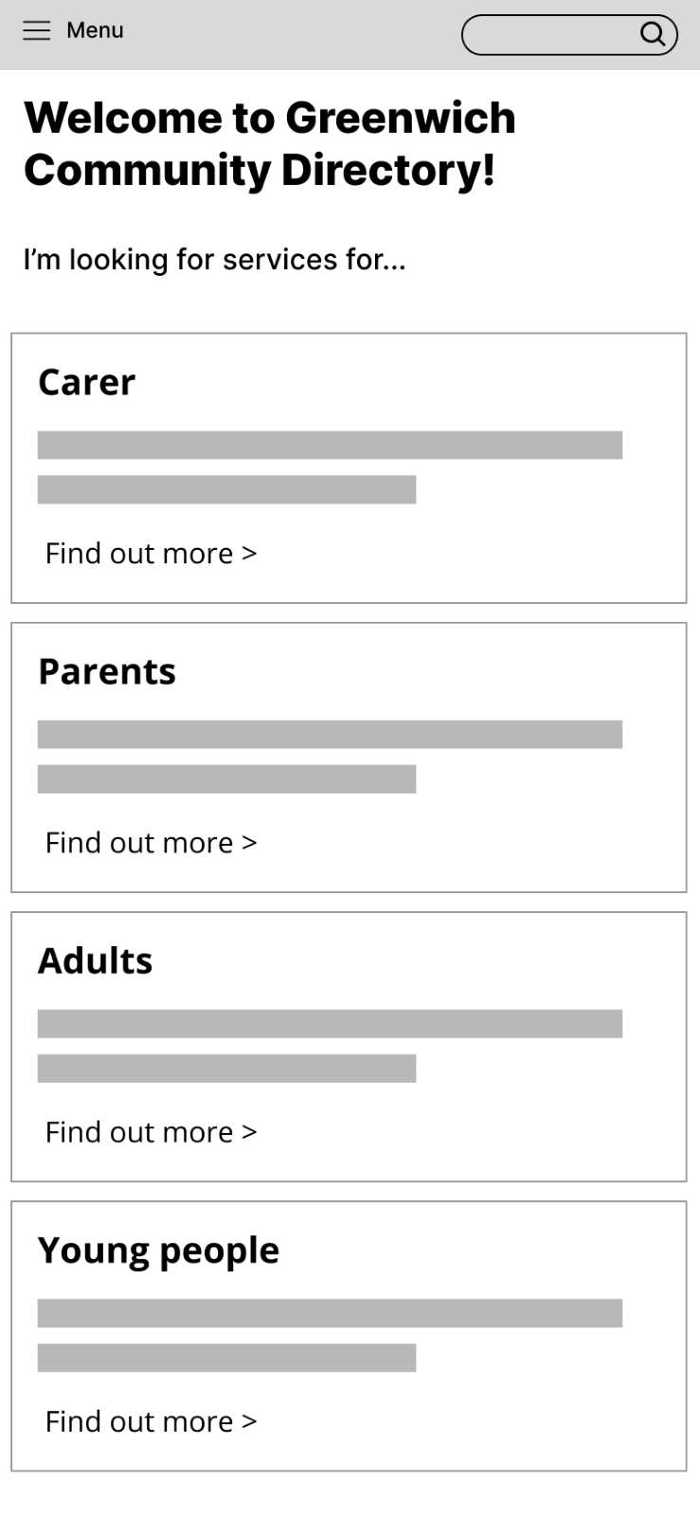
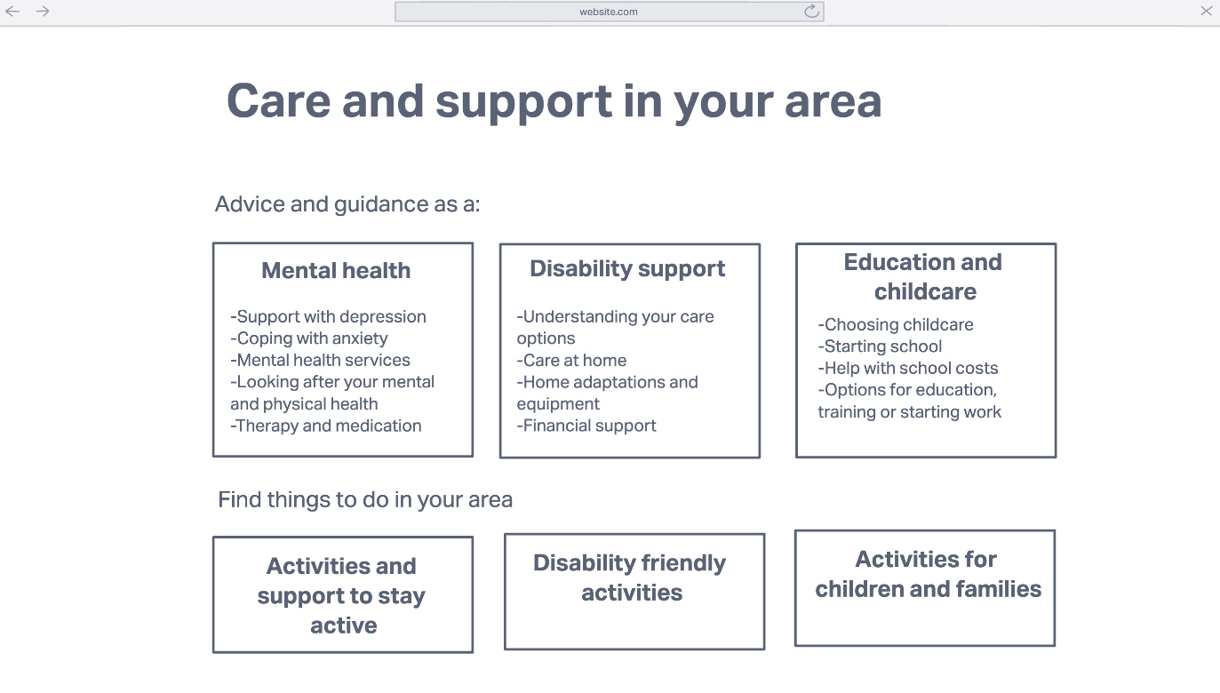
Categorising by user type or topic
A homepage that people navigate through based on the information they know.
Prototype 1: By user type​
Prototype 2: By topic
Notes:
We also created a scenario for the residents in the community to suggest an edit if they find the information is incorrect, and show the service providers the suggestion, to highlight the influences.
We also experimented the language to talk to service providers to make it more interactive and engaging.

Slide 26
Having seen some of our prototypes today, what springs to mind for you?
Join us at Slido.com
#7002 835

Slide 27
Next steps
Decide whether we want to do any more testing for how we might keep content up to date
Test some of our most recent prototypes with residents and referrers
Start experimenting with how we should categorise content on the GCD
Notes:
Beth & Alex

Slide 28
Thank you for coming. Any questions?

Slide 29
Thank you for coming!
Ways to stay in touch:
Read our weeknotes – these are sent to all Show & Tell attendees every Friday
Come to our future Show & Tell events
Send us an email or a message on Microsoft Teams:
Bethany.Mindham@royalgreenwich.gov.uk
Alex.Sturtivant@royalgreenwich.gov.uk

Slide 30
Showing some front-end ideas
Showing some sketches and pictures that show ways of directing a directory/navigating things
Show some prototypes we’ve done already and some that we aren’t as worked up
We’ve become aware that we need to make the content easier to navigate – this is what we’re focusing on, to do that we need to tie in with information people might already be looking at on similar topics, some of this already exists on the RBG website – how do we make that all work together?
Looking through the prototypes - do people have examples of how their service might fit into them? – What any of this be useful for a particular part of your service?
Does this work align with a project you are working on? If so, how? E.g. website re-design?
For people working the website re-design; how could we learn from each other more or progress this?
Doing this in S&T: Navigating Miro collectively on the call?
Notes:
Alysia to populate

Slide 31
Slido input after going through miro board
Looking through the prototypes - do people have examples of how their service might fit into them? – What any of this be useful for a particular part of your service?
Does this work align with a project you are working on? If so, how? E.g. website re-design?
For people working the website re-design; how could we learn from each other more or progress this?
Notes:
Beth to populate

